Slide 1
Chemistry
Review Game

Slide 2
Rules
Participants buzz in after the majority of the question is read to answer
  Each correct response results in 1 point

Slide 3
Rules Continued:
Incorrect answer: Same question goes to any other person remaining that did not buzz in before - awarded 1 point
  Next question will go to another set of lab table representatives
Outside talking amongst lab tables during a round results in deduction of point

Slide 4
Rules Continued:
  First response - only response (cannot change answer)

Slide 5
Question #1
What are the 3 particles that make up an atom?

Slide 6
Question #2
When an atom gains or loses an electron, what type of atom does it become?

Slide 7
Question #3
What is the atomic number of atom equal to?

Slide 8
Question #4
What type of elements are found in Group 18 of the Periodic Table? They do not react with anything, and its gases can be found in many lighting systems.

Slide 9
Question #5
C₃H₈
How many carbon atoms are in this compound?

Slide 10
Question #6
What is the chemical factor that will increase the rate of a chemical reaction once it has been added?

Slide 11
Question #7
You freeze a bucket of water into a solid block of ice. What type of change is this?

Slide 12
Question #8
How can a chemical reaction seem to gain or lose mass?

Slide 13
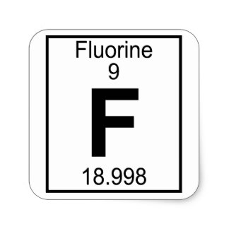
Question #9
What is this element’s atomic mass?

Slide 14
Question #10
Chemical compounds have ___________ properties from the elements that comprise them.

Slide 15
Question #11
What particle of the atom is responsible for forming compounds with other atoms?

Slide 16
Question #12
A number in a chemical formula, which is written to the right slightly below an atomic symbol, indicates how much of that element is present in the compound. What is this number called?

Slide 17
Question #13
What are the 3 physical factors in which to increase the rate of a chemical reaction?

Slide 18
Question #14
The chemical compound NH4, ammonium, contains what elements?

Slide 19
Question #15
You combine 2 elements, sodium (Na) and chlorine (Cl), to make sodium chloride (NaCl). What type of chemical reaction is this?
  2Na + Cl2 ---> 2NaCl

Slide 20
Question #16
Finish the following statement: Matter cannot be _________ nor __________.

Slide 21
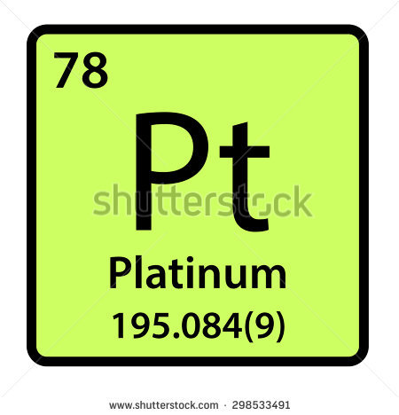
Question #17
What is this element’s atomic number?

Slide 22
Question #18
Where are metals located on the Periodic Table?

Slide 23
Question #19
Where are non-metals located on the Periodic Table?
  Extra point – what is the only non-metal located away from the other non-metals on the Periodic Table?

Slide 24
Question #20
How can you tell if a chemical reaction has produced a gas?

Slide 25
Question #21
If you have 1 complex reactant, and it breaks apart into 2 or more simple products, what type of chemical reaction is this?

Slide 26
Question #22
You mix 2 liquids and a white, solid product is formed. What is the evidence of a chemical reaction?

Slide 27
Question #23
What particles make up the nucleus of an atom?

Slide 28
Question #24
What is the electric charge of an electron?

Slide 29
Question #25
You have a solid reactant, and break it apart into smaller pieces before adding it to a second reactant to make the reaction go faster. What factor did you alter to the solid reactant to increase the rate of the reaction?

Slide 30
Question #26
What is the definition of a product of a chemical reaction?

Slide 31
Question #27
If a clear liquid does not react with metals, is this liquid an acid or a base?

Slide 32
Question #28
Acids taste _______, while bases taste __________.

Slide 33
Question #29
What is the definition of a reactant?

Slide 34
Question #30
What is the definition of a metalloid?

Slide 35
Question #31
If you ignite propane, what type of chemical reaction is this?

Slide 36
Question #32
What is the pH value for a neutral substance?

Slide 37
Question #33
You mix HCl with baking soda and it begins to bubble. What is the chemical reaction producing?
  extra point = what type of compound is produced

Slide 38
Question #34
What is the pH value range for an acid?

Slide 39
Question #35
How will the mass of the reactants compare to the mass of the products in a chemical reaction?

Slide 40
Question #36
What is the name of the group of metals located between Groups 3-12 on the Periodic Table and are used in the production of jewelry, currency, etc.?

Slide 41
Question #37
In the lab in which you added chalk and hydrochloric acid (HCl), you decided to add more HCl to the reaction to make it go quicker. What factor did you alter to the HCl to increase the rate of the chemical reaction?

Slide 42
Question #38
You burn a pile of wood while camping. What type of change is this?

Slide 43
Question #39
The speed at which molecules in a chemical move refers to its what?

Slide 44
Question #40
What type of product would you typically find in a base chemical?
  Food products
  Naturally occurring in cells
  Cleaning products
  None of the above

Slide 45
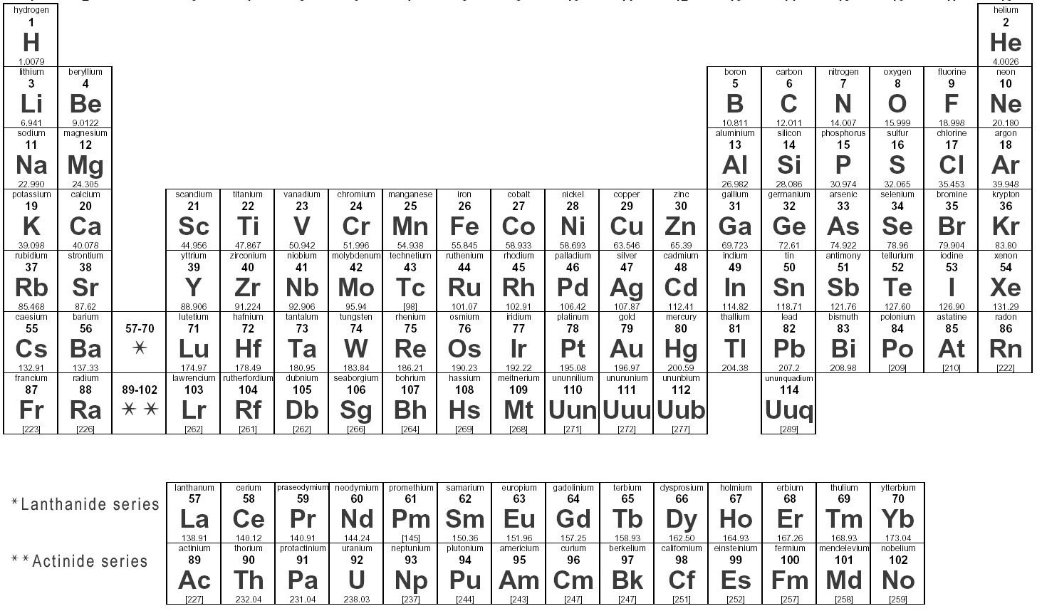
Bonus Question
Is Bromine (Br) going to share more properties with Chlorine (Cl) or Selenium (Se)?

