Slide 1
Chapter 6
The Chemistry of Life

Slide 2
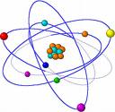
6.1 Atoms and their interactions
Element- a substance that cannot be broken down into simpler chemical substances
Atom- smallest particle of an element that exhibits the characteristics of the element

Slide 3
Natural elements in living things
25 Elements essential to life
4 compose 96% of the human body
  CHON
Trace elements present in small amounts
  Selenium example

Slide 4
Atoms:
Building blocks of Elements
Protons- (+ charge) Located in the nucleus.
Neutrons- (no charge)
Electrons- (- charge) Cloud- space around nucleus
Atomic Number = # of protons
Can the number of protons change?

Slide 5
Electron Diagrams
Electron Energy Levels
1st- 2 electrons
2nd- 8 electrons
3rd- 8 or 18 electrons
Drawing electron diagrams
Symbol and # of protons (circle)
Draw 1st energy level : Supply electrons
Keep adding levels until all electrons are used
Worksheet

Slide 6
Atoms
Atomic Mass = # of protons + # of neutrons
Can the atomic mass change?
Isotopes- atoms containing different #s of neutrons
Carbon-
atomic mass- _______ (periodic table)
Why is the number not a whole number?

Slide 7
Oxygen
Hydrogen
Sodium

Slide 8
__ Protons + __ Neutrons = ___ Atomic Mass Frequency=____
__ Protons + __ Neutrons = ___ Atomic Mass Frequency=____
__ Protons + __ Neutrons = ___ Atomic Mass Frequency=____
__ Protons + __ Neutrons = ___ Atomic Mass Frequency=____
__ Protons + __ Neutrons = ___ Atomic Mass Frequency=____
__ Protons + __ Neutrons = ___ Atomic Mass Frequency=____

Slide 9
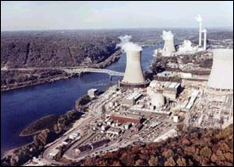
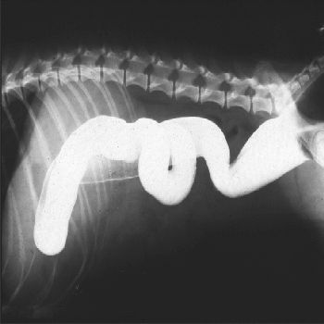
Isotope uses:
Nuclear Power (Uranium)
Show up on X-ray (Barium)
  Upper GI
  Lower GI

Slide 10
Compounds and Bonding
Compound- substance composed of atoms of different elements chemically combined
  H2O
  CO2
  NaCl
  O3 ?
  O2 ?
Bonding- atoms held together because they take or share electrons to become stable

Slide 11
Drawing Compounds
Draw the element with the least atoms in the middle. Ex: H2O-
Put the electrons around each atom.
Determine the type of bond that exists by how the elements become stable.

Slide 13
Types of Bonding
Covalent Bond- force holding together atoms sharing electrons
Ionic Bond- force holding together atoms give/take electrons

Slide 14
Elements
O Na C Cl
H Mg N Fe
Ca I P Cu
K Zn S F

Slide 15
Ionic Bonds
Metal bonds to a non-metal
  (+) (-)
Metal gives extra electrons to the non-metal
Ex: NaCl, LiF, BeO, LiO ?

Slide 16
Covalent Bonds
Non-metals share electrons (H is a non-metal)
H2O, O2, H2, CO2

Slide 17
Practice Problems
Worksheet
How do I know if it is ionic or covalent?

Slide 18
Lithium and Fluorine
Silicon Dioxide (SiO₂₎

Slide 20
Ionic vs. Covalent
Metal and Non-metal
Results in ions
Weak bond
(breaks in H2O)
Oxidation #s = 0
Ex:
Na + Cl → NaCl
+1 -1
Two Non-metals
Results in molecules
Strong bond
Organic compounds
(Fat, Protein, Carb.)
Ex: O2, H2O, CO2

Slide 21
Chemical Reactions
Metabolism -all chemical reactions occurring within an organism.
Writing Chemical Reactions:
CH4 + O2 → CO2 + H2O
Reactants- substances that undergo a reaction
Products- substances formed by a reaction

Slide 22
Chemical Reactions
H2O How many hydrogen? Oxygen?
The number after the element is the number of atoms per compound.
2H2O
The number before the compound is the number of compounds.

Slide 23
Balancing Equations
Atoms cannot be created or destroyed, just rearranged.
  Reactants = Products
  Balance equations by adding molecules of products and reactants
  ___Mg + ___ HCl → ___ MgCl2 + ___ H2

Slide 24
Balancing Equations
Practice:
CH4 + O2 → CO2 + H2O
Worksheet

Slide 25
Balancing Quiz
Na + I₂ → NaI
N₂ + O₂ → N₂O
N₂ + H₂ → NH₃
CH₄ + O₂ → CO₂ + H₂O
KI + Cl₂ → KCl + I₂

Slide 26
S + O₂ → SO₃
H₂O₂ → H₂O + O₂
Na + H₂O → NaOH + H₂
H₂O → H₂ + O₂
KClO₃ → KCl + O₂

Slide 27
Mg + O₂ → MgO
N₂ + H₂ → NH₃
Al + O₂ → Al₂O₃
KMnO₄ → K₂O + MnO + O₂

Slide 28
Quiz
CO₂ (Carbon: 6, Oxygen: 8)
H₂O (Hydrogen: 1, Oxygen: 8)
Mg and Cl (Magnesium: #12, Chlorine: #17)

Slide 29
Quiz
Mg + Mn₂O₃→ MgO + Mn
Fe + Cl₂ → FeCl₃
C₂H₂ + O₂ → CO₂ + H₂O
Bonus:
A₃ + B₂C → A₂B₃ + C₂

Slide 30
Mixtures and Solutions
Mixture- combination of substances in which each component retains its own properties
  Trail mix, gravel, sugar and sand
Solution- mixture in which one substance (solute) is distributed evenly in another substance (solvent)
  Ex: Kool-aid, sugar water, iced tea

Slide 31
Mixtures and Solutions
Living things require a specific range of solute concentration.
  Blood sugar
  Water salinity
  Waste removal (toxins)

Slide 32
pH: Acids and Bases
pH: scale to determine if a solution is acidic or basic
Range: 0 (acidic) → 14 (basic)
7 is neutral

Slide 33
pH Scale
Acid- any substance forming hydrogen ions (H+) in H2O
- HCl → H⁺ + Cl⁻ (many H⁺ ions)
- pH below 7
Ex: most foods, pop, orange juice

Slide 34
pH Scale
Base- any substance forming hydroxide ions (OH⁻) in water
- NaOH → Na⁺ + OH⁻
- pH above 7
Ex: cleaners, detergent, ammonia, lime

Slide 35
pH Scale
Neutral Solution- substance forming equal amounts of hydrogen ions (H⁺) and hydroxide ions (OH⁻)
- pH of 7
Ex: water, milk, blood, bread

Slide 36
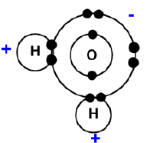
Water Importance
70-95% of organisms (sap, blood)
Polar- shared electrons are pulled more
strongly by oxygen causing a +end and -end
      Dissolves ionic and polar compounds
      Water molecules attract to each other
      (Hydrogen bond)- weak bond between O and H

Slide 37
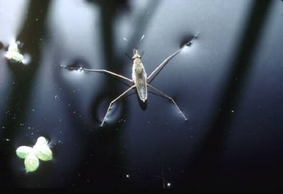
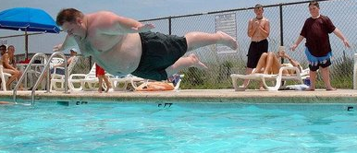
Water
High Surface Tension
- attraction of water molecules due to
H-bonding
-insects walk on it

Slide 38
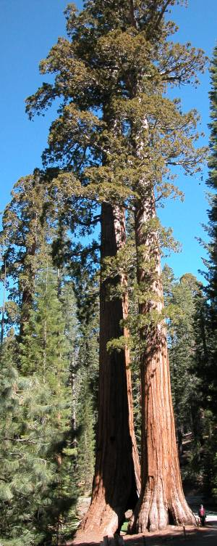
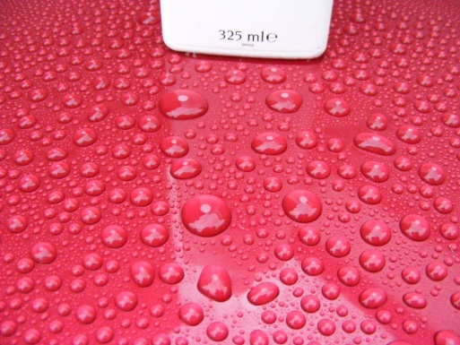

Water
Capillary Action – ability to climb a tube (trees)
cohesion- attraction to self
adhesion- attraction to another

Slide 39
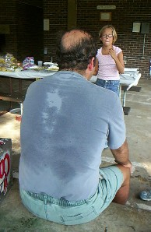

Water
Heat of Vaporization
- much energy is required to evaporate water
- keeps more water in liquid form
- sweat- removes heat when evaporated
Resists Temperature Change
- High specific heat → wind at the beach
- coastal temperatures are more constant

Slide 40
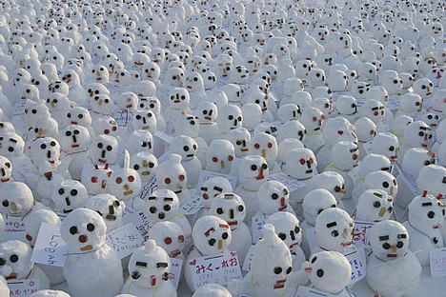
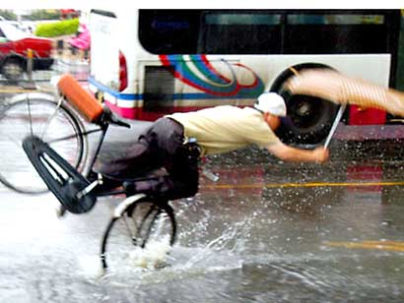
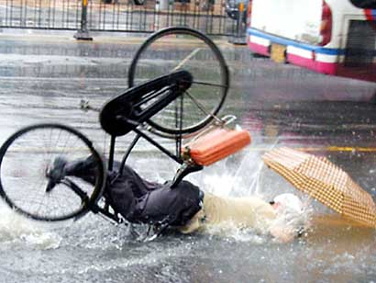
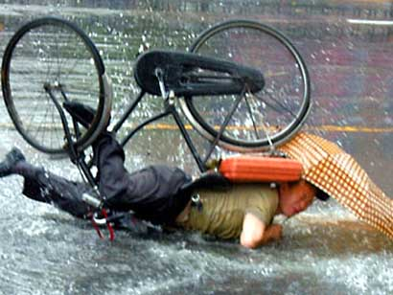


Water
Expands when Frozen
- less dense → floats
- Cracks rocks or roads (PA is one of the worst)
Ice melts when pressure is applied
- Two types of snow?
Packing / Non-Packing
- Ice Skating- weight of skater melts ice

