Slide 1
Biology Chapter 2- The Chemistry of Life
Essential Question: What are the basic chemical principles that affect living things?

Slide 2
2.1 The Nature of Matter
What 3 subatomic particles make up atoms?
Atom- the basic unit of matter
If you were to lay 100 million atoms side by side they would be about 1cm long. Despite how small atoms are, they are composed of even smaller particles
The subatomic particles that make up atoms are protons, neutrons, and electrons

Slide 3
Protons and neutrons are both located in the nucleus and have about the same mass. They are held together by strong charges
Protons have a positive charge (+)
Neutrons have no charge
Electrons (e⁻) have a negative (-) charge, and 1/1840 the mass of a proton. Electrons are constantly moving and are located in the area surrounding the nucleus
The (-) charges of the electrons are attracted to the (+) charge of protons, to balance the atom

Slide 4
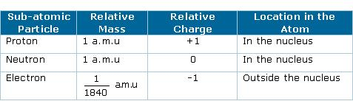

Slide 5
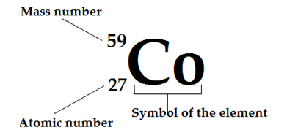
How are all of the isotopes
of an element similar?
Element-a pure substance that consists entirely of one type of atom
Elements are represented by 1 or 2 letter symbols (Ex: C, H, O, He, Li)
Atomic number- the number of protons in the nucleus of an element.
Isotope-atoms of the same element that differ in the number of neutrons they contain.
Mass Number=total # of protons + total # of neutrons
-mass number identify isotopes

Slide 6
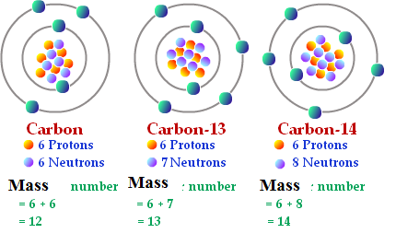
Because they have the same number of e⁻, all isotopes of an element have the same chemical properties
Radioactive isotopes- can be used to determine the age of rocks/fossils, detect and treat cancer, kill bacteria.

Slide 7
In what ways do compounds differ from their component elements?
Compound- substance formed by the chemical combination of 2 or more elements
Examples: H₂O, NaCl, OH, NO₃, PO₄
The physical and chemical properties of a compound are usually very different from those of the elements from which it is formed.
2 stable substances can combine to form a highly reactive substance and vice versa

Slide 8
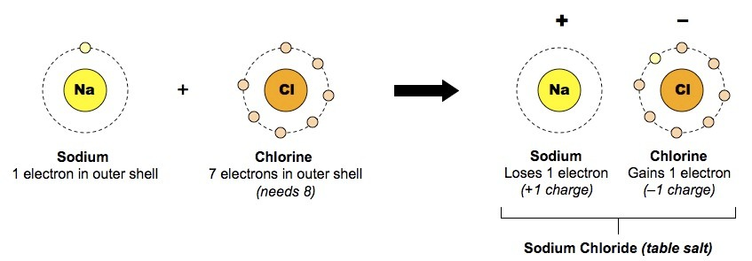
What are the main types of chemical bonds?
Ionic bonds, covalent bonds, and Van Der Waals forces
Ionic bonds- formed when 1 or more e⁻
are transferred from one atom to another.
-An atom that loses e⁻ becomes positively charged, and atom that gain e⁻ becomes negatively charged. Charged atoms=ions

Slide 9
Covalent bonds- when electrons are shared
When atoms share 2 e⁻ that is called a single covalent bond. When atoms share 4 e⁻ that is called a double covalent bond.
Molecule- the structure that results from atoms joined by covalent bonds.
Molecules are the smallest units of most compounds
Van der Waals forces- slight attraction that develops between oppositely charged regions of nearby molecules

Slide 10
2.2 Properties of Water
How does the structure of water contribute to its unique properties?
It is polar- the charges are unevenly distributed (like a magnet w/ 2 poles)
Hydrogen bonding- the polar molecules attract each other w/ their partial + and partial – charges.
B/c water is a polar molecule, it is able to form multiple hydrogen bonds, which account for many of water’s special properties.

Slide 11
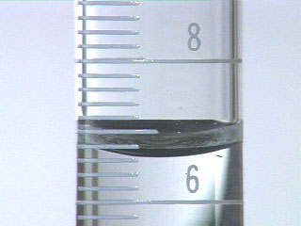
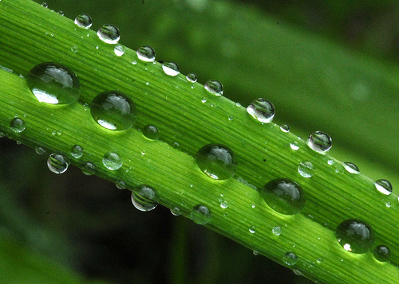
Cohesion- the attraction between molecules of the same substance.
Adhesion- an attraction between molecules of different substances.
Water has a high heat capacity- the amount of heat energy required to increase temperature

Slide 12
How does water’s polarity influence its properties as a solvent?
Mixture- a material composed of 2 or more elements or compounds that are physically mixed together but NOT chemically combined.
Types of mixtures:
1. Solution= all components are evenly distributed
-solute= substance that is dissolved
-solvent= substances in which solute dissolves
Water’s polarity gives it the ability to dissolve both ionic compounds and other polar molecules

Slide 13
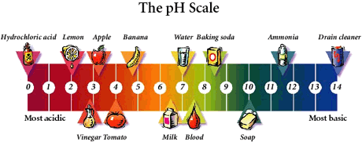
2. Suspension- mixture with non-dissolved material
Why is it important for cells to buffer solutions against rapid changes in pH?
pH scale-measures the concentration of H⁺ ions in a solution. Ranges from 0-14. 7=neutral. 14=most basic, 0= most acidic

Slide 14
Acid- any compound that forms H⁺ ions in a solution
Base- any compound that produces OH⁻ ions in a solution
Buffer- weak acids or bases that can react with strong acids or bases to prevent sharp, sudden changes in pH
-Buffers dissolved in life’s fluids play an important role in maintaining homeostasis
Litmus paper turns acids red and bases blue

Slide 15
2.3 Carbon Compounds
What elements does carbon bond with to make up life’s molecules?
Carbon can bond w/ many elements, including hydrogen, oxygen, phosphorus, sulfur, carbon, and nitrogen to form molecules of life.
Carbon has the ability to form millions of different large and complex structures.

Slide 16
What are the functions of each of the 4 groups of macromolecules?
Monomer-small chemical unit that makes up a polymer
Polymer- molecules composed of many monomers, makes up macromolecules
Macromolecules are grouped based on their chemical composition, and functions.

Slide 17
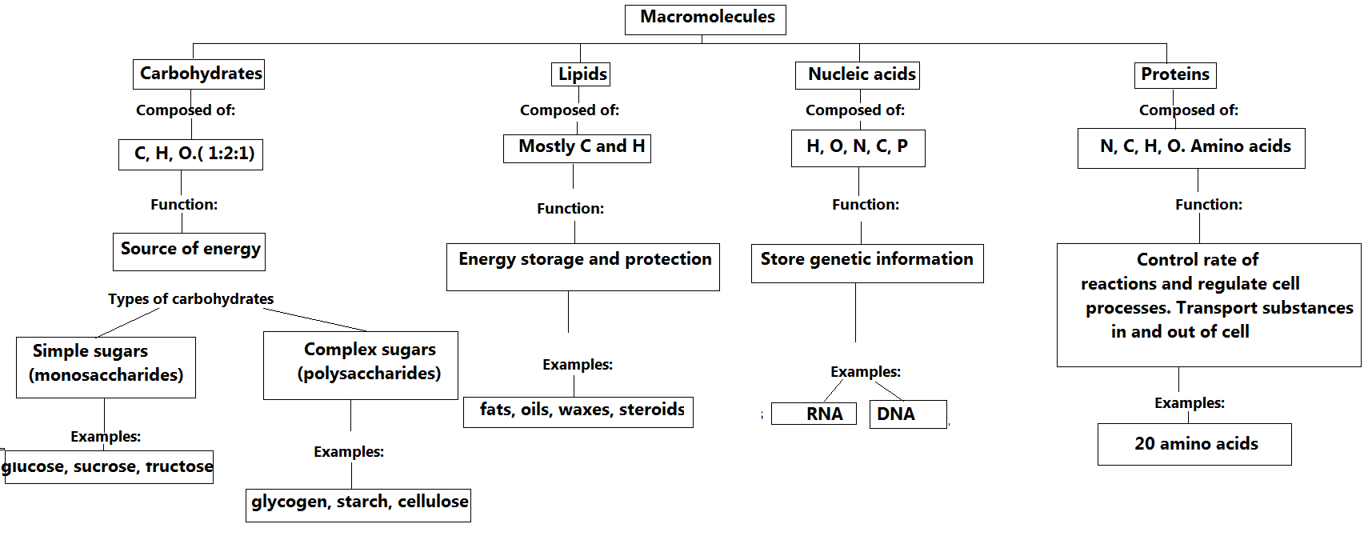

Slide 18
Living things use carbohydrates as their main source of energy. Plants, some animals, and other organisms also use carbohydrates for structural purposes.
Lipids can be used to store energy. Some lipids are important parts of biological membranes and waterproof coverings.
saturated: fatty acid chains are joined together by single bonds
Unsaturated: Has at least 1 C:C double bond

Slide 19
Nucleic acids store and transmit hereditary, or genetic information
Some proteins control the rate of reactions and regulate cell processes. Others form important cellular structures, while still others transport substances into or out of cells or help to fight disease.
-The reason amino acids differ from each other= “R group”, which have a vast range of properties

Slide 20
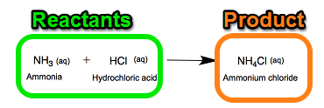
2.4 Chemical
Reactions and Enzymes
What happens to chemical bonds during chemical reactions?
Chemical reaction- a process that changes/transforms one set of chemicals into another
Reactant- The elements/compounds that enter the reaction
Product- The elements/ compounds that are produced by the reaction
Chemical reactions involve changes in the chemical bonds that join atoms in compounds

Slide 21
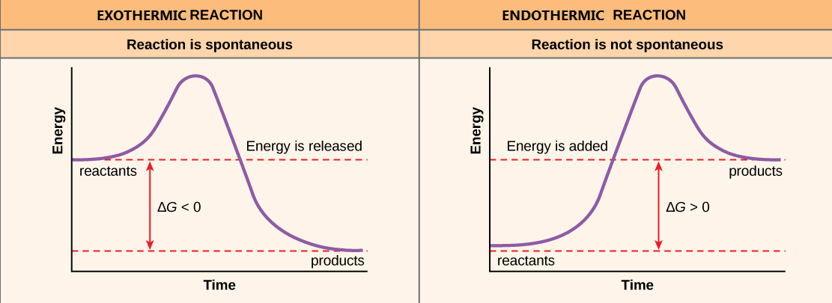
How do energy changes
affect whether a chemical reaction will occur?
Chemical reactions that release energy often occur on their own, or spontaneously. Chemical reactions that absorb energy will not occur w/out a source of energy

Slide 22
Activation energy (E_{A})- the energy needed to start a reaction.
What role do enzymes play in living things and what affects their function?
Catalyst- a substance that speeds up the reaction
Enzymes-proteins that act as biological catalysts
Enzymes lower the E_{A} needed to start a reaction

Slide 23
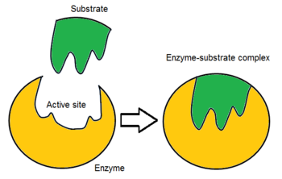
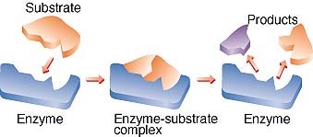
Enzyme-substrate complex
Active site: where reactants are brought together to react
Substrate: the reactants of enzyme-catalyzed reactions
Like a “lock and key” they must fit perfectly together
Temperature, pH, and regulatory molecules can affect the activity of enzymes

