Slide 1
Chapter 2- Chemistry
What are we made of?
  What three subatomic particles make up atoms?
Protons-
Neutrons-
Electrons-

Slide 2
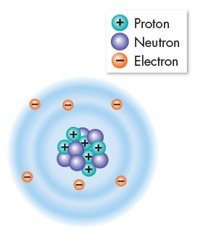
Atoms are incredibly small. 100 million atoms = 1 centimeter —about the width of your little finger!

Slide 3
Nucleus- In and out
INSIDE = protons and neutrons
OUTSIDE = electrons
Constant motion
Attracted to nucleus…why?
Protons = Electrons (Neutral charge)

Slide 4
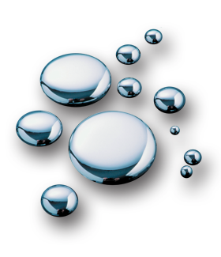
Elements
Pure substances consisting entirely of 1 type of atom
Elements are represented by one- or two-letter symbols. For example, C stands for ________, H for _______, Na for _________, and Hg for __________ (shown).

Slide 5
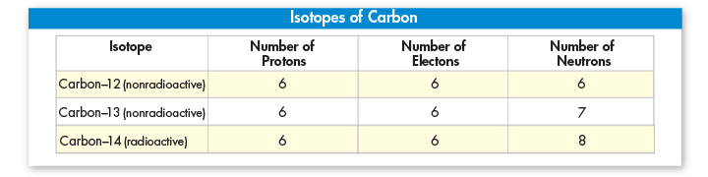
Elements and Isotopes
Atoms are named based on atomic number
Atomic # = # of ________________
Atoms of the same element that differ in the number of neutrons they contain are known as isotopes.

Slide 6
Atomic mass (mass number)
Protons + neutrons = mass number.
Isotopes are identified by mass numbers; carbon-12, carbon-13, and carbon-14.
Some isotopes are radioactive, meaning their nuclei are unstable and break down
  Date rocks and fossils
  Detect and treat cancer
  Kill bacteria that spoil food

Slide 7
Chemical compounds
In what ways do compounds differ from their component elements?
Compound- a substance formed by the chemical combination of two or more elements in definite proportions.
a. Formulas
1.) Water
2.) Table Salt
a.) Sodium
b.) Chlorine (gas)

Slide 8
Chemical bonds
Ionic
  One or more electrons are transferred from one atom to another.
  An atom that loses electrons becomes positively charged. An atom that gains electrons has a negative charge. These positively and negatively charged atoms are known as ions.
Covalent
  Sometimes electrons are shared by atoms instead of being transferred.
  The structure that results when atoms are joined together by covalent bonds is called a molecule, the smallest unit of most compounds.
Bond formation involves the electrons that surround each atomic nucleus.
The electrons that are available to form bonds are called valence electrons.

Slide 9
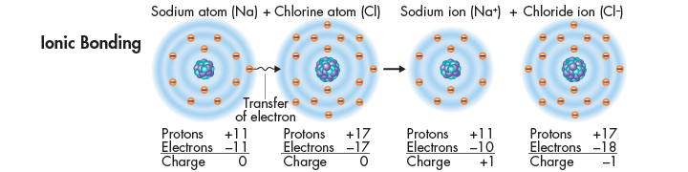
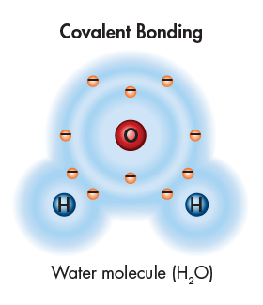
Chemical bonds

