Slide 1
Anatomy and Physiology
Basic Chemistry Review

Slide 2
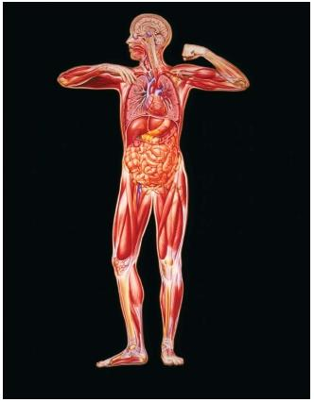
Matter and Energy
When learning about the human body understanding matter and energy is crucial to the understanding of the human body.
Matter is anything that takes up space and has mass.
Energy is defined as the capacity to do work, or to put matter into motion

Slide 3
Forms of Energy
Chemical Energy is the form stored in the bonds of chemical substances. (example: adenosine triphosphate; ATP)
Electrical Energy reflects the movement of charged particles. In the body, electrical currents are generated as charged particles called ions move across cell membranes.
Mechanical Energy is energy directly involved in moving matter.
Radiant Energy is energy that travels in waves.

Slide 4
Atomic Level of organization
Common Elements Composing the Human Body
Major (96.1%)
Oxygen
Carbon
Hydrogen
Nitrogen
Lesser (3.9%)
Calcium
Phosphorus
Sulfur
Chlorine
Magnesium
Iodine
Iron
Trace (Less than 0.01%)
Chromium
Cobalt
Cupper
Fluorine
Manganese
Molydenum
Selenium
Silicon
Tin
Vanadium
Zinc

Slide 5
Biochemistry
Organic Compounds contain carbon.
All organic compounds are covalently bonded molecules, and many are large.
Examples: carbohydrates, proteins, lipids, nucleic acids
Inorganic Compounds are all other chemicals in the body.
Example: water, salts, acids and bases

Slide 6
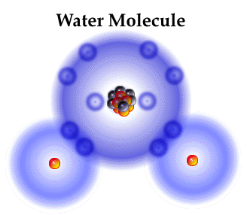
Water
1. High heat capacity
It absorbs and releases large amounts of heat before changing appreciably in temperature itself.
2. high heat of vaporization
requires a large amount of heat must be absorbed to break the hydrogen bonds that hold water molecules together.
3. polar solvent properties
Universal solvent; transporting;
4. Reactivity
Hydrolysis reactions and dehydration synthesis reactions
5. Cushioning
Resilient cushion around certain body organs; protection

Slide 7
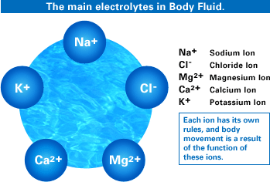
Electrolytes are ions that conduct an electrical current in solution
Salts
Acids and Bases

Slide 8
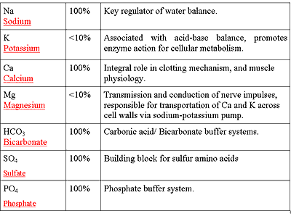

Slide 9
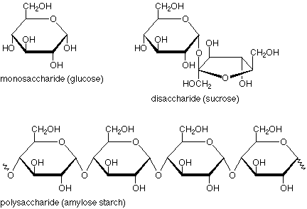
Organic Compounds contain carbon
Carbohydrate
Elements = C, H, & O
Building Block = Monosaccharide
Function = major fuel for forming ATP
Excess stored as glycogen

Slide 10
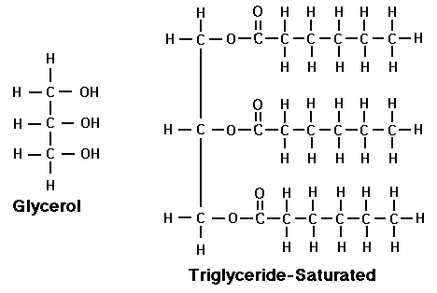
Lipid
Dissolve in fats and organic solvents, but not in water
Elements = C, H, & O
Building blocks = fatty acids & glycerol
Phospholipids are modified lipids that have polar and nonpolar portions and found in plasma membranes
The steroid cholesterol is found in cell membranes and is the basis of steroid hormones, bile salts, and vitamin D

Slide 11
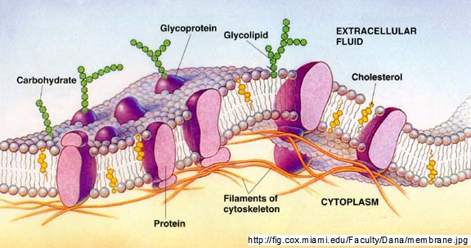

Slide 12
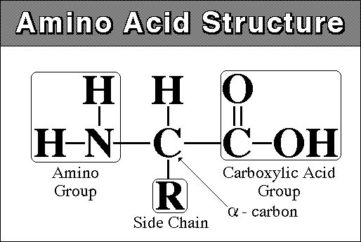
Proteins
Element = C, H, O, & N
Building Block = amino acid, 20 common amino acids are found in the body
The sequence of amino acids determines what type of protein is formed. Each amino acid is joined by a peptide bond.

Slide 13
Nucleic Acids (DNA & RNA)
Elements = C, H, O, and N
Building Block = nucleotide -→ nitrogen base (adenine, guanine, cytosine, thymine, or uracil); a sugar group (deoxyribose or ribose); and a phosphate group
DNA is a double-stranded helix; contains nucleotide that contains deoxyribose, A,G,C, & T. DNA specifies protein structure and replicates itself exactly before cell division.
RNA is single-stranded; contains nucleotides that contain ribose, A,G,C, & U. RNA is involved in carrying out DNA’s instructions for protein sysnthesis.

Slide 14
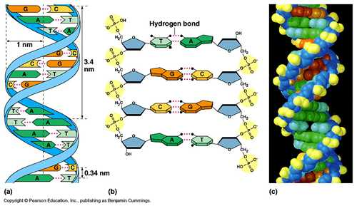

Slide 15
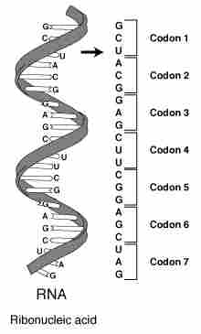

Slide 16
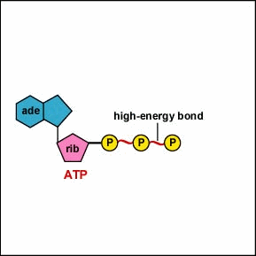
Adenosine Triphosphate (ATP)
ATP is the universal energy compound of body cells.

