Slide 1
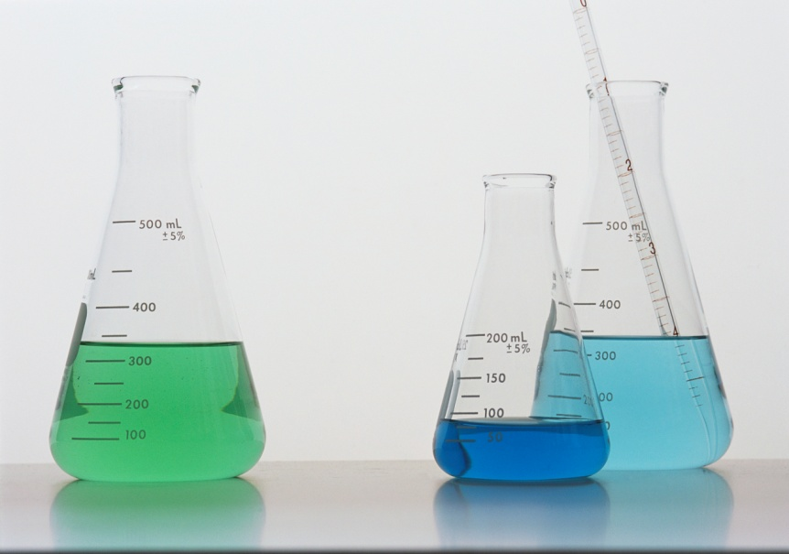
Acids and Bases in Chemistry
Scientists use “indicators” to test if an unknown substance is an acid, base or neutral substance.

Slide 2
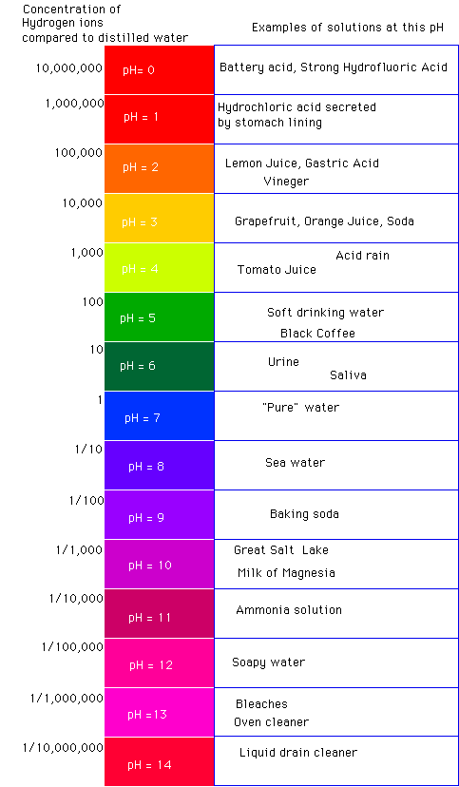
The pH scale is used as an indicator. The pH scale measures the substance on a value of 1-14. Any substance that measures a 1-6 is an ACID, 7 is neutral and 8-14 indicates the substance is a BASE. pH paper is used to show these color changes that indicate the correct identification of the substance.

Slide 3
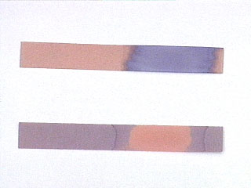
Other INDICATORS
Red and Blue litmus paper: use forceps to hold strips into liquid-SAFETY first!
Red litmus paper STAYS red in an acid and turns BLUE in a base. Blue litmus paper STAYS blue in a base and turns RED in an acid. What about neutrals?

Slide 4
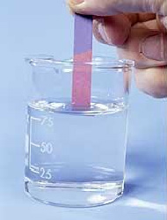
*Remember: You only need to gently dip the end of the litmus into the liquid. Be sure you don’t drop the paper into the liquid.
*Lay the strip onto a paper towel to dry. Look at the color of the strip where the liquid stops rising.

Slide 5
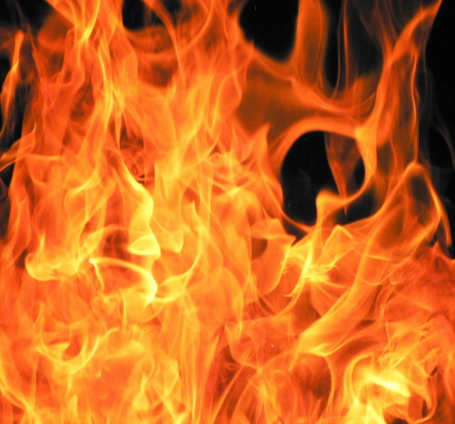
Phenolphthalein Solution Indicator: Phenol. Soln.
*Highly flammable/combustible material-be sure to keep lid on container when not using. Can ignite in air. Use only small amounts with eyedroppers.
Phenol. indicator is a clear liquid with a strong, cooling odor. When a drop is placed in an acid, the acid does not change color. When a drop is placed in a base, the liquid turns bright PURPLE.

Slide 6

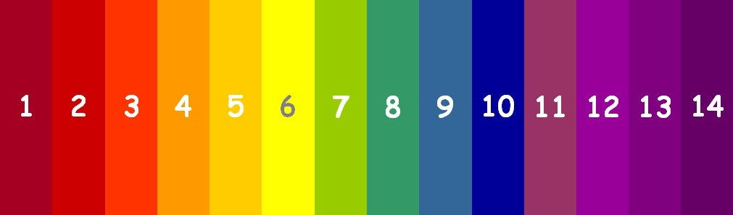
A few drops of this indicator will turn acids light red or orange, neutrals will be either greenish-yellow or yellow and bases will be blue to indigo.
Universal indicator-this is a red, flammable liquid. Be careful not getting it on your skin or clothes, it also stains!

Slide 7
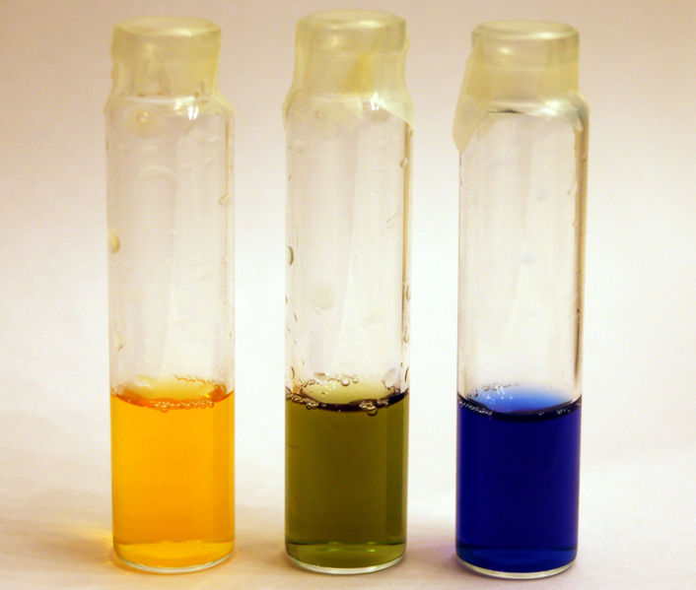
Bromothymol Blue: Bromo. Blue Soln.
This indicator is dark green in color. If you put 3 or 4 drops in an acid, it will turn yellow. Putting 3 or 4 drops in a base will turn it blue. Neutral substances remain light green in color.

Slide 8
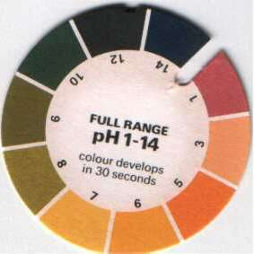
pH paper or UNIVERSAL paper
Generally the color of this paper is orange or light tan. If you place it in an acid, the paper will turn red or dark orange. If it is placed in a neutral substance, the pH paper will generally stay orange or tan and in bases, the paper will generally turn dark green to brown…this is a poor indicator to identify an exact pH value!

