Slide 1
Chemistry Test 2012-2013
Review Slides

Slide 2
Studying Ideas
Do “Ions: The Final Countdown”
Go through the checklist on the Study Guide. Revisit the notes for the boxes you do not check. Make flashcards for vocab words.
Go through the questions on this slideshow
Do more of the “yellow envelope” activities

Slide 3




These are the mugshots of some suspicious elements. Based on these images, you can tell which Period #1-4 are from. Record your thoughts:
1. | 2.
3. | 4.
1
3
4
2

Slide 4
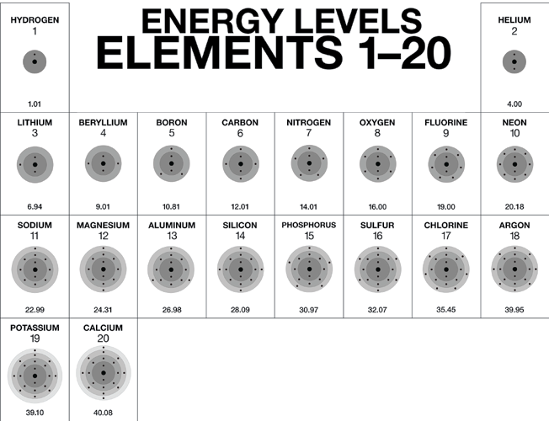
5. The missing element has
______energy levels
______electrons in the outer shell
______protons
3
4
14

Slide 5
6. The missing element has
______energy levels
______electrons in the outer shell
______protons
2
2
4

Slide 6
7. The missing element has
______energy levels
______electrons in the outer shell
______protons
1
1
1

Slide 7
8. The missing element
Is in the ______period
Has an atomic number of ________.
Has _________ TOTAL electrons.
4
20
20

Slide 8
9. The missing element
Has an atomic number of ________.
Has the same number of electrons in its OUTER energy level as __________.
Has _________energy levels.
7
P
2

Slide 9
10. The missing element
Has an atomic number of ________.
Has the same number of electrons in its OUTER energy level as __________.
Has _________energy levels.
17
F
3

Slide 10
1. The missing element
Is in the ______period
Has an atomic number of ________.
Has _________ TOTAL electrons.
3
14
14

Slide 11
2. The missing element
Has an atomic number of ________.
Has the same number of electrons in its OUTER energy level as __________.
Has _________energy levels.
19
Group 1
4

Slide 12
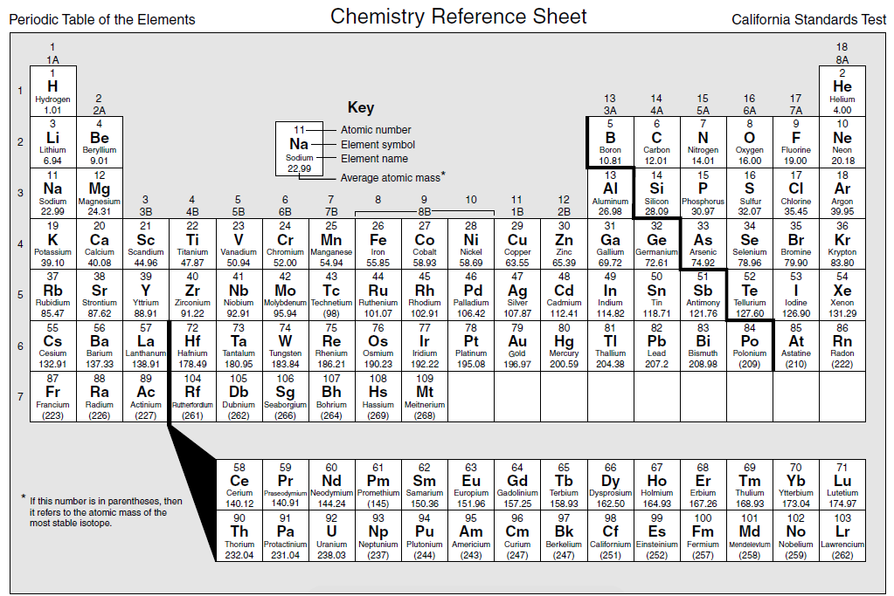
Can you still describe the missing element?
2
2
4
3. The missing element has
______energy levels
______electrons in the outer shell
______protons

Slide 13
Can you still describe the missing element?
3
13
13
4. The missing element
Is in the ______period
Has an atomic number of ________.
Has _________ TOTAL electrons.

Slide 14
Can you still describe the missing element?
11
Group 1
3
5. The missing element
Has an atomic number of ________.
Has the same number of electrons in its OUTER energy level as __________.
Has _________energy levels.

Slide 15
This is the periodic table you can use on our test!

Slide 16
6. The missing element has
______energy levels
______electrons in the outer shell
______protons
2
4
6

Slide 17
7. The missing element
Is in the ______period
Has an atomic number of ________.
Has _________ TOTAL electrons.
3
18
18

Slide 18
20
Group 2
4
8. The missing element
Has an atomic number of ________.
Has the same number of electrons in its OUTER energy level as __________.
Has _________energy levels.

Slide 19
1) The missing element
Is in the ______period
___________valence electrons
Has _________ TOTAL electrons.
4
2
38

Slide 20
2) The missing element has
______energy levels
______valence electrons
______group number
5
3
3

Slide 21
8
Group 8
Period 6
3) The missing element
______________valence electrons
Has the same number of valence electrons as _____________________________
Has the same number of energy levels as _____.

Slide 22




These are the mugshots of some suspicious elements. Tell me the PERIOD and GROUP of the element.
4. | 5.
6. | 7.
Period 3 Group 3
Period 2 Group 8
Period 1 Group 8 (Helium has a full valence shell)
Period 4
Group 1

Slide 23
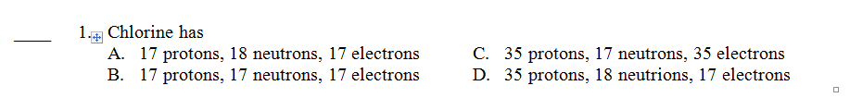
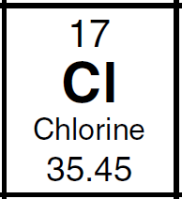

Slide 24

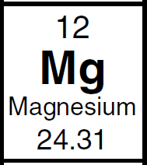

Slide 25
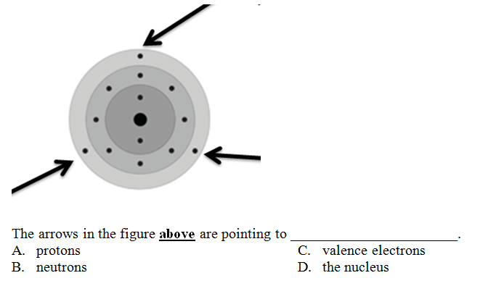

Slide 26


Slide 27
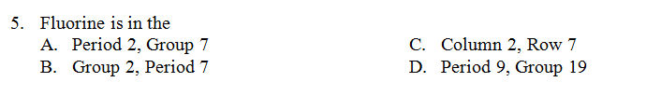

Slide 28
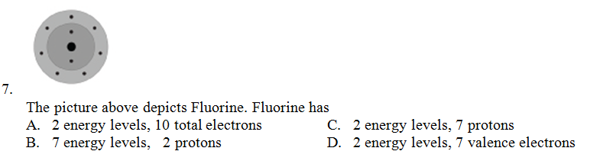

Slide 29
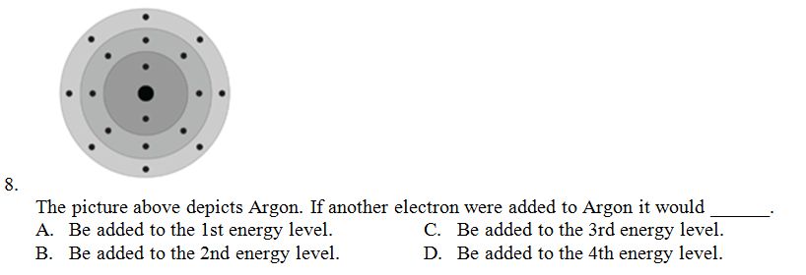
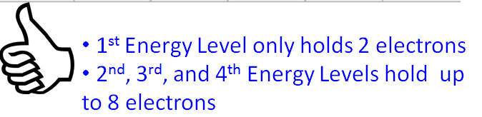

Slide 30
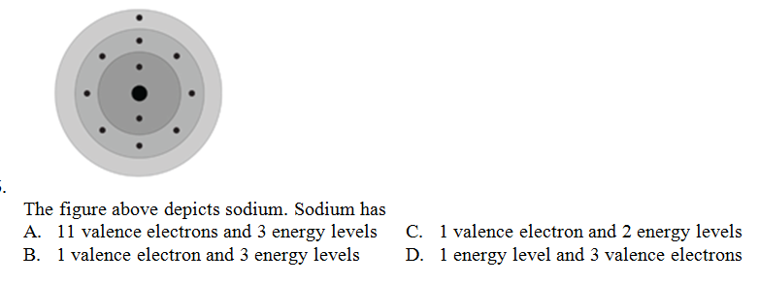

Slide 31
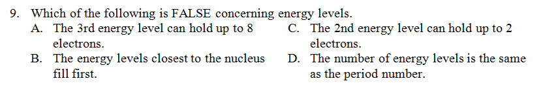

Slide 32
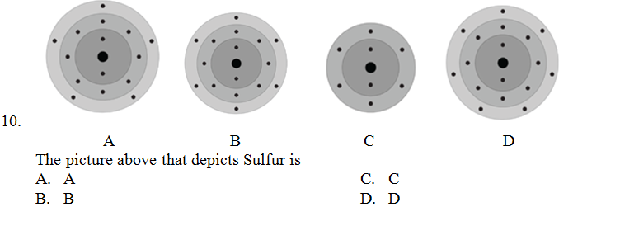
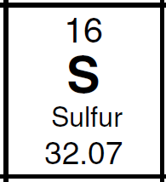

Slide 33
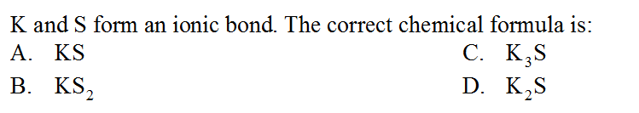
1

Slide 34
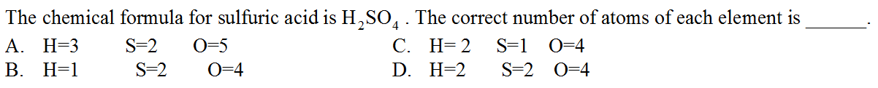
2

Slide 35
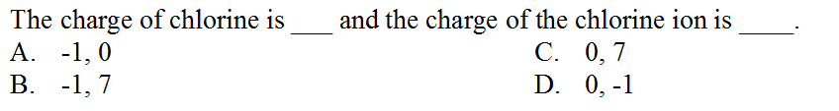
3

Slide 36
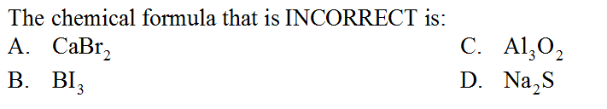
4

Slide 37
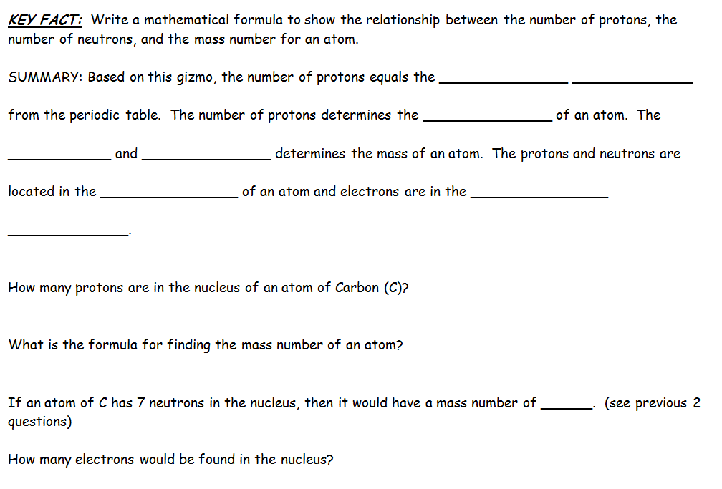
Atomic number
identity
protons
neutrons
nucleus
Electron cloud
6
Protons + neutrons = mass number
13
0 – electrons are not found in the nucleus
6 would be found in the electron cloud
6 negative electrons balance out 6 positive protons

Slide 38

What period is this element in?
What element is it?
Period 3
Sulfur

Slide 39

What period is this element in?
What element is it?
Period 3
Sodium

Slide 40

What period is this element in?
What element is it?
Period 2
Lithium

Slide 41
Element Math Practice
http://education.jlab.org/elementmath/question.php?71751208

