Slide 1

Chapter 2
Chemistry of Life
2.3 Water, Acids, and Bases
Learning Objectives for section 2.3:
Describe the distribution of Earth’s water
Identify water’s structure and properties
Define acids, bases, and pH.
Explain why water is essential for life.

Slide 2
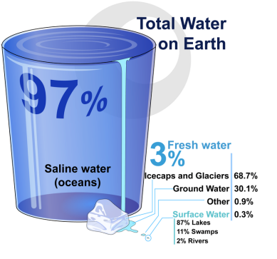
Water, Acids, and Bases
Water is a common chemical substance on Earth.
Almost 75% of the planet is covered in water.
- 97% of that water is salt water ocean
- 3% is freshwater
- 68% of all freshwater is locked in ice caps and
glaciers (although that is changing)
- 30% is ground water
- 2% is surface water
- 87% of the surface water is found in lakes
- 11% is located in swamps
- 2% is found in our rivers

Slide 3
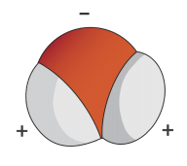
Chemical Structure of Water
Water is made up of one atom of oxygen and two atoms of hydrogen.
The oxygen atom in a water molecule attracts electrons more strongly than the hydrogen atoms.
Oxygen
Hydrogen
Hydrogen
The result is that the oxygen side of the molecule is slightly negative while the hydrogen side is more positive.
The difference in electrical charges on different sides of a molecule is called polarity. Water is a polar molecule.

Slide 4
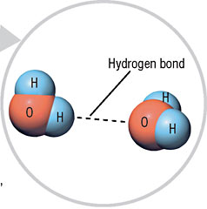

Slide 5
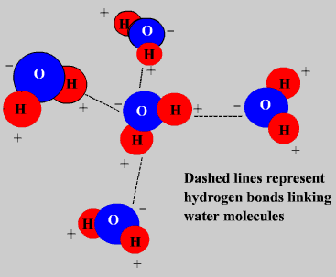
Hydrogen bonding explains much about the various properties of water.

Slide 7
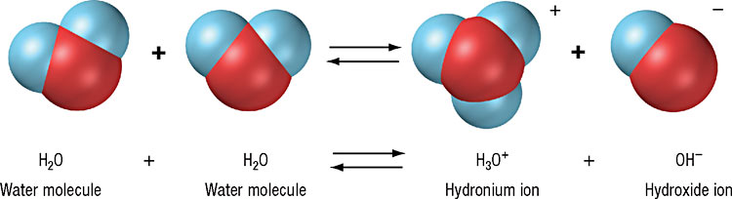
Acid, Base and pH

Slide 8
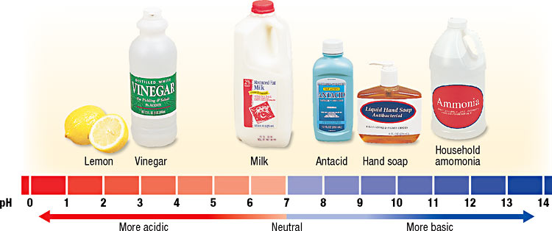
The scale is logarithmic. Each value, from 0 – 14, has 10 times greater ion concentration than the value below it.
pH 5 is 10 times more acid than pH 6.

