Slide 1
Alabama Driver Manual Ch. 3
The Driving Task

Slide 2
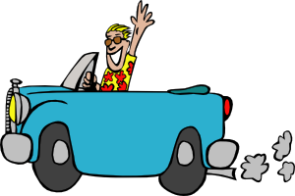
The Driving Task
Driving a motor vehicle is a serious responsibility not only to you, but all others on the road
To be a good, safe driver you must know the rules and respect them, know and follow proper driving procedures, and have a good attitude
Courtesy towards others should be practiced at all times.

Slide 3
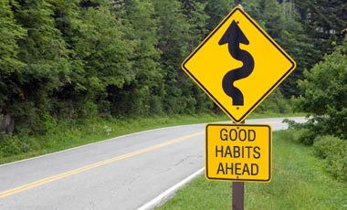
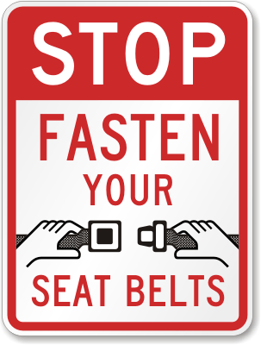
Good Driving Habits
Form good driving habits and use them EVERY trip!
Entering the Car
  Develop a routine for entering your car
  Adjust the seat and mirrors
  Check passengers to be sure they are properly seated and do no interfere with your driving
  BUCKLE YOUR SEATBELT

Slide 4
Posture and Steering
Good posture will result in better vision, control, and ability to maneuver in an emergency
Sit erect firmly gripping the outside of steering wheel with both hands
Always keep both hands on the wheel except when it is necessary to remove one for signaling or for another purpose necessary to the operation of the vehicle.

Slide 5
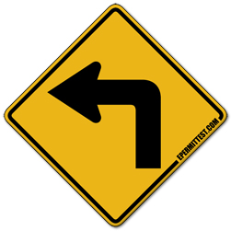
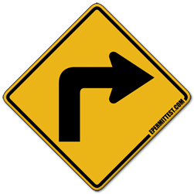
Rules for Turns
Prepare to turn before you get there, don’t make the decision at the last moment.
Get in proper turn lane well ahead of the place you will make your turn
At least 100 ft before making the turn, signal your intentions
Reduce speed before making turns
Always finish your turn in the proper lane, turn into the closest legal lane
Make sure in advance it is safe to turn. Check the front, rear and sides, for cars and pedestrians.
Watch for situations developing in the street you will enter upon turning
Be certain your signals are discontinued after completing the turn

Slide 6
Turning From Four Lane Highways
Making a right turn, enter the right lane well in advance of the turn and make a right turn into the right lane of the cross street.
Making a left turn, move to the lane nearest the center line or traffic divider and turn from the inside lane. Avoid a wide swing during the turn, and enter the cross street just to the right of the centerline.
Remember some intersections are marked to permit turns from more than one lane and you may make your turns as indicated by signs or pavement markings.

Slide 7
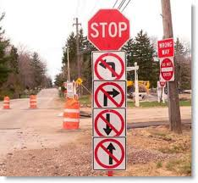
Proper Turning Rules
Plan Ahead
Be in the proper lane well before the turn
Signal the direction you plan to turn
Reduce your speed and check for persons and vehicles in your turning path
Turn into the proper lane
Adjust speed to flow of traffic

Slide 8
Guidelines for 3 Point Turns
Must be made without endangering other traffic
Are normally permitted where your vehicle can be seen for a great distance and where traffic is such that making the 3 point turn would not constitute a hazard.
Are not allowed on interstate freeways, curves, or near the tops of hills where you cannot be seen by drivers of other vehicles approaching from either direction within 500 feet.
Are governed by local ordinances and there may be no signs to warn you
Prohibitory signs are usually posted at hazardous locations

Slide 9
Making a 3 Point Turn
Check traffic, signal, and stop as close to right edge of the curb as possible. Do not run off the roadway. Check both directions and make sure you have a 20-30 second gap
Signal for a left turn. Check rear mirror, left mirror. Blind spot and Look over left shoulder. (1)Turn wheel sharply to the left and move vehicle slowly across the opposite lane.
Stop the vehicle just short of the curb. (2) Shift to reverse. Turn the wheel sharply back to the right check blind spot, look over right shoulder, and Back the vehicle just short of the opposite curb. (3) Shift to drive. Turn wheel sharply to the left and move into the proper lane.

Slide 10
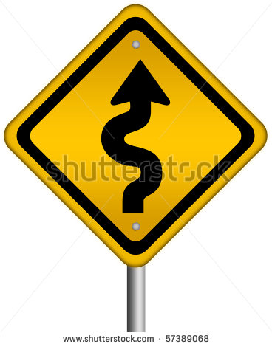
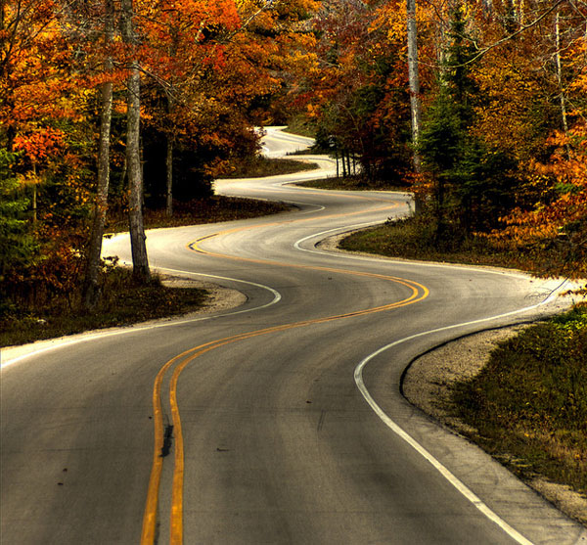
Curves
Slow down before entering curves because of the danger of running over the center line or leaving the roadway.
A driver should enter a curve slow enough to enable him to accelerate slightly when actually rounding the curve.

Slide 11
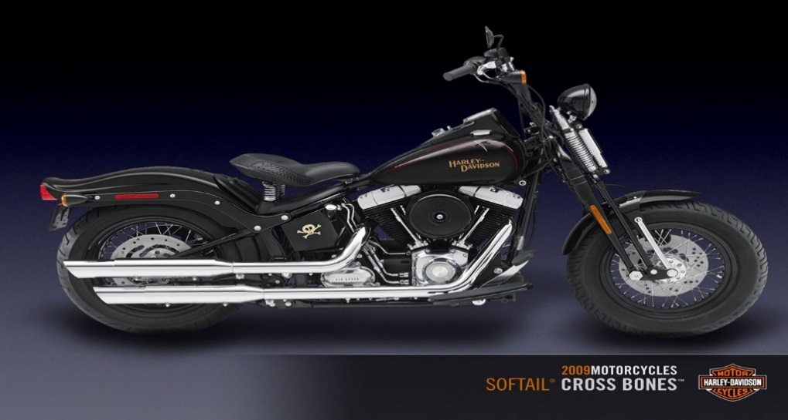
Sharing the Road with Motorcycles
Operating a motorcycle safely in traffic requires special skills and knowledge.
Motorcycle accident statistics show that a substantial percentage of the accidents involve riders with limited experience.

Slide 12
Sharing the Road with Motorcycles
  Motorcyclists have the same rights and responsibilities on public highways as other users.
  It is extremely important for other highway users to be aware of motorcycles and their operation.
  Statistics show that a substantial percentage of the accidents involve riders with limited experience.
  Motorcycles are harder to see than other users.
    Only about 2 feet wide (vehicles 5-6 feet wide)
    Distance is harder to judge
    Harder to determine speed of motorcycles

Slide 13
Sharing the Road with Motorcycles
Drivers turning left in front of motorcycles account for a large percentage of car/cycle accidents.
LOOK AND LOOK AGAIN for motorcycles and make sure you have enough room to make left turn safely.
Motorcycle turn signals are not automatic self canceling – make sure they are turning before passing or turning in front of them.
Do not follow too closely – stay at least 2 seconds away

Slide 14
Sharing the Road with Motorcycles
  All motorcycles are entitled to full use of traffic lanes.
  Good cyclists constantly change positions within their lane to maximize being seen by other users.
  The operator of a motorcycle shall not overtake and pass another vehicle in the same lane, nor should a driver
  No person shall operate a motorcycle between lanes of traffic.

Slide 15
Sharing the Road with Motorcycles
Inclement weather and slippery surfaces are a real problem for motorcycles.
Allow more following distance for motorcycles when it is dark, raining or the road surface is wet and slippery.
Rain, wind, dust and smog can affect the cyclist’s vision.

Slide 16
Sharing the Road with Motorcycles
Cross winds can be hazardous to motorcyclists.
Windy conditions can actually move a motorcycle out of its lane of travel.
Open areas, bridges, and fast moving trucks can create windblasts.
Gravel, debris, pavement seams, small animals and, even, manhole covers can cause a cyclist to change speed or direction.
Railroad crossings, grated bridges, and grooved pavement can cause a cyclists to adjust speed and lane position.
Regardless of fault, the motorcyclist is usually the loser in an accident. It is important for the driver to always be alert for a motorcycle.

Slide 17
Motorcycle Safety
Under Alabama law motorcycles must follow these laws:
  You cannot carry another person unless your cycle has separate foot pegs for that rider.
  Cyclists shall not ride while carrying anything (box, package, object, etc.) that would keep them from having both hands on the handlebars at all times.
  No person may ride a motorcycle on any street or highway in the state of Alabama without a helmet approved by a national safety organization.

Slide 18
Safety Rules
Wind blast from oncoming vehicles can be much greater than you think. Get ready for it.
Railroad tracks and metal bridges will give you trouble not felt in enclosed vehicles.
Instruct your passengers about how to ride with you. New riders may not understand about things such as:
  Leaning in curves
  How to hold on
  Where their feet should go
  Talking

Slide 19
OTHER HIGHWAY USERS
Other highway users often don’t see you in their normal search pattern. Make your self as visible as possible!!!!!
Never drive your cycle in other vehicles blind spots.
The center of the lane is the safest place to ride, it allows drivers of enclosed vehicles to see you in their rear view mirrors.

Slide 20
Protective Equipment
The State of Alabama encourages cyclists to use these items at all times while underway:
  Plastic face shield to protect eyes and face.
  Safe riding apparel i.e. leathers, gloves, boots, etc.
  Roll bar and tailpipe protection

Slide 21
Motorcycle Rules To Live By
If you own a cycle NEVER let someone borrow or ride your bike without your full knowledge that they can ride safely. This is one of the major causes of serious injury and death. Riding a cycle is great fun, but it takes hours of practice to learn your limits.
Weather that would not be a hazard to people driving enclosed vehicles can cause you a great deal of trouble on a motorcycle.
Drivers WILL TURN LEFT in front of you, be ready.

Slide 22
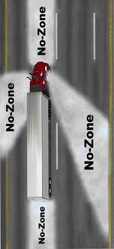
Sharing the Road with Large Vehicles
When sharing the road with trucks, buses, or other large vehicles, there are special tips that are important to remember:
  No-Zones are danger areas
    around trucks and buses where
    crashes are more likely to occur.
    Some of the No-Zones are blind
    spots where your car “disappears”
    from the view of the truck or bus
    driver

Slide 23

Blind Spots/No Zones
Side No-Zones: Don’t hang out on either side of trucks or buses! They have large blind spots on both sides. If you can’t see the driver’s face in the side-view mirror, the driver can’t see you. When passing a truck or bus, always try to pass on the left and do it as quickly as possible. Do not ride alongside a truck or bus.
Rear no-zones: Avoid tailgating! Unlike cars, trucks and buses have huge no-zones directly behind them that could extend as far as 200 feet. The truck or bus driver can’t see your car and you can’t see what is occurring ahead of you. When following a large vehicle at night, always dim your headlights. Bright lights will blind the driver when they reflect off the side mirrors of the bus or truck. If you cannot see the trucks mirrors, he cannot see you.

Slide 24

Blind Spots/No-Zones
Front no-zones: Pass safely! Never cut off a truck! Larger vehicles need 2 times more room to stop. Look for the entire front of the vehicle in your rear-view mirror before pulling in front and don’t slow down.
  According to a National Safety Council, at 55 mph a car needs 193 feet to safely stop where it would take a loaded truck 430 According to a National Safety Council, at 55 mph a car needs 193 feet to safely stop where it would take a loaded truck 430 feet.
Backing no-zones: Pay closer attention! Never cross behind a truck or bus that is backing up. Drivers of larger vehicles cannot see directly behind them. They may not be able to see you.

Slide 25

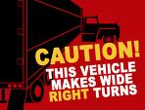
Blind Spots/No-Zones
Turning No-Zones: Avoid the “squeeze play”! Truck and bus drivers need to swing wide to the left to safely make a right turn. Watch the driver’s signal. When the right signal is blinking, do not attempt to pass on the right. It is best to wait until the truck or bus as completed the maneuver before proceeding.

Slide 26
PARKING
Any vehicle left standing along a rural highway for any reason must be moved off the paved or main traveled portion of the roadway.
If the vehicle cannot be moved, you must take lighting and marking precautions to eliminate danger to other traffic. (flashers, reflectors, cones)

Slide 27
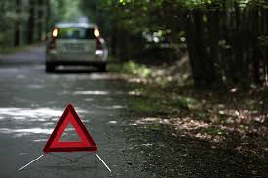

Slide 28
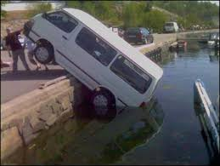
Parking on a Hill
When parking on a hill you must make sure your car does not roll into traffic if the brakes do not hold.
ALWAYS set the parking brake.
Shift to PARK (or reverse or low gear for a manual).

Slide 29
PARKING ON HILLS
Make sure the vehicle does not roll into traffic – set the parking brake and shift to park, then turn the wheels correctly:
- Facing Downhill with a curb
* Turn wheels to the right or toward the curb.
- Facing Uphill with a curb
* Turn wheels to left or away from the curb.
- Facing Uphill without a curb
* Turn wheels to the right or toward the side of the road
-Facing Downhill with no curb
*Turn wheels to the right or toward the side of the road

Slide 30
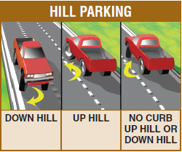

Slide 31
Parking
DO NOT PARK:
- Within intersections
- On a crosswalk of sidewalk
- Within 20 feet of a crosswalk at an uncontrolled intersection
- Within 15 feet of a fire hydrant.
- Within 30 feet of any flashing beacon, stop sign or traffic signal
- In front of a driveway
- On any bridge or in a tunnel
- On the roadway side of any vehicle parked at the curb or edge of a highway (double parking)
- Beside a curb that is painted yellow, or where official signs prohibit parking

Slide 32
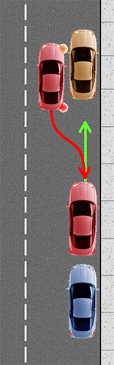
Steps in Parallel Parking
Car 2 pulls even with car 1.
Car 2 maneuvers gently toward
the space.
Car 2 turns wheels sharply.
Car 2 begins straightening wheels.
Wheels on car should be turned
parallel to the curb.
1
2

Slide 33
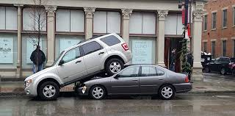

Slide 34
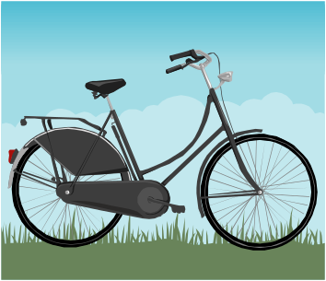
Bicyclists
Traffic laws also apply to bicyclists, but sometimes both adults and children cyclists appear unaware of responsibilities.
Bicycle riders must ride as close to the right curb or edge of the roadway as possible except when: (Bicycles ride with flow of traffic)
-passing another vehicle
-preparing for a left turn
-to avoid road or traffic conditions (debris, car doors, pedestrians, etc).
Drivers may ride two side by side unless they impede the normal flow of traffic.
Bicycle riders are required to signal for all turns, land changes, or stops by using hand signals
Every bicycle driver on a roadway has to wear an approved helmet.

Slide 35
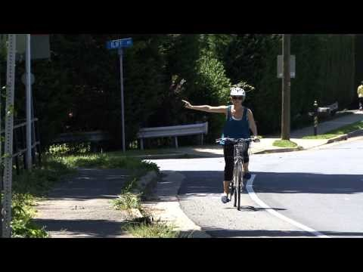

Slide 36
BICYCLES
Special situations motor vehicle drivers must be aware of:
  Do not drive in an established bicycle lane, except to park, when permitted, to enter or leave the highway or to prepare for a turn.
  When turning across a bicycle lane, do not intrude upon the safety of the bicycle driver in the lane.
  Be careful when passing a bicyclist, wind currents can affect the safety of the cyclist.
  Do not follow a cyclist too closely and do not blast your horn at the driver.
  Be especially careful at intersections, when crossing sidewalks, or when entering or leaving driveways and alleyways.
  During wet weather, be prepared to compensate for a cyclist’s decreased ability to slow or stop.
  Watch for bicyclists during darkness or periods of poor visibility – not all have lights or reflectors.

Slide 37

Safety Belt Law
The Alabama Safety Belt Law requires that all front seat occupants, regardless of age, be restrained.
This is a primary law and is subject to a fine when not obeyed.

Slide 38


Slide 39

Child Restraint Laws
Alabama’s Child Restraint Law states that the driver of a motor vehicle is responsible for seeing that any passenger under the age of 15 is properly belted.
This applies to front and back seats in all passenger cars, trucks, minivans, and SUVs.
Violators will have points assessed against their license, as well as, paying a fine.
The law requires the following size appropriate restraint systems:
-Infant-only seat or convertible seat used
in the rear facing position
-Convertible seat in the forward position
or forward-facing seat until a child
is at least 5 years of age or 40 lbs.
-Booster seat until a child is 6 years old.
-Seat belt until a child is 15 years of age.

