Slide 1
Mrs. Hunter’s Intro:
WELCOME TO MY CLASS!
Everything you need to know to start the 2021-2022 school year in Calculus or Honors Math 2 (AOIT) .

Slide 2

Mrs. Deborah Hunter
How to contact me:
1. “Remind” (instructions on
my CMHS webpage)
2. My email (link on
my webpage)
3. Canvas Discussion Board

Slide 3
What You will Need Daily
AB/BC Calculus
Honors Math 2 (aoIT)
Bring your CMHS Chromebook
Graphing Calculator
Access to the following:
Canvas, WebAssign,
AP College Board, Remind
4. Paper and Pencil
CMHS Chromebook
Graphing Calculator
Access to the following:
Canvas, Remind, Desmos
Aleks, Mastery Connect,
4. Paper and Pencil

Slide 4
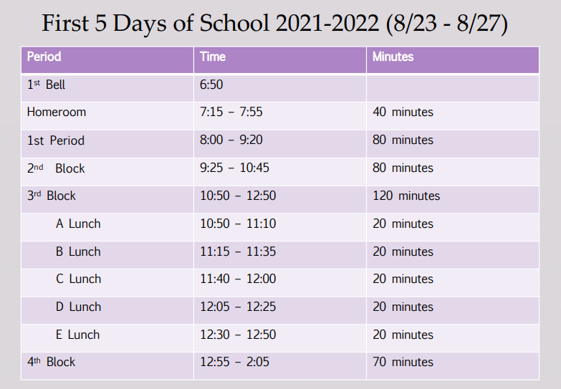
Cox Mill High School Weekly Schedule

Slide 5
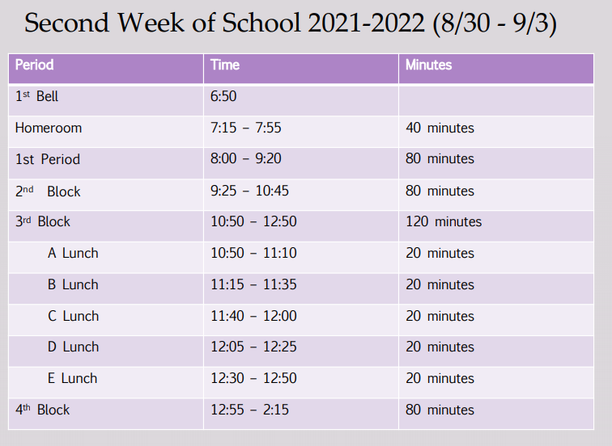
Cox Mill High School Weekly Schedule

Slide 6

Using Your Canvas Course
Canvas is the Learning Management System (LMS) for all Cabarrus County Schools.
TO GET TO CANVAS GO TO CMHS WEBPAGE AND CLICK ON CANVAS ICON
You have already been placed into all of your Canvas Courses at Cox Mill High
For this class the Canvas Intro Page (Home Page) helps you navigate in Canvas
Class Calendar, Announcements, Discussion Boards, and most importantly, Lesson “Modules” can be accessed easily from the homepage or side bar in Canvas
Canvas will list your homework and let you know if you are to submit it in Canvas or in WebAssign or College Board’s My Classroom.
YOU SHOULD CHECK CANVAS DAILY AND NOT JUST GO TO YOUR HOMEWORK (WEBASSIGN, ALEKS, ETC…) TO SEE IF YOU HAVE WORK!

Slide 7
Grading Policy & Assignments
Grading Policy
Grades will be posted in PowerSchool
You will be graded on homework, classwork, quizzes, tests, projects
The percentages of such are listed on the class syllabus in Canvas.
Overdue assignments will only be eligible for <50% credit and may be denied depending on circumstances.
Assignments
Canvas is the LMS. All lessons & assignments will be in Canvas. Canvas will tell you what your assignments are (homework, quiz, test etc…)
The actual assignment may be in a different software (Aleks, WebAssign, etc…)
Cheating including plagiarism, sharing answers, accessing online answer keys, etc…will result in zero credit and administrative referral

Slide 8
Class Curriculum & Syllabi
AB/BC Calculus
Honors Math 2 (AOIT)
If you are taking AB Calculus with me, you should also be taking BC Calculus with me.
AB Calculus is College Calculus 1 & BC Calculus is College Calculus 2.
We follow the curriculum listed in AP College Board but in the order of your textbook, Stewart Calculus Ed7.
AB Covers textbook chapters 1-6,& 9 while BC covers chapters 7,8,10,11
Syllabi are posted in Canvas.
Honors Math 2 is a continuation of Honors Math 1, with an emphasis on technology, and reviews a lot of the same topics. It then adds Geometry topics & introduces additional topics on operations with functions.
There is no textbook since CCS was only issued Alg.2 textbooks & Geometry textbooks about 15 years ago.
Additional helps such as Kahn Academy, Aleks, Math Videos will be provided
Syllabi are posted in Canvas

Slide 9


