Slide 1
CMS
Summer Algebra Readiness Program
2013-2014 School Year

Slide 2
Why We’re Here
The CMS Math PLC spent a day working on student placement for next year
We used a variety of data including: teacher recommendation, Math MSP, Easy CBM, grades, Orleans Hanna Algebra Readiness (where possible), Science MSP (where possible)
As a result of our data analysis, your student was identified for advanced mathematics placement
Our aim is to ensure that each student that has the potential to participate in algebra in middle school has the chance to succeed

Slide 3
Math Progression
Beginning 2013-2014 School Year
Pre-Algebra 1 (7th Grade Standards) | Pre-Algebra 2 (8th Grade Standards) | Algebra 1 (9th Grade Standards)
Pre-Algebra 2 | Algebra 1 | Geometry
Algebra 1 | Geometry | Algebra 2
Geometry | Algebra 2 | Pre-Calculus
Algebra 2 | Pre-Calculus | AP Calculus AB and /or AP Statistics
Pre-Calculus | AP Calculus AB and /or AP Statistics | AP Calculus CD
AP Calculus AB and /or AP Statistics | AP Calculus CD
AP Calculus CD

Slide 4
Getting Ready for Algebra
We want to ensure that each student has both been exposed to and developed a competency with the variety of 6th, 7th and 8th grade standards related to algebra readiness
We also want to ensure that each student feels prepared for his/her grade level MSP
We aim to use Khan Academy as our tool of choice for engaging your student in his/her preparation for algebra success.

Slide 5
Khan Academy Playlists
Pre-Algebra 1
Pre-Algebra 2
Algebra 1

Slide 6
Summer Algebra Readiness
Not only do we aim to minimize the potential for any gaps that students may incur by skipping one or two grade levels, but to identify and close any gaps that may exist as a result of prior experiences

Slide 7
Khan Academy
Khan Academy is a free online resource that offers a variety of tutorials and tools for practice and mastery of a variety of math skills
Students sign in using their NTPS Google Gmail accounts
Students will set goals based on the course they are entering in the 2013-2014 school year
Students will work towards mastery of these goals under the supervision of the CMS Math PLC—your coaches
Khan Academy offers your student great flexibility in terms of the time he/she has to participate this summer

Slide 8
Placement Next Year
Placement for next year is simply a recommendation and not a guarantee
Placement is more likely guaranteed by successful participation in and completion of our summer program
Please sign a letter of intent indicating your choice of participating in this summer program or not

Slide 9
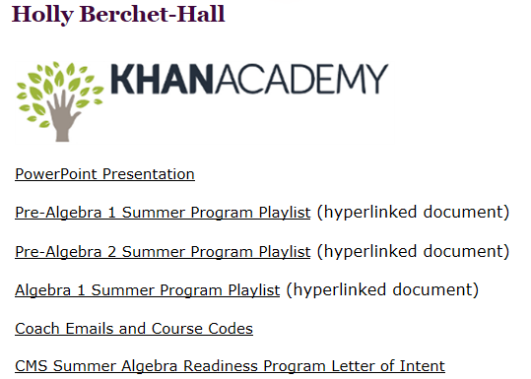
The Nuts & Bolts
Navigate to Chinook Middle School Teacher Pages—Berchet-Hall
(Please complete in this order to avoid confusion)
Choose the course based on the class you will be in next year. Open the document.
Open the Coach Emails and Course Codes Document
Navigate to Khan Academy with the hyperlink
3
1
2

Slide 10
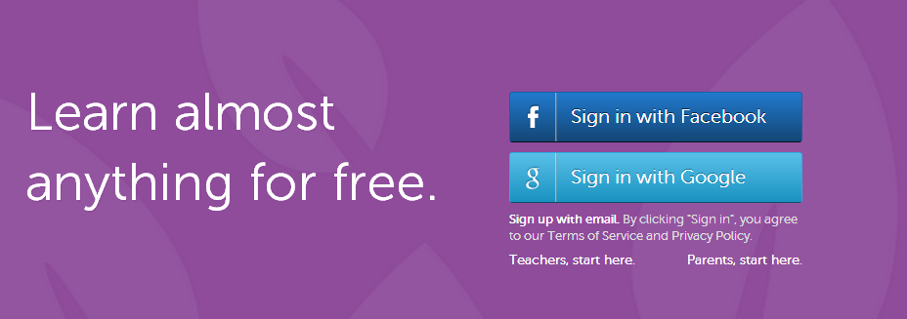
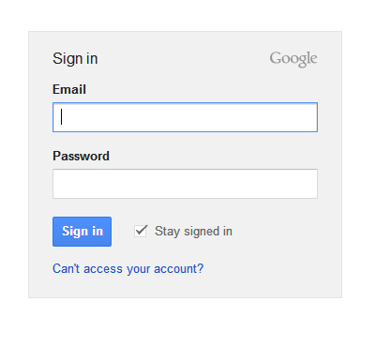
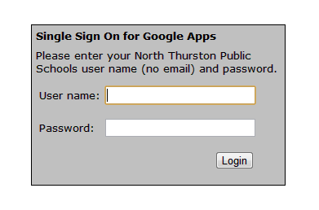
The Nuts & Bolts, page 2
4. Sign in with Google
5. Use your NTPS Gmail address:
username@stu.nthurston.k12.wa.us
DO NOT PUT IN PASSWORD ON THIS
STEP! Just choose Sign In button
6. You will be directed to the
Single Sign On for Google Apps screen
This is where you use your NTPS user name and password, just as if you were logging into any district computer

Slide 11


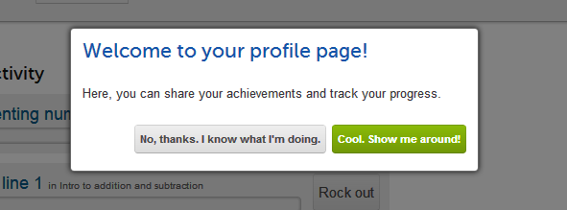
The Nuts & Bolts, page 3
7. If this is a new account, you will need to accept the use agreement. If it is a current account, you will need to allow access.
8. You will now be in Khan Academy! You can choose to do the tutorial or explore on your own.

Slide 12
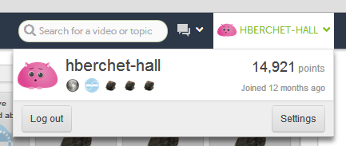
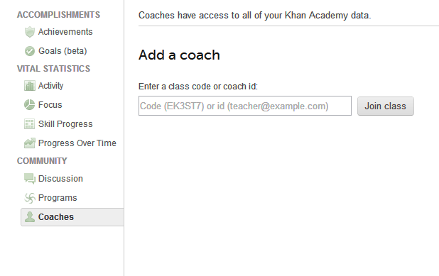
The Nuts & Bolts, page 4
9. Add the course code and all the math coaches!
(Copy and paste the names one at a time from the document you opened.)
Pre-Algebra 1 Summer Course Code: CEAHBR
Pre-Algebra 2 Summer Course Code: HRA4A4
Algebra 1 Summer Course Code: VKUHD5
hberchet-hall@stu.nthurston.k12.wa.us
rking@stu.nthurston.k12.wa.us
choward@stu.nthurston.k12.wa.us
kstarkey@stu.nthurston.k12.wa.us
jnunn@stu.nthurston.k12.wa.us

Slide 13
Questions to Help You Explore Your Profile
What are energy points? What is a stack?
What is the difference between getting 1, 2, and 3 leaves?
How are exercises connected to each other on the page that looks like the galaxy?
What kind of information can you see about yourself?
What is an avatar? What are badges? How can you earn them?

Slide 14
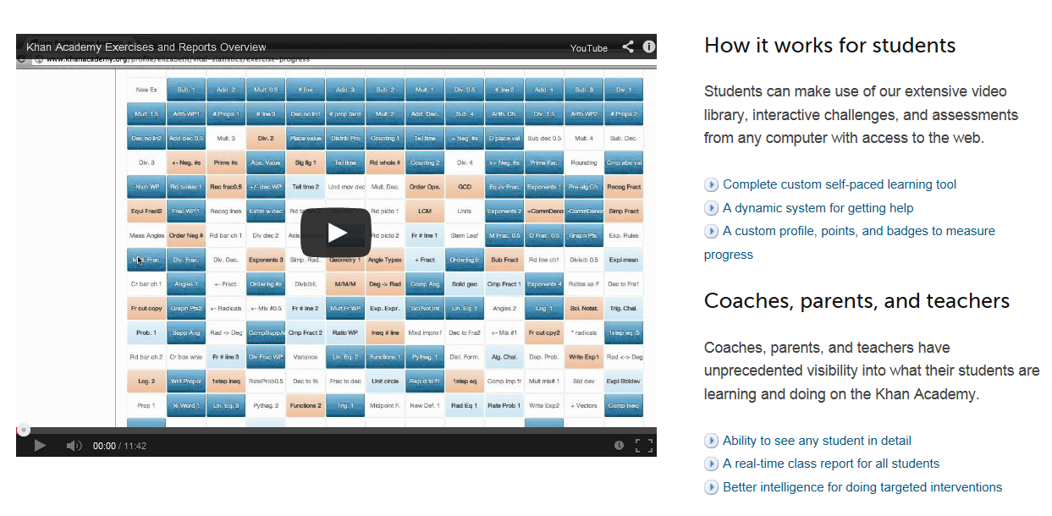
About Khan Academy
Follow the hyperlink above to learn more about Khan Academy

Slide 15
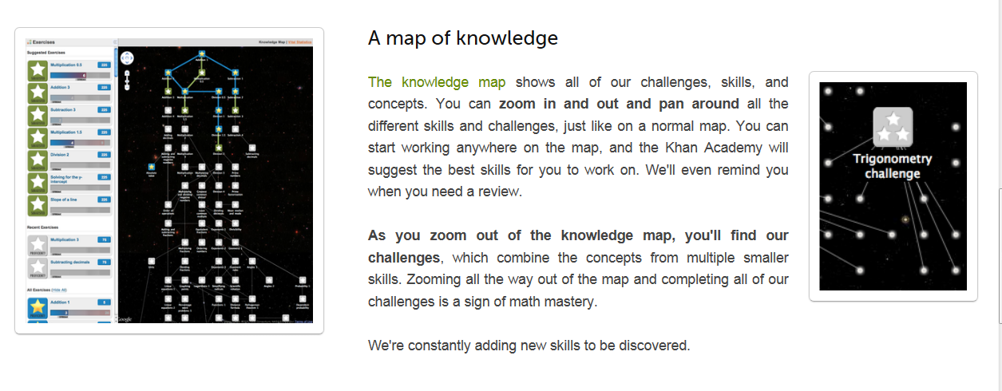
About Khan Academy
Follow the hyperlink above to learn more about Khan Academy

Slide 16
Recap
Use the hyperlinks on your playlist page to select the Khan Academy modules you will need to master this summer.
Khan Academy keeps track of your progress and your coaches can see how you are doing. Don’t hesitate to ask for help if you get stuck. Email is the best way to contact us. Send your questions to all coaches and the coach on duty will get back to you.
Please let us know if a link doesn’t work, or you find anything that needs to be edited.
Have fun and, as John and Hank Green say, “Don’t Forget To Be Awesome!” (DFTBA)

