Slide 1
Integration/Antiderivative

Slide 2
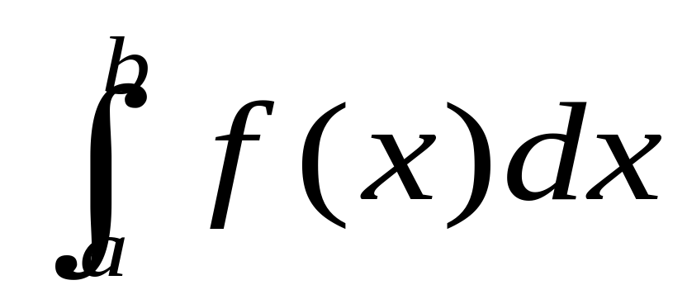
First let’s talk about what the integral means!
Can you list some interpretations of the definite integral?

Slide 3
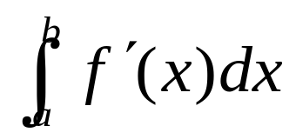
Here’s a few facts:
1. If f(x) > 0, then returns the
numerical value of the area between
f(x) and the x-axis (area “under” the curve)
= F(b) – F(a) where F(x) is
any anti-derivative of f(x).
(Fundamental Theorem of Calculus)
3. Basically gives the total cumulative
change in f(x) over the interval [a,b]

Slide 4
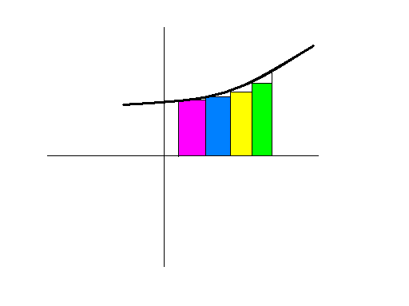
What is a Riemann Sum?
Hint: Here’s a picture!

Slide 5
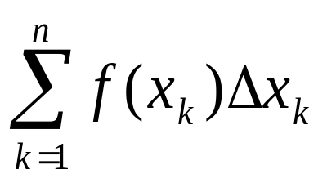
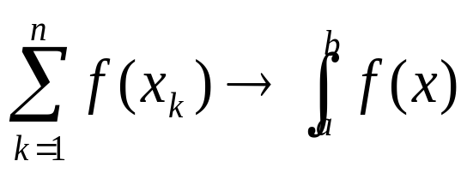


A Riemann sum is the area of n rectangles used to approximate the definite integral.
    = area of n rectangles
    As n approaches infinity…
    and
    So the definite integral sums infinitely many infinitely thin rectangles! (Calculus trivia: as n (number of rectangles) goes to the summation sign becomes the integral sign and x becomes dx)

Slide 6
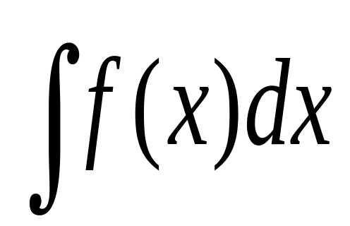
The indefinite integral
= ?

Slide 7
Well…hard to write; easy to say
The indefinite integral equals the general antiderivative…
= F(x) + C
Where F’(x) = f(x)

Slide 8
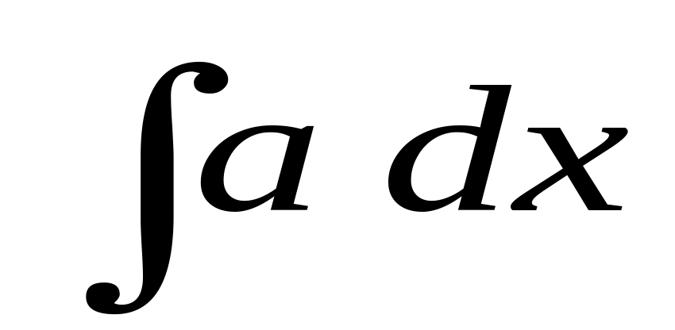
= ax + C

Slide 9
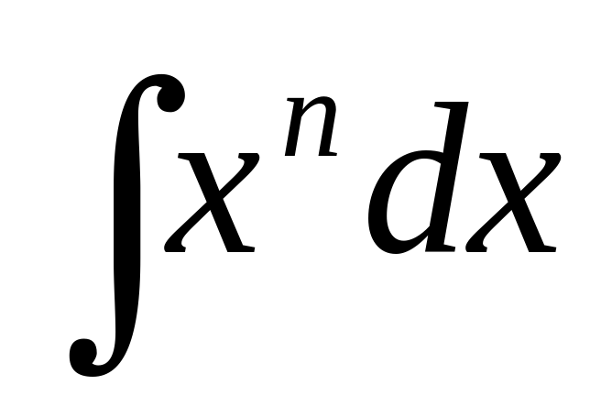
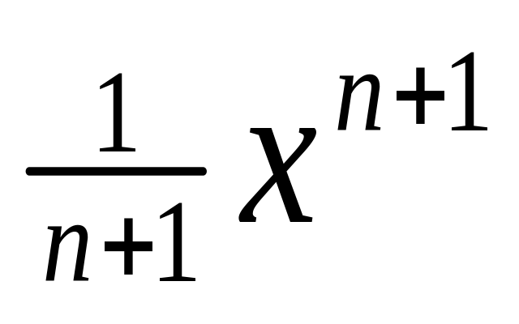
=
+ C

Slide 10
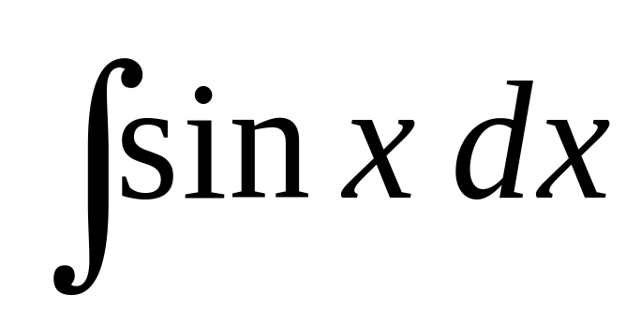
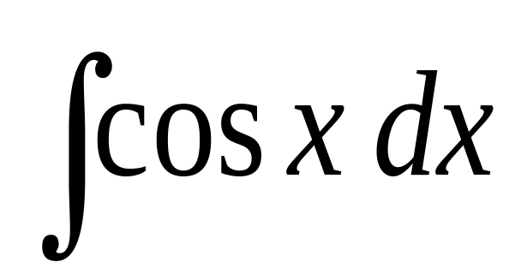
= - cos x + C
Don’t forget we are going backwards!
So if the derivative was positive, the
anti-derivative is negative.
= sin x + C

Slide 11
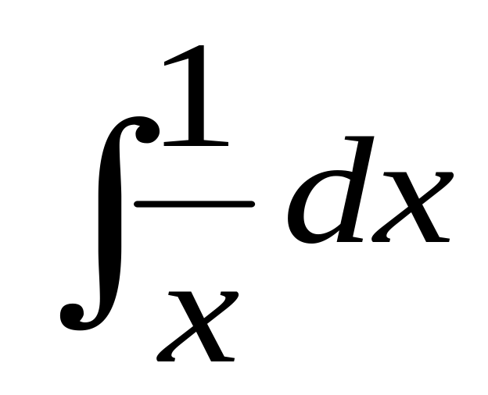
= ln |x| +C
You need the absolute value in case x<0

Slide 12
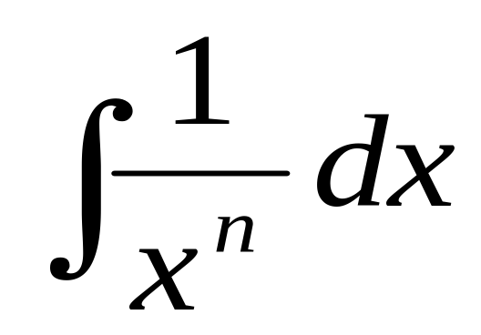


where n > 1
Hint:

Slide 13
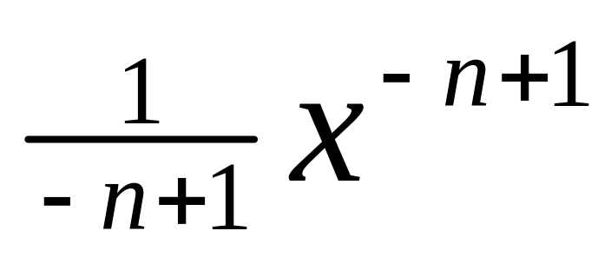
1/x^{n} = x^{-n}
sooooooo…….
the answer is:
+ C
You didn’t say ln(x^{n}) did ya??

Slide 14
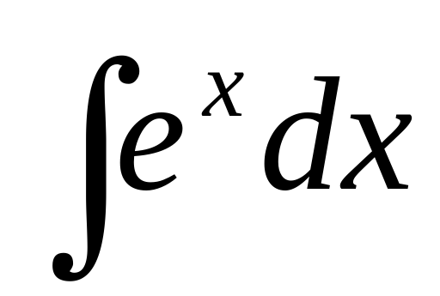

= e^{x} + c
Easiest anti-derivative in the universe, eh?

Slide 15


Slide 16
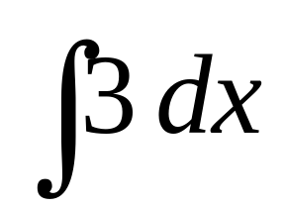
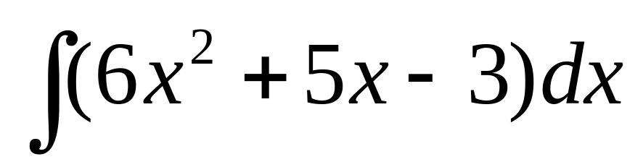

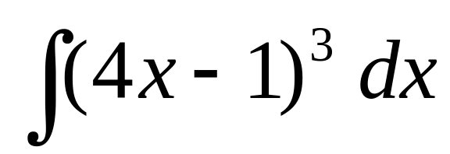
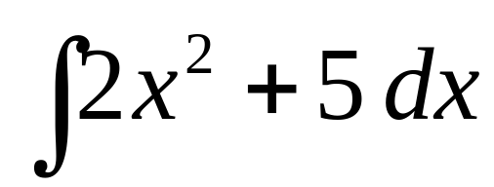
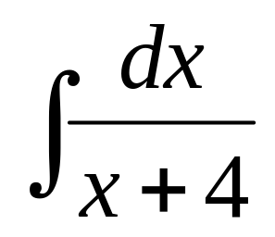
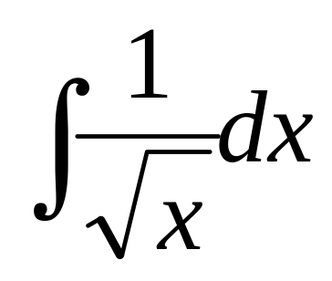
Examples:

