Slide 1
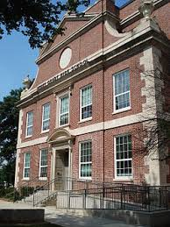
Grady High School
Mathematics Department
Local School Council Meeting
March 2, 2014
Presented by: Mr. Rives – Math Department Chair
Dr. D. Stoner – Instructional Coach

Slide 2
Coordinate Algebra
Spring 2013

Slide 3

Coordinate Algebra
Spring 2014

Slide 4
Analytic Geometry
Spring 2014

Slide 5
AP Math Course Data
Notes:
Grady is AP Scholar School

Slide 6
Continuous Improvement
Vertical Teaming with Inman
Generation Ready
MRESA Courses
Weekly Professional Learning Communities (PLC’s)

Slide 7
Interventions
ALEKS – All Support Classes
Edgenuity – Unit Recovery
Tutorials – All Math Teachers

Slide 8
Math Teacher Support
Monthly Department Meetings
Faculty School-Wide Meetings
Cluster Teachers

Slide 9

Integrated Versus Discrete
The Georgia Department of Education is allowing districts to decide whether to remain with the integrated standards or to switch to the discrete standards.
CCGPS: discrete studies of algebra and geometry with connectivity by linking algebra and geometry in each of the three courses
Proposed Traditional: discrete studies of algebra in two courses and a discrete study of geometry in one course.

Slide 10
Next Steps
Continuous Professional Development
- Greater emphasis on data analysis with
common assessment
- Practicing with constructed response
using template
- More frequent opportunities for students
to assess on computers (constructed
response).

Slide 11
Questions????

