Slide 1
Today in Pre-Calculus
Go over homework
Need a calculator
Notes: Increasing/Decreasing and Extrema
Homework

Slide 2
Extrema
Definition: The peaks and valleys where a graph changes from increasing to decreasing or vice versa.
Types: Minima and Maxima
Local (relative) and absolute

Slide 3
Local (or relative) extrema
A local maximum for a function f, is a value f(c) that is greater than or equal to the range values of f on some open interval containing c.
A local minimum for a function f, is a value f(c) that is less than or equal to the range values of f on some open interval containing c.

Slide 4
Absolute extrema
An absolute maximum for a function f, is a value f(c) that is greater than or equal to ALL of the range values of f.
An absolute minimum for a function f, is a value f(c) that is less than or equal to ALL of the range values of f.

Slide 5
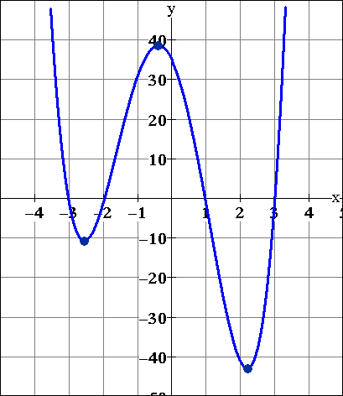
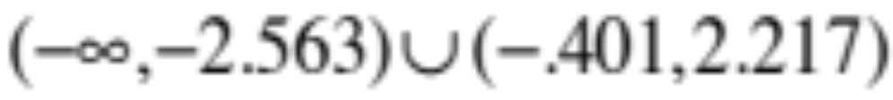
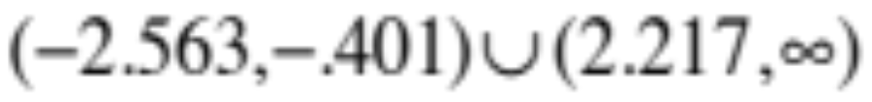
Example
Relative minimum of
-10.752 at x = -2.563
Relative max of
38.603 at x = -0.401
Absolute min of
-42.938 at x = 2.217
Decreasing
Increasing

Slide 6
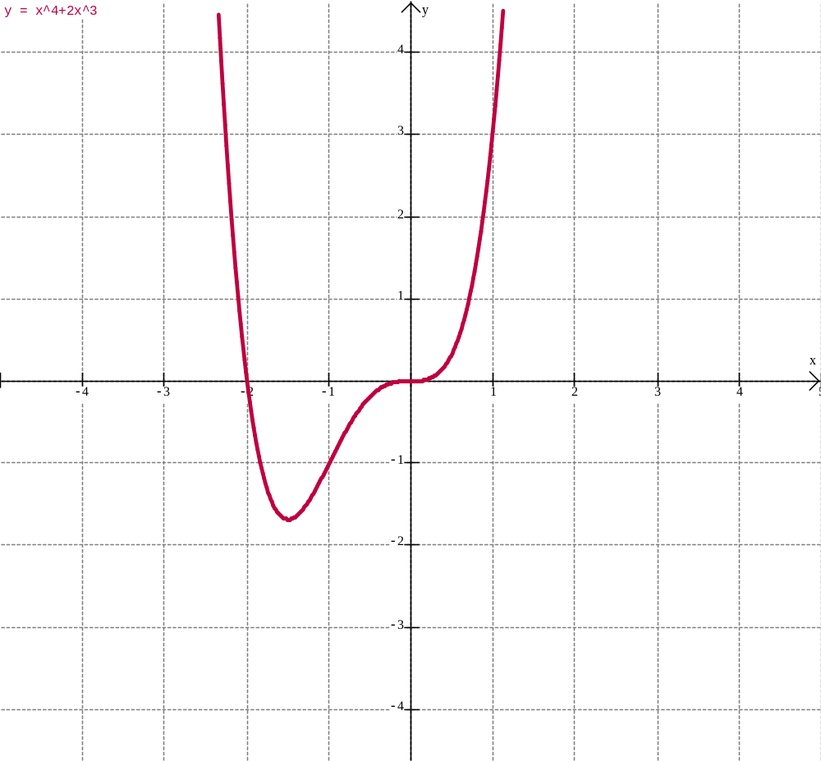
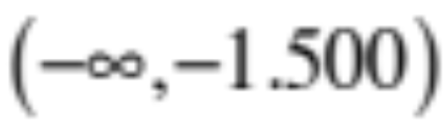
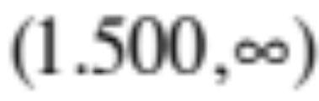
Example 1
Absolute minimum of -1.688 at x = -1.500
Decreasing
Increasing

Slide 7
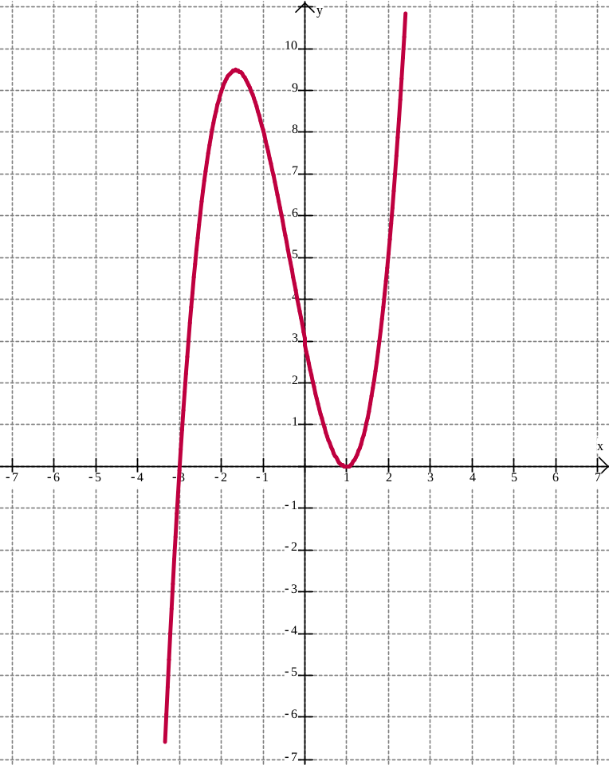
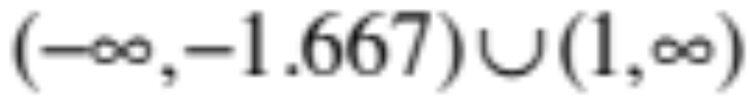
Example 2
Local maximum of 9.481 at x = -1.667
Local minimum of 0 at x = 1
Increasing
Decreasing
(-1.667,1)

Slide 8
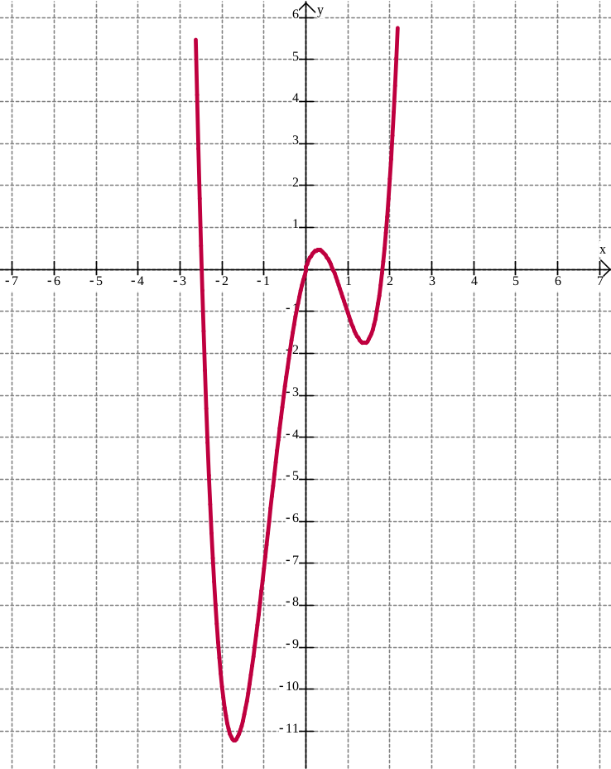
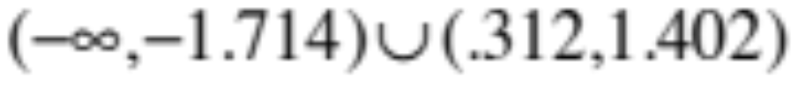

Example 3
Abs min of -11.2 at x = -1.714
Rel max of 0.459 at x = 0.312
Rel min of -1.758 at x = 1.402
Decreasing
Increasing

Slide 9
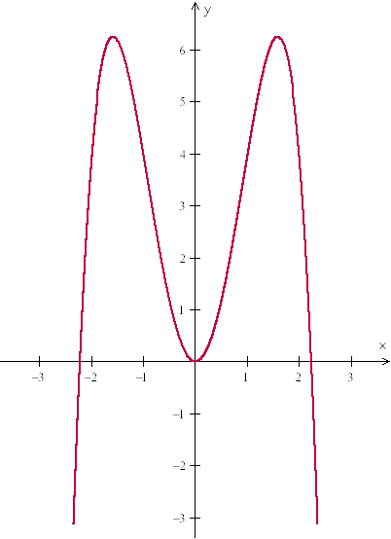
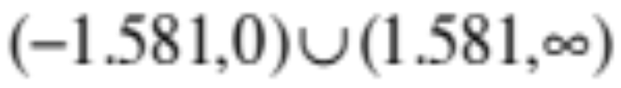
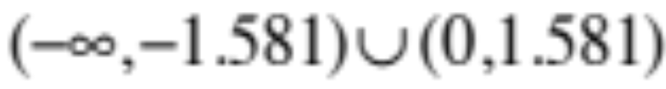
Example 4
Abs max of 6.25 at x = -1.581, 1.581
Rel min of 0 at x = 0
Decreasing
Increasing

Slide 10
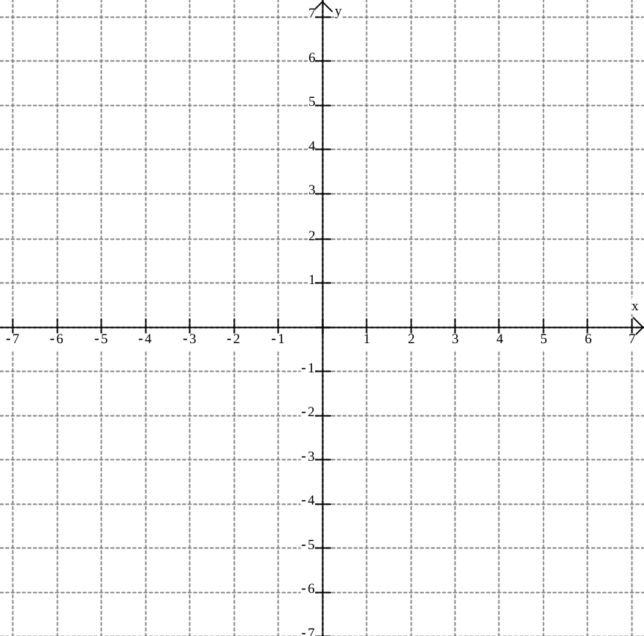
Example 5
Absolute minimum of -4 at x = 2
Relative minimum of -1 at x = -3
Relative maximum of 3 at x = 1

Slide 11
Homework
Wkst.

