Slide 1

Worthington Schools
February 9, 2015

Slide 2
CC+ Classes taught by Worthington Staff
High School Class Name | Partner College | College Course Code | High School
AP Calculus AB | COTC | MATH 200 | Both
AP Calculus BC | COTC | MATH 200 | Both
Intro to Programming Logic | CSCC | CSCI 1103 | Both
Pre-Calculus | COTC | Math 150 | Both
Intro to Business | COTC | BUS 105 | WKHS
Honors Chemistry | COTC | CHEM 100 | TWHS
AP Chemistry | COTC | CHEM 110 and 111 | TWHS
Notes:
Formerly known as Dual Enrollment

Slide 3
Model Pathway Anticipated Classes
Course Code | Course Name | Sem Hours | When Offered | HS Credit | PreReq/ Notes
ENGL 1100 | Composition 1 | 3 | Y1 Fall | 1 | 69 on Compass/ 18 ACT
ENGL 2367 | Composition 2 | 3 | Y1 Spring | 1 | ENGL 1100 with C or better
PSY 1100 | Intro to Psychology | 3 | Y1 Fall | 1
POLS 1100 | Intro to Am. Government | 3 | Y1 Spring | 1
SOC 1101 | Intro to Sociology | 3 | Y1 Spring | 1
HIST 2224 | African Amer Hist Since 1877 | 3 | Y2 Spring | 1 | Course still pending
PHIL 1130 | Ethics | 3 | Y2 Spring | 1 | Course still pending
STAT 1450 | Practice of Statistics | 4 | Y2 Fall | 1.3 | Course still pending
HART | World Cinema | 3 | Y2 Spring | 1 | Course still pending
 | Science TBD | 4 | Y2 Fall | 1.3 | Course still pending
Notes:
Anticipated
Model pathway options will hopefully be available in the home high schools at both TWHS and WKHS – depending on adequate registration – or would be combined to be offered at the new Worthington Academy area at Phoenix Middle School building
How these classes were selected
Still working on Year 2 pathway options that will be available in the high schools
Do not have to take all of the classes – can pick and chose

Slide 4

How student schedules will work*
Fall Semester:
Class 1: M/ W 8:00 – 9:20am
Class 2: T/ R 8:00 – 9:20am
Spring Semester:
Class 1: M/W 8:00 – 9:20am
Class 2: T/ R 8:00 – 9:20am
Class 3: F 8:00 – 9:20am plus online
3rd – End of Day available for high school classes
*Anticipated times/ schedule

Slide 5

Balance
Think carefully about courses you’re selecting
Like an AP Class all in 1 semester rather than across a year
High School weighted grade
Grade on college transcript for future
Notes:
Even on pathway classes – not all or nothing – can pick and choose
Athletic eligibility
Equals 2 high school classes

Slide 6

Next Steps
Conversations with colleges
Form
  Return by April 1st (March 27th)
Follow college criteria for application
Spring Compass testing if necessary
Work with counselor to finalize selections and course plans

Slide 7
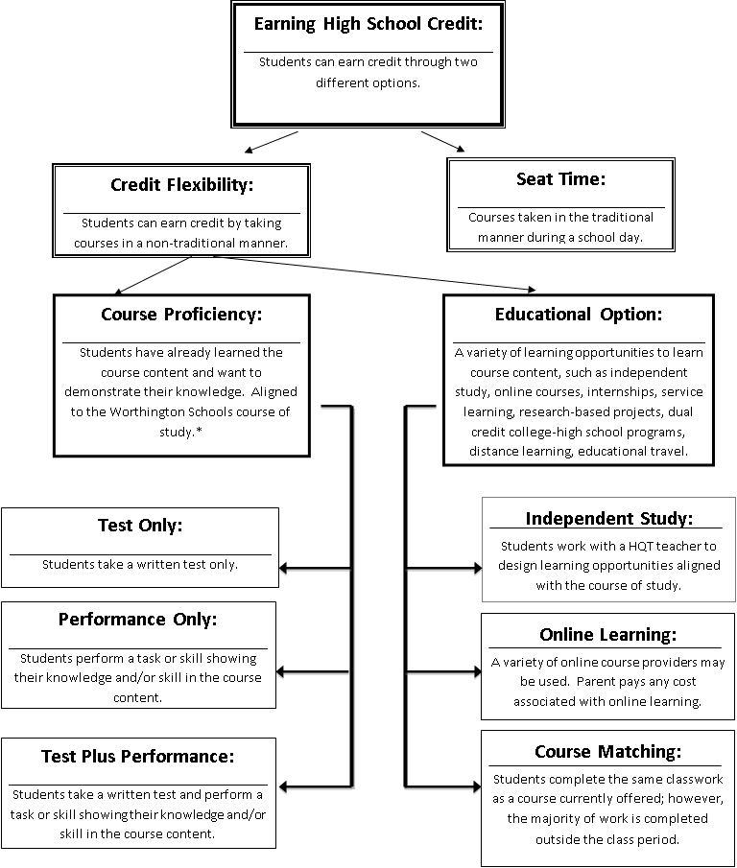
Credit Flexibility
Notes:
Flow chart – This will be the overview of what we are going to talk through tonight

Slide 8
Earning High School Credit
Traditional Seat-Time
Credit Flexibility
Students take courses during regular scheduled day
Instruction by teachers
Earn grades at the end of each semester that is reflected on transcript
Students have flexibility to design instruction based upon individual needs and strengths

Slide 9
Credit Flex Categories
Demonstration of Proficiency
For students who have already learned the course material
Educational Options
For students who do not yet know the course material, but want to learn
Examples: student designed courses, online learning, internships, matching

Slide 10
Completing a Credit Flex Application
Students are responsible for completing all steps of the credit flex application and receiving all signatures of approval before coursework can begin
Worthington Schools Credit Flexibility Plan is available at www.worthington.k12.oh.us
  Our District → Credit Flexibility

Slide 11
Thank you for attending!
Worthington Kilbourne:
  www.wkhscounselors.com
Thomas Worthington:
  www.worthington.k12.oh.us/domain/8
Linworth:
  www.linworth.org

