Slide 1
Today in Pre-Calculus
Review Chapter 9 – need a calculator
Homework
Go over homework

Slide 2
Combinatorics
An arrangement of objects in a specific order or selecting all of the objects.
An arrangement of objects in which order does not matter.
Difference between permutations and combinations:
  Combinations: grouping of objects
  Permutation: putting objects in specific places or positions, or selecting all of the objects.

Slide 3
ExampleS
There are ten drivers in a race. How many outcomes of first, second, and third place are possible?
In a study hall of 20 students, the teacher can send only 6 to the library. How many ways can the teacher send 6 students?

Slide 4
Conditional Probability & Tree Diagrams
Two identical cookie jars are on a counter. Jar A contains 2 chocolate chip and 2 peanut butter cookies, while jar B contains 1 chocolate chip cookie. Selecting a cookie at random, what is the probability that it is a chocolate chip cookie?

Slide 5
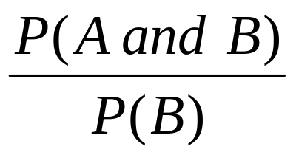
Conditional Probability
Notation: P(A|B) probability of A given B
P(chocolate chip|jar A)=
P(chocolate chip|jar B)=
P(A|B)=
P(jar A|chocolate chip) =

Slide 6
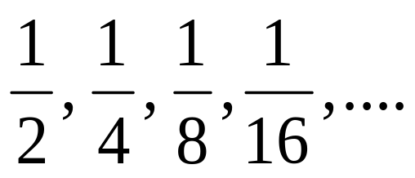
Sequences
Arithmetic Sequence: a sequence in which there is a common difference between every pair of successive terms.
Example: 5,8,11,14
General formula: a_{n} = a₁ + (n-1)d
Geometric: a sequence in which there is a common ratio (or quotient) between every pair of successive terms.
Example:
General formula: a_{n} = a₁r^{(n–1)}

Slide 7
Explicitly Defined Sequence
A formula is given for any term in the sequence
Example: a_{k} = 2k - 5
Find the 20th term for the sequence
Write the explicit rule for the sequence 55, 49, 43, …
Write the explicit rule for the sequence 5, 10, 20, …

Slide 8
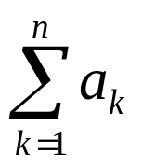
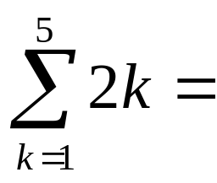
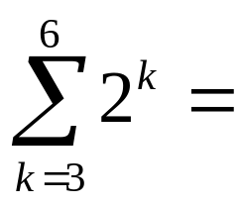
Series
Series: the sum of the terms of a sequence {a₁, a₂, …,a_{n}}
Written as:
Read as “the sum of a_{k} from k = 1 to n”.
k is the index of summation

Slide 9
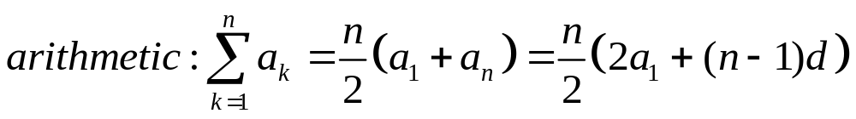
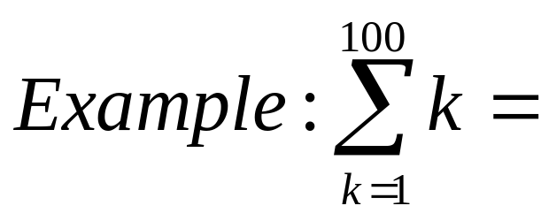
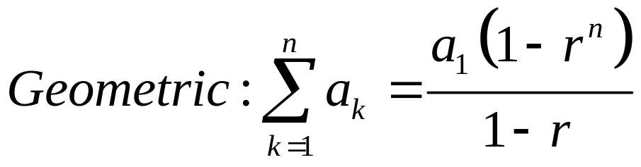
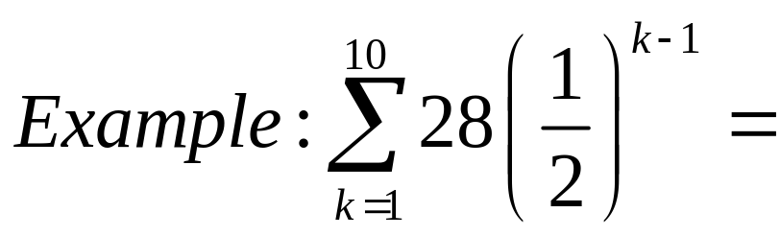
formulas

Slide 10
Example
Write the sum of the following series using summation notation:
Example 1: 13 + 17 + 21 + … + 49
Example 2: 1 + 8 + 27 + … + (n+1)³
Example 3: 3, 6, 12, …, 12,288

Slide 11
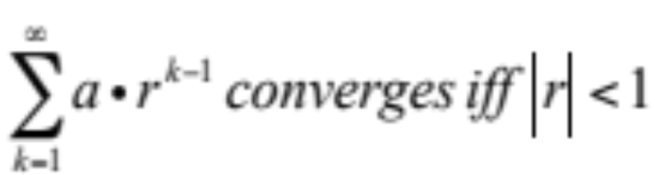
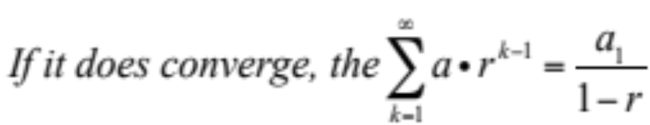
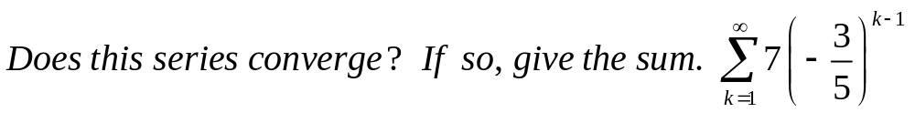
Infinite Series
An infinite series can either:
Converge – if, as n increases, the series sum approaches a value (S)
Diverge – if as n increases, the series sum does NOT approach a value.

