Slide 1
Simple machines
2nd grade Science Standard Addressed:
Strand2-Concept2-PO1: Identify components of familiar systems
Strand2-Concept2-po2:Identify the following characteristics of a system:
  Consists of multiple parts of subsystems
  Parts work interdependently

Slide 2
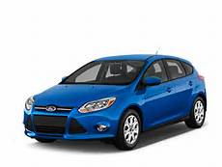
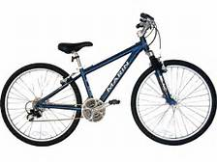
WHAT IS A MACHINE?
  A tool with lots of moving parts
  These moving parts help move the tool
  A machine is used to lift or carry things
  Examples of Machines:
    Cars (tires, steering wheel, engine)=carry people and things
    Bikes (tires, steering wheel)=carry people
  Turn to your neighbor:
  Name one machine and tell your neighbor what it is used for

Slide 3
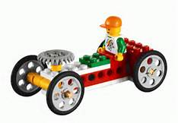
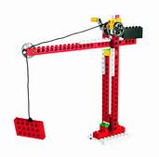
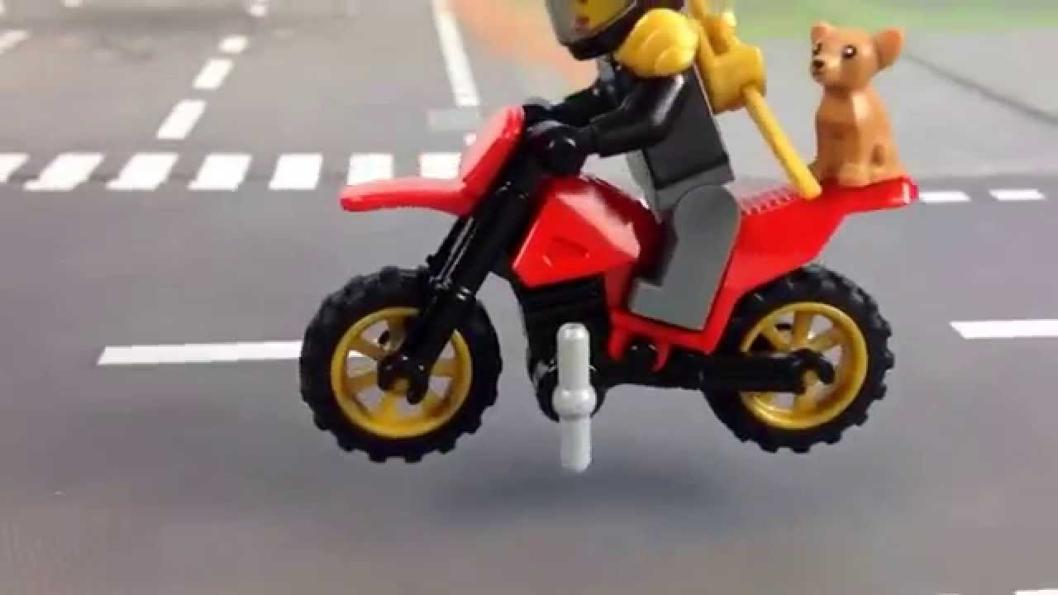
machines
Parts and uses

Slide 4
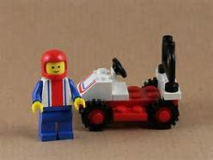
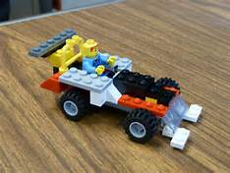
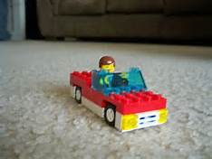
Building a car with Legos

Slide 5
Careers
Automotive Engineer-A person that designs, develops and builds cars, trucks and motorcycles.
  Skills Required-Excellent at math and have great problem solving skills
  Average Salary-$74,000
  Companies that employ Automotive Engineers- Ford Motor Company, General Motor Corporation (Chevrolet, GMC)

Slide 6
Review Visual Instructions
A
B
Lego Parts
Every simple machine has two booklets (A and B)

Slide 7
Objective
Expectations
I will be able to build a car with legos.
Use visual instructions (A,B)
Legos stay out of mouths
Legos do not belong in your pockets
Legos stay on table
Stay in your seat
Share with your partner
Use inside voices

Slide 8
Start Building

Slide 9
CLOSURE
TELL YOUR PARTNER 2 THINGS YOU LEARNED ABOUT THE MACHINE YOU ARE BUILDING
DISCUSS CHALLENGES
HOW DO THE PARTS WORK TOGETHER TO MAKE A WHOLE?

