Slide 1
Grouping Cards
The following are designed to be cut apart, laminated, and distributed to the students.
This set has 18 “unique” cards for 6 VNPS.
The numbers were colored according to the color of the shape so they could be used independently.

Slide 2
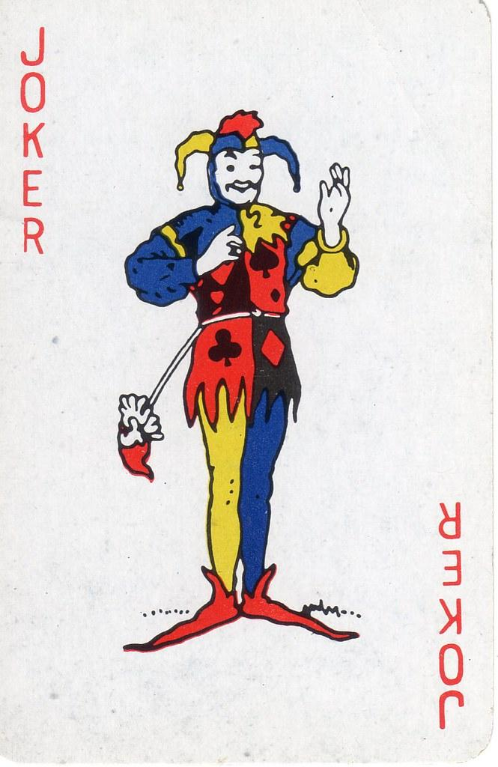


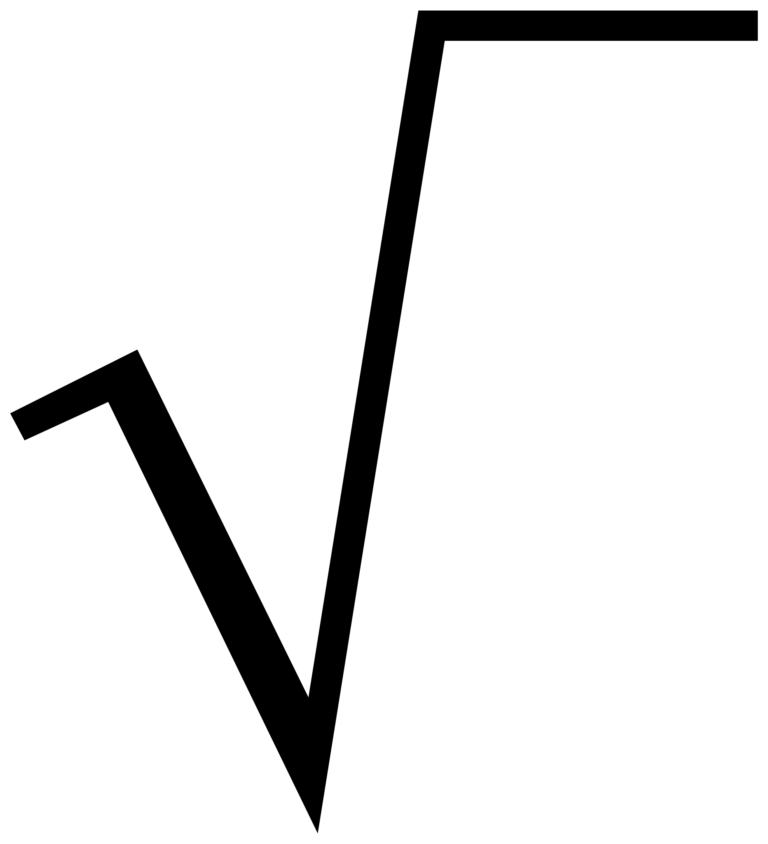



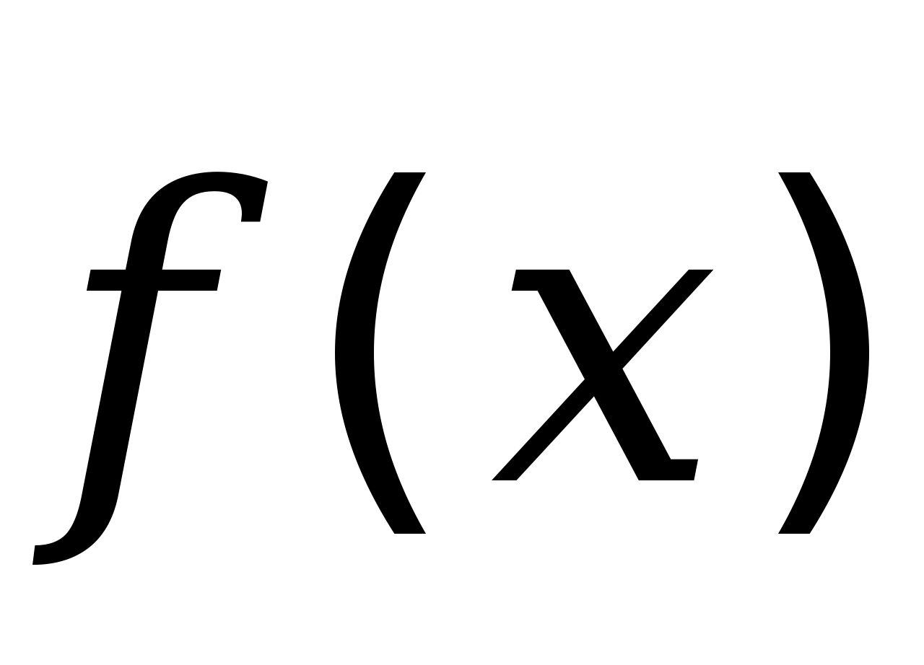




3
5
2
6
4
1

Slide 3
2
6
3
4
1
5

Slide 4
6
1
4
2
5
3

Slide 5
Signs for the VNPS
The following pages are designed to be printed, cut apart, laminated, and placed above a VNPS. These have been designed for 6 VNPS so each will get a shape, a color, a number, a card suit, and a math symbol. After handing out the small cards in the beginning of this file, you can call out “Shapes” and send the students to the boards according to what (gray) shape is on their card.

Slide 6
1
Right Triangle

Slide 7
2
Parallelogram

Slide 8
Star
3

Slide 9
4
Circle

Slide 10
5
Trapezoid

Slide 11
6
Hexagon

Slide 12
Square Root
Dollar Sign

Slide 13
F of x - function notation
Not Equal to

Slide 14
Percent Sign
Pi ≈ 3.14

