Slide 1
Organisms are sensitive to changes in pH
By:
Emily Jones and Josh Kendrick

Slide 2
pH
The pH level is the measure of hydrogen ion concentration equal to –log [H+] and ranging in value from 0 to 14. –Biology book
ACID- an acid is a substance that increases the hydrogen ion concentration of a solution.
BASE- a substance that reduces the hydrogen ion concentration of a solution

Slide 3
Relationship between acids, bases, and the pH scale.
Both acids and bases affect pH levels.
ACID-
Hcl H⁺ + Cl⁻
BASE-
NH₃ + H⁺ NH₄⁺
Or
NaOH Na⁺ + OH ⁻

Slide 4
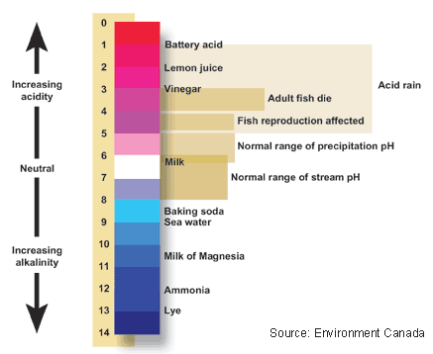
pH scale

Slide 5
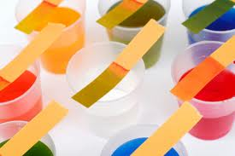
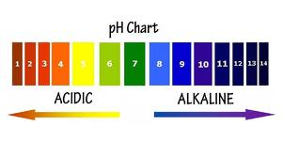

Slide 6
On the pH scale:
The closer to 0, the more acidic
The closer to 14, the more base
Around 7 (in the middle), more neutral

Slide 7
Buffers
BUFFERS- Substances that minimize changes in the concentrations of H⁺ and OH– in a solution.
Buffers keep the pH levels neutral.

Slide 8
Buffers:
In some cases, buffers are very crucial to life. For example:
Buffers keep the pH levels of human blood at about 7.4
When the level drops to 7 or rises to 7.8, a person can only live for a few minutes.

Slide 9
Picture Sources
http://hl4y.com/health-news/2010/02/22/how-can-i-become-more-alkaline/
http://ga.water.usgs.gov/edu/phdiagram.html
http://www.vendio.com/stores/holhoshop/item/aquarium-fish-fish-food/240-pcs-full-range-1-14-ph-pap/lid=8175950

Slide 10
Questions:
1.) What substance(s) is neutral on the pH scale?
2.) What is a buffer’s function?
3.) How are buffers crucial to life? (example)
4.) Acids ______ the hydrogen ion concentration of a solution.
5.)Bases ______ the hydrogen ion concentration of a solution.

Slide 11
Answers
1.) water; blood; milk
2.) Buffers minimize changes in the concentration of H⁺ and OH⁻ in a solution.
3.) pH level of human blood
4.) increase
5.) decrease

