Slide 1
Honors Biology chapter 7
Cell Structure & Function
SC B-2 The student will demonstrate an understanding of the structure & function of cells & their organelles

Slide 2
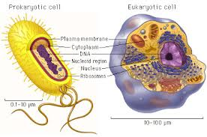
Chapter 7 Section 1
Life is Cellular
Essential Question:
  How would you characterize prokaryotic cells and eukaryotic cells?

Slide 3
The Discovery of Cells
mid 1600’s 1st time microscope used
Robert Hooke
  1665 used early light microscope
  looked at thin slice of cork → cells seen for 1st time

Slide 4
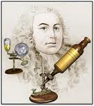
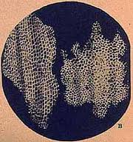
Robert Hooke
named what he saw “cells”

Slide 5
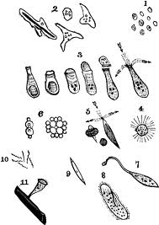
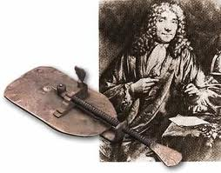
Anton van Leeuwenhoek
looked at pond water under single lens microscope
“animalcules”

Slide 6
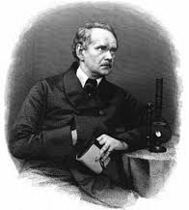
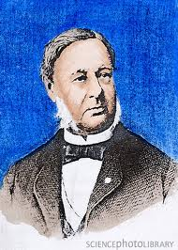
Studying cells in 1830’s
Mathias Schleiden
Theodor Schwann
“All plants are made of cells”.
“All animals are made of cells”

Slide 7
The CELL THEORY
I. All living things are composed of cells.
II. Cells are the basic unit of structure & function in living things.
III. New cells are made from existing cells.

Slide 8
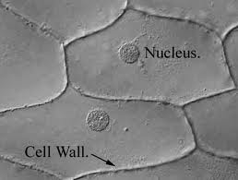
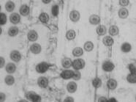
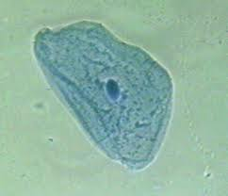
Light Microscope

Slide 9
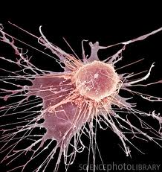
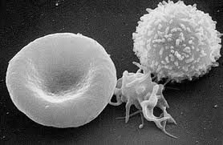
Scanning Electron Microscope (SEM)

Slide 10
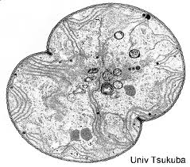
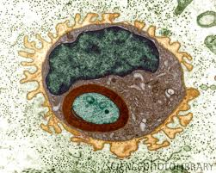
Transmission Electron Microscope (TEM)

Slide 11
Prokaryotic Cells
earliest cells on Earth
small (0.2 microns – 5 microns)
reproduce asexually
not complex
  no nucleus (DNA in loop in cytoplasm)
  no membrane-bound organelles
Bacteria
  2 Domains: Bacteria, Archaea

Slide 12
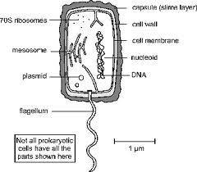
Prokaryotic Cell

Slide 13
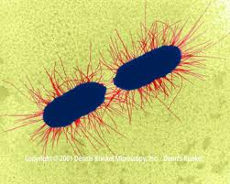
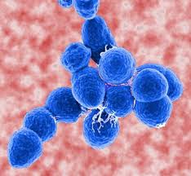
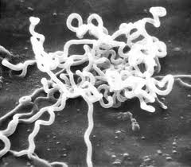

Slide 14
Eukaryotic Cells
larger
  2 – 100 microns
more complex
(+) nucleus
(+) membrane-bound organelles
form unicellular or multicellular organisms
examples: plants ,animals, protists, & fungi

Slide 15
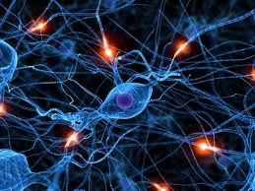
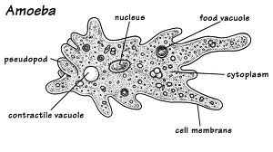
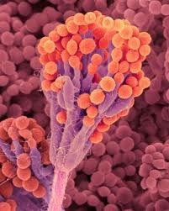
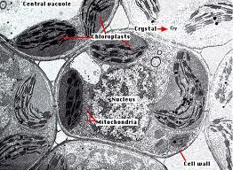
Eukaryotic Cells

