Slide 1
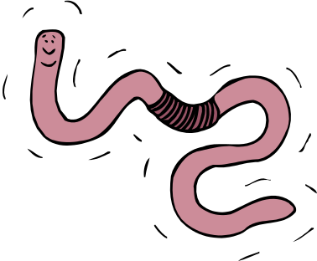
Earthworm Behavior Lab!!
Biology

Slide 2

Knowledge of Earthworms:
What do you guys already know about worms????

Slide 3

Video clip
Things to think about:
  What are worms instinctive behaviors?
  How do worms eat?
  Where do they reside?
  Are they predators or prey?
http://dsc.discovery.com/videos/planet-earth-caves-glow-worms.html

Slide 4

General Info.
Kingdom:
  Animalia
Phylum:
  Annelida
  Segmented Bodies
Phylum Members:
  Leech
  Peacock Worm
  Pompeii Worm
  Many others!!

Slide 5
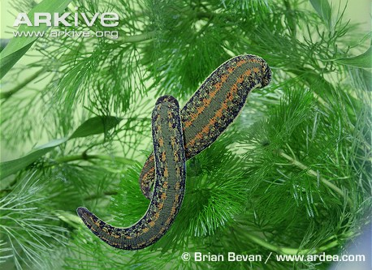

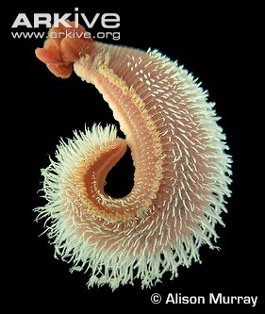

Slide 6
Lab Activity:
You and your lab group will be observing the behaviors of worms under strict circumstances.
You MUST treat the worms with care!!

Slide 7
Lab cont.
Materials Needed:
  1worm
  Paper towels
  1 plate
  Q-tips
  Light source
  Ruler

Slide 8


Different Observations:
General Movement:
Anatomical:
Observe worms response to:
  Being flipped over
  Running into object
    Hit plate into wall
    Place index card in front
      of worm
Observe:
  Which side is more active
  Label parts of worm
  Length

Slide 9

Observations Continued
Response to Touch
Response to Odor
Observe:
  Dry or Moist Paper Towel
8 total trials
Observe:
  Response to vinegar
  Both anterior and posterior
4 total trials
DO NOT TOUCH WORM WITH VINEGAR!!!

Slide 10


Observations Continued
Response to Light:
Response to Gravity:
You will develop YOUR OWN experiment!
Testing whether worms can sense light or dark
Tilt plate to observe earthworms response.
DO NOT DROP PLATE!

Slide 11



HAVE FUN
BUT BE SMART!

