Slide 1
Jeopardy
Scientific
Method
Life's
Classification 1
Life's
Classification 2
Life's
Classification 3
Life's
Classification 4
$100
$100
$100
$100
$100
$200
$200
$200
$200
$200
$300
$300
$300
$300
$300
$400
$400
$400
$400
$400
$500
$500
$500
$500
$500
Final Jeopardy

Slide 2
1 - $100
Is a personal view a fact or an opinion?
A personal view is an opinion.

Slide 3
1 - $200
A scientist who works in the field of biology would most like study...
A scientist who works in the field of biology would most likely study animals.

Slide 4
1 - $300
An explanation based on many observations and investigations is called...
An explanation based on many observations and investigations is called scientific theory.

Slide 5
1 - $400
A rule that describes a pattern in nature is a...
A rule that describes a pattern in nature is a scientific law.

Slide 6
1 - $500
Which step of the scientific inquiry would most likely occur first during an investigation?
The step of the scientific inquiry that would most likely occur first during an investigation would be asking a question.

Slide 7
2 - $100
Which of the following characteristics is shared by all living things?
-reproduction -moving around -eating other organisms
The characteristic that is shared by all living things is reproduction.

Slide 8
2 - $200
What do living things use for energy?
Living things use food for energy.

Slide 9
2 - $300
Binomial nomenclature is used for what?
Binomial nomenclature is used for naming organisms.

Slide 10
2 - $400
Which organisms typically reproduce asexually?
Bacteria is the organism that typically reproduce asexually.

Slide 11
2 - $500
What uses questions that have two answer choices to identify living things?
The dichotomous key uses questions that have two answer choices to identify living things.

Slide 12
3 - $100
What is a specific environment where an organism lives?
A specific environment where an organism lives is called a habitat.

Slide 13
3 - $200
___________consist of lipids, carbohydrates, proteins, and nucleic acids.
Macromolecules consist of lipids, carbohydrates, proteins, and nucleic acids.

Slide 14
3 - $300
_________is an organism that converts light energy into usable energy.
Autotroph is an organism that converts light energy into usable energy.

Slide 15
3 - $400
___________is an organism that obtains energy from other organisms.
Heterotroph is an organism that obtains energy from other organisms.

Slide 16
3 - $500
_________ is a group of organisms.
Taxon is a group of organisms.

Slide 17
4 - $100
_________ is an aid to identification.
A key is an aid to identification.

Slide 18
4 - $200
______ means without an equal, distinctive.
Unique means without an equal, distinctive.

Slide 19
4 - $300
What is the liquid part of a cell inside the cell membrane?
The cytoplasm is the liquid part of a cell inside the cell membrane.

Slide 20
4 - $400
___________is a type of cell that has a nucleus and other membrane-bound organelles.
Eukaryotic Cell is a type of cell that has a nucleus and other membrane-bound organelles.

Slide 21
4 - $500
_________type of cell that has no nucleus or other membrane-bound organelles.
Prokaryotic Cell is a type of cell that has no nucleus or other membrane-bound organelles.

Slide 22
5 - $100
_______is a particle consisting of RNA and proteins found in the cytoplasm.
Ribosome is a particle consisting of RNA and proteins found in the cytoplasm.

Slide 23
5 - $200
_______is an organelle that breaks down food and releases energy.
Mitochondrion is an organelle that breaks down food and releases energy.

Slide 24
5 - $300
Plants, algae, and many bacteria make their own food through the process of ____________.
Plants, algae, and many bacteria make their own food through the process of photosynthesis.

Slide 25
5 - $400
What is the first word in a two-word name of an organism? (example: Pisaster Ochraceus)
The first word in a two-word name of an organism is called a genus.

Slide 26
5 - $500
Where is the hereditary material located in the eukaryotic cell?
In the eukaryotic cell, the hereditary material is located in the cell membrane.

Slide 27
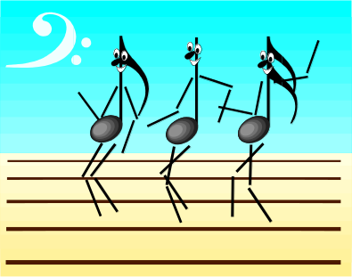
Final Jeopardy
How do multicellular organisms grow?
Multicellular organisms grow by making more cells.

