Slide 1
Reproduction, Growth and Development
9.1

Slide 2
Learning Targets
I can compare and contrast asexual reproduction and sexual reproduction
I can describe the process of reproduction and development as it happens in different animals
I can define DNA, trait, and diversity

Slide 3
Asexual Reproduction
Asexual
Genetically identical offspring
One
parent
Mitosis is one form

Slide 4
sexual Reproduction
Sexual
Diversity among offspring
Two
parents
Meiosis is required

Slide 5
Where does life come from?
Explain in your own words where life comes from: ____________________________________________________________________________________________________________________________________________________________________________________________________________________________________________________________________________________________________________
How do you know this to be true? ______________________________________________________________________________________________________________________________________________________

Slide 6
Spontaneous Generation n
The idea that living things could come from non-living things
Centuries ago, when people saw flies come out of rotten meat, they believed that rotten meat produces flies
When they saw frogs hop out of muddy ponds, they thought mud made frogs
Italian scientist Francesco Redi conducted an experiment to prove spontaneous generation does not happen (pg. 190)

Slide 7
DNA
Cells store information in the form of a chemical called DNA
DNA stores information in a pattern of chemicals
The pattern in DNA provides info for making a new cell/organism
The new cell/organism will have the traits, or characteristics, of the original
Each organism has its own unique DNA
  Human DNA makes humans, frog DNA makes frogs, etc

Slide 8
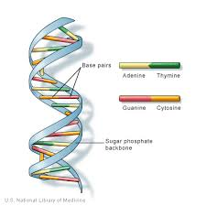
DNA Model
http://www.wikihow.com/Make-a-Model-of-DNA-Using-Common-Materials

Slide 9
DNA and reproduction
Bacteria can reproduce asexually, which involves only one parent
The parent passes copies of all of its DNA on to its identical offspring
Plants and animals reproduce sexually, which needs two parents
The DNA is not an exact copy of one parent, but rather a combination of both parent’s DNA

Slide 10
The advantage of diversity
Plant and animals produce unique offspring (due to the combination of both parent’s DNA)
Unique offspring are said to have diversity
Diversity is the range of differences among the individuals
Diversity can help a species population continue to survive
If a species is diverse, then it will also be able to adapt (a result of DNA info passed on)

Slide 11
Vocabulary
DNA
Trait
Diversity
Self Check Questions pg. 192
COMPLETE SENTENCES

Slide 12
How do organisms reproduce?
9.2

Slide 13
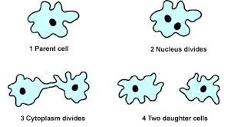
Asexual Reproduction
One parent passes an exact copy of their DNA on
The offspring are identical to the parent
Cells will divide to form two identical cells

Slide 14
What reproduces asexually?
Bacteria
Yeast
Protist
Fungi
Some Plants
Some Animals
  Many cells in our bodies reproduce asexually
    Skin Cells
    Bone Cells
    Muscle Cells

Slide 15
Pros and Cons
Pros of Asexual Reproduction
  An organism can reproduce alone, does not need a mate
  Time; asexual reproduction happens very quickly
Cons of Asexual Reproduction
  The offspring are exact copies of the parent
  The offspring lack diversity and the ability to adapt
  Organisms need an environment that does not change much

Slide 16
Mitosis
Mitosis is the dividing of the cell’s nucleus and occurs right before the cell divides into two
Before mitosis, the cell makes a copy of the DNA in the nucleus
DNA is the rod-shaped structures called chromosomes
When the DNA is copied, the chromosomes form pairs (pg. 194)

Slide 17
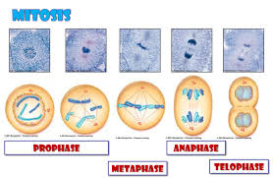
Image of Mitosis

Slide 18
Sexual reproduction
Two parents
A cell from one parent joins with a cell from the other parent
Pros: Leads to greater diversity and adaptation
Cons: An organism must find a mate to reproduce
Takes longer to produce offspring

Slide 19
What’s involved in sexual reproduction?
Involves both male and female parent
  Female produces the egg cells
  Male produces the sperm cells
Sperm and egg cells are called sex cells, or Gametes
Gametes usually contain half the number of chromosomes than non-sex cells of the organism
  For example: human gametes have 23 chromosomes, while human body cells have 46

Slide 20
Meiosis
The nucleus divides to form the gametes; this process is called meiosis
Meiosis begins after the chromosomes have been copied
A nucleus forms around paired up chromosomes and then and divides to make 2 new cells
Next, each new cell divides again to make 4 sex cells

Slide 21
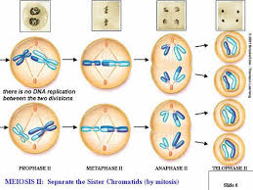
Image of Meiosis

Slide 22
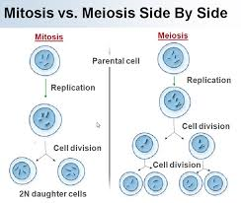

Slide 23
Fertilization
The process by which a sperm cell and an egg cell join to form one cell
This new cell, called a zygote, then begins to develop into a new organism
2 types of fertilization:
  External – the egg is fertilized outside the female body
  Internal – the egg is fertilized inside the female body

Slide 24
Vocabulary
Chromosome
Mitosis
Gamete
Meiosis
Self Check Questions pg. 197
COMPLETE SENTENCES

Slide 25
How do animals grow and develop?
9.3

Slide 26
Zygote to Embryo
A new animal begins as a zygote, a single cell that contains a complete set of chromosomes
The zygote divides to form two identical cells that are attached to each other
Then those two cells divide, then divide again…
This process is repeated many times
Eventually, the zygote divides into millions of cells that make up an embryo

Slide 27
Differentiation
An embryo’s cells gradually take on different shapes and functions
Each cell will have a specific job and function
The cells will start to form the eyes, mouth, heart, stomach, etc.

Slide 28
Development
For most animals, embryos develop in eggs
Some species lay thousands of eggs at one time (fish), which increases the chances of survival
While other species will lay fewer eggs at a time (turtles, snakes, etc.)

Slide 29
Mammal Offspring
Mammals produce very few offspring at one time
Most mammals take care of their young for long periods of time, unlike other animals who abandon their young
Taking care of offspring helps protect them from danger and increases their chance of survival
Survival is the key to ensure your species carries on

Slide 30
Gestation
Different mammals have different gestation times
Gestation time depends on the size of the animal
Gestation time is the period of time from fertilization of an egg until birth occurs
In general, the larger the mammal, the longer the gestation period

Slide 31
Vocabulary
Cell Differentiation
Gestation time
Self Check Questions pg. 202
COMPLETE SENTENCES

