Slide 1
Biology 10
Chapter 19-2
p546-552
“Patterns and Processes of Evolution”

Slide 2
Objectives
Be able to identify processes that influence whether species and clades survive or become extinct.
Describe what gradualism and punctuated equilibrium mean.
Give examples of adaptive radiation, convergent evolution, and coevolution

Slide 3
Speciation and Extinction
macroevolutionary patterns: transformations in anatomy, phylogeny, ecology and behavior that take place in clades larger than a single species
includes speciation, and extinction

Slide 4
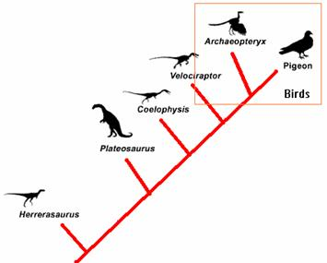
Macroevolution and Cladistics
Fossil evidence is used to classify organisms into clades
A cladogram does NOT imply that one species was a direct ancestor to another
It instead shows how species branch off from common ancestors

Slide 5
Adaptation and Extinction
Clades produce new species under pressure from their environments
Other species in the clade go extinct as a result of this pressure
If the rate of speciation is greater than the rate of extinction, then the clade survives.
Conversely, if the rate of extinction is greater than the rate of speciation, the clade will eventually go extinct.

Slide 6
Patterns of Extinction
Species are going extinct all the time as they struggle to survive
This level of extinction is called “background extinction”
Alternately, once in awhile drastic environmental changes cause MOST species to go extinct
  called a mass extinction event
  mass extinctions are usually caused when multiple environmental changes hit at once
  occasionally, a single event can cause a mass extinction (ex: asteroids and dinosaurs)
  While tragic, organisms that survive the mass extinction now have a golden opportunity to branch out quickly!

Slide 7
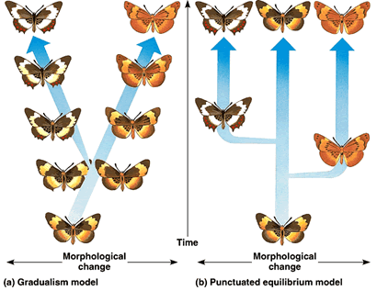
Rates of Evolution
Two main patterns
  gradualism: slow, steady rate of change
    how Darwin thought organisms evolved, which is correct for some species!
  punctuated equilibrium: organisms don’t change hardly at all for a long time, and then quickly change over a brief period
    also is evidenced in the fossil record!

Slide 8
Rapid Evolution After Equilibrium
Three situations where a species may evolve rapidly
  1) if a population becomes isolated from the main population
  2) if a population migrates to a new environment
  3) survivors of a mass extinction

Slide 9
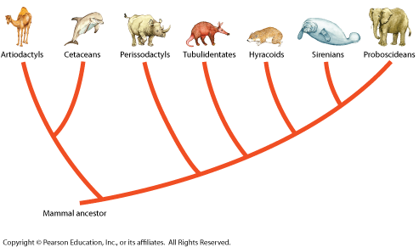
Adaptive Radiation
adaptive radiation: where a species or group of species evolves into several different forms that live in different ways
ex: mammalian evolution after the extinction of the dinosaurs.
ex 2: Galapagoes finches

Slide 10
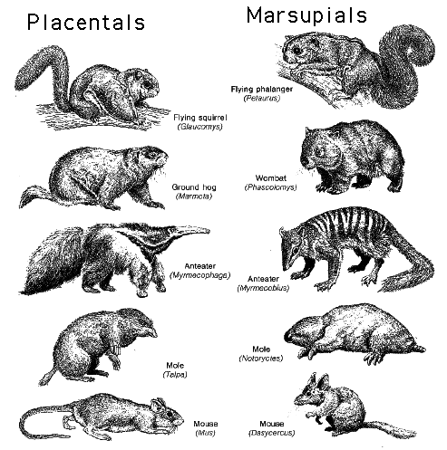
Convergent Evolution
convergent evolution: evolution of similar structures and characteristics in organisms that aren’t closely related
occurs as natural selection favors similar solutions to the same problem!
ex: marsupial vs placental mammals
ex 2: shark, dolphin

Slide 11
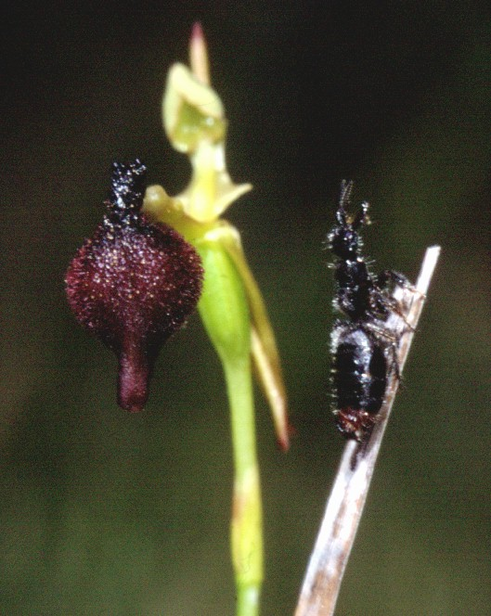
Coevolution
coevolution: the evolution of a species in response to another species
  ex: bats/moths
  ex 2: flowers/pollinators

