Slide 1
All Things Alternate

Slide 2
Todays Objectives
Review FAQs concerning “All Things Alternate”.
Clarify district justifications and submission.
Discuss state and district alternate assessment data.
Review ESSA Alternate Diploma Criteria.
Review standards-based IEP examples for students with significant cognitive disabilities.
Discuss student schedules/transcripts/credits and course codes.
Review the updated WV Rubric for Alternate Assessment Eligibility.
Notes:
Read each
Go back and mention that All Things Alternate FAQs are one of the attachments that was sent out on the listserv yesterday
Most of the time this afternoon will be spent on IEPs and Schedule updates

Slide 3
Frequently Asked Questions
Why are changes being made related to alternate standards, assessment, and diploma?
Do ninth through twelfth grade IEPs need to be rewritten to reflect all courses per student schedules?
Will IEPs for students with significant cognitive disabilities continue to address functional skills such as daily living and social skills?
Whose responsibility is it to inform schools and make changes to 9th grade schedules to be compliant with ESSA requirements pertaining to alternate diplomas?
Notes:
Why Changes-
Whose Responsibility-

Slide 4
FAQs Continued
Will there be performance descriptor levels (PDLs) included with the alternate standards as in the past?
When is it necessary to submit a justification to the WVDE pertaining to the 1% alternate assessment participation cap?
What is the difference between an improvement plan as required by ADA and a justification as required by the USDOE?
Is it a requirement for districts to complete the WV Alternate Assessment Eligibility Rubric for students taking the alternate assessment?
Notes:
Performance Descriptors-
Justification vs Improvement Plan-

Slide 5
District Justifications
Each district should have received updated participation data from Amber Stohr (astohr@k12.wv.us) .
Justifications must be submitted to WVDE by 12/15/17.
Email justifications as an attachment to Dawn Embrey-King dembreyking@k12.wv.us
Template location:
WVEIS 1) SPE 200 2) SE.forms
* see attached procedures for saving justifications

Slide 6
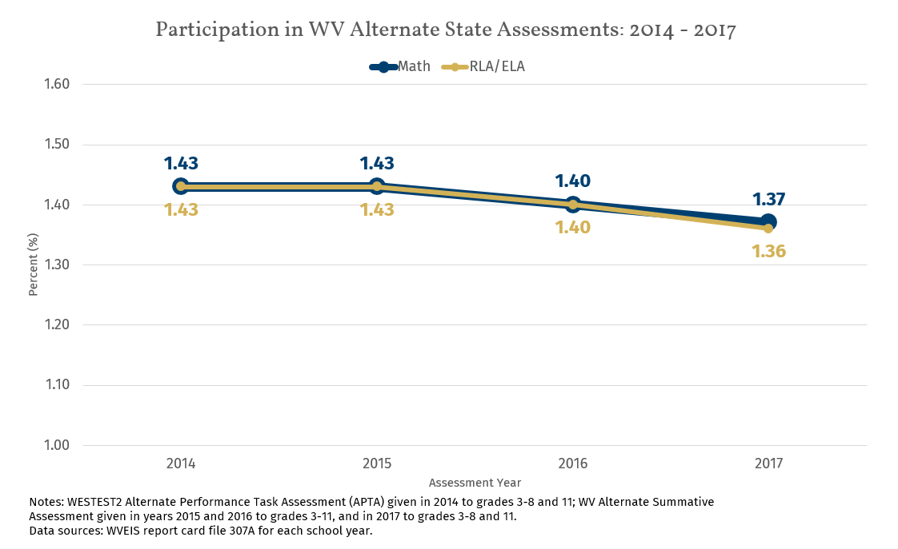
State and District Data
Notes:
Rates have been in a steady decline over past three years.

Slide 7
To reach 1.0% participation in the ASA:
Content Area | Current participation percent (%) | Current participation number (#) | Participation number (#) needed to reach 1.0%* | Change in participation number (+/-) to reach 1.0%*
Math | 1.37 | 1855 | 1358 | -497
ELA | 1.36 | 1853 | 1359 | -494
Science | 1.47 | 844 | 576 | -268
*Results for the participation number needed to reach 1.0% and the change in participation number to reach 1.0% are calculated with the assumption that the total number of students tested remain constant. Change in participation numbers are rounded to nearest whole number. Data source: WVEIS RPTCRD17
Notes:
Reducing participation by approximately 500 students in Math and ELA and close to 300 students for Science would allow WV to reach the state target of 1.0%.

Slide 8
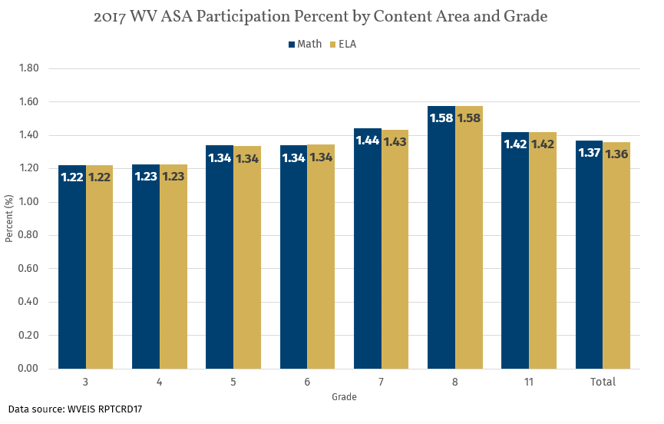
WV target = 1.0%
Notes:
Use data to see patterns, identify outliers, and ask the question “Why?”.
At 3rd grade, the first grade level assessed, the state is already over 1.0%. The peak participation percentage is seen in the 8th grade.

Slide 9
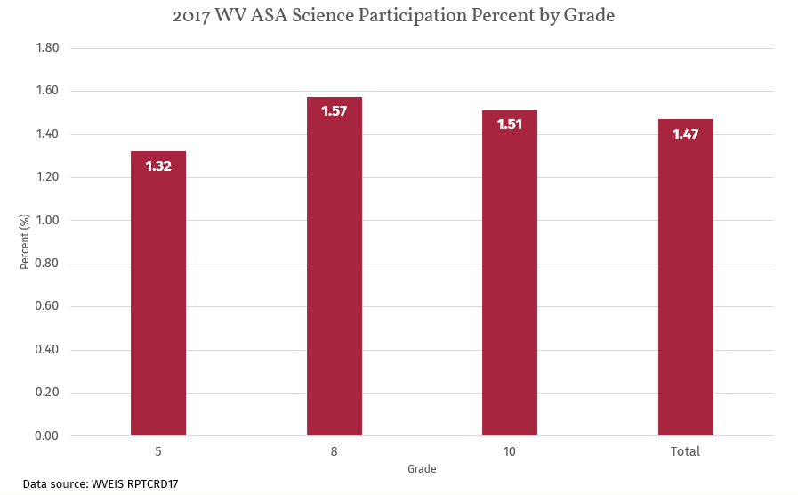
WV target = 1.0%
Notes:
Science, while testing fewer grade levels, follows the same pattern of participation as Math and ELA assessments.

Slide 10
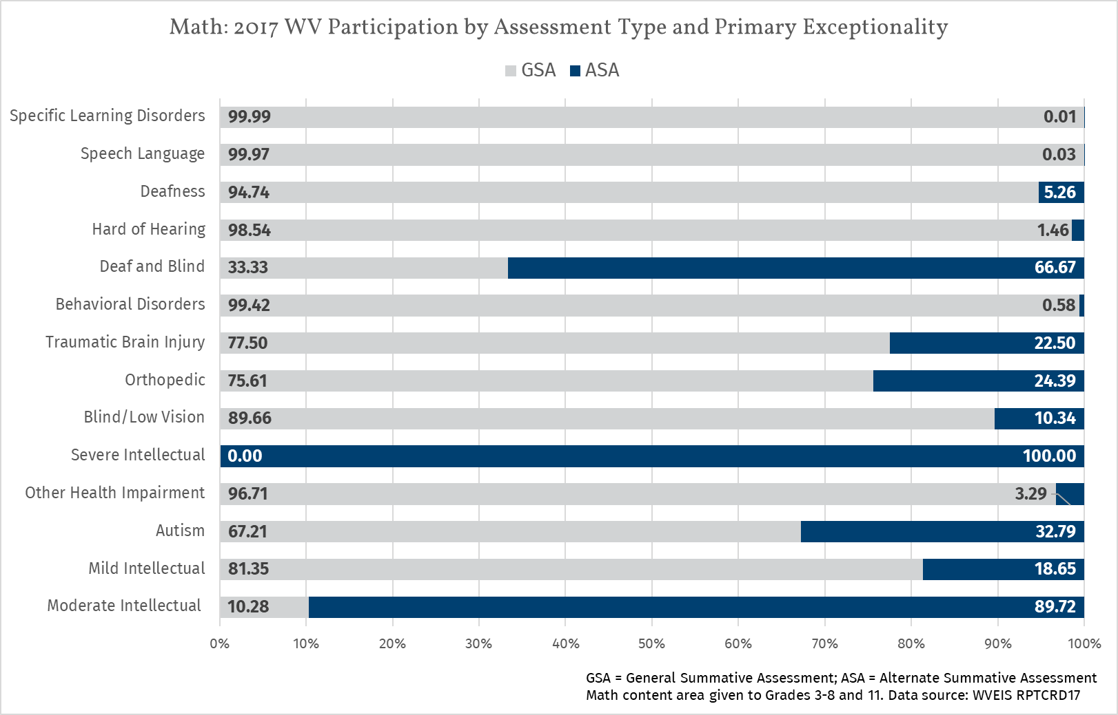
Notes:
Are the most appropriate primary exceptionality codes being used among those taking the ASA?
Over 30% of students identified with Autism participated in the ASA
Over 60% of students identified as deaf/blind participated in the ASA
Nearly 20% of students identified with Mild Intellectual Disability participated in the ASA
Close to 90% of students identified with Moderate Intellectual Disability participated in the ASA
100% of students identified with Severe Intellectual Disability participated in the ASA
Between 25% and 30% of students identified with an Orthopedic Disability participated in the ASA
Around 20% of students identified with Traumatic Brain Injury participated in the ASA

Slide 11
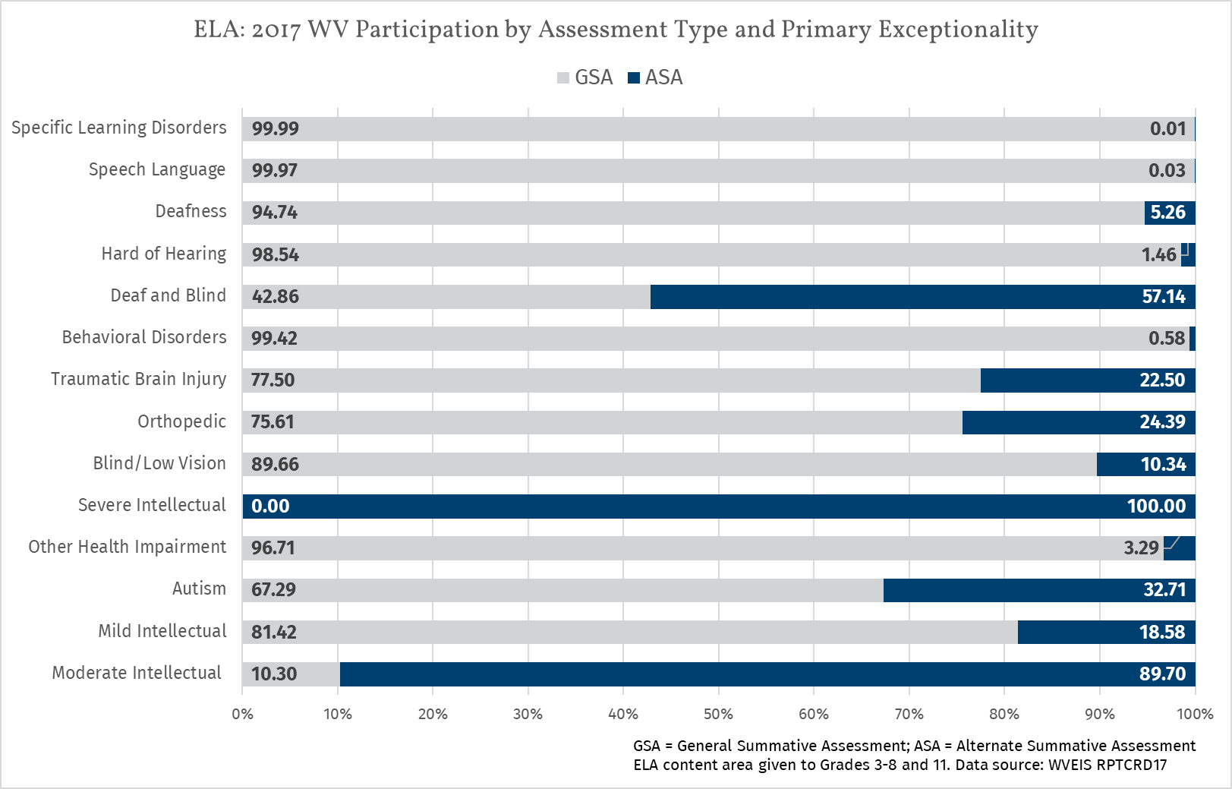
Notes:
Similar patterns as Math.

Slide 12
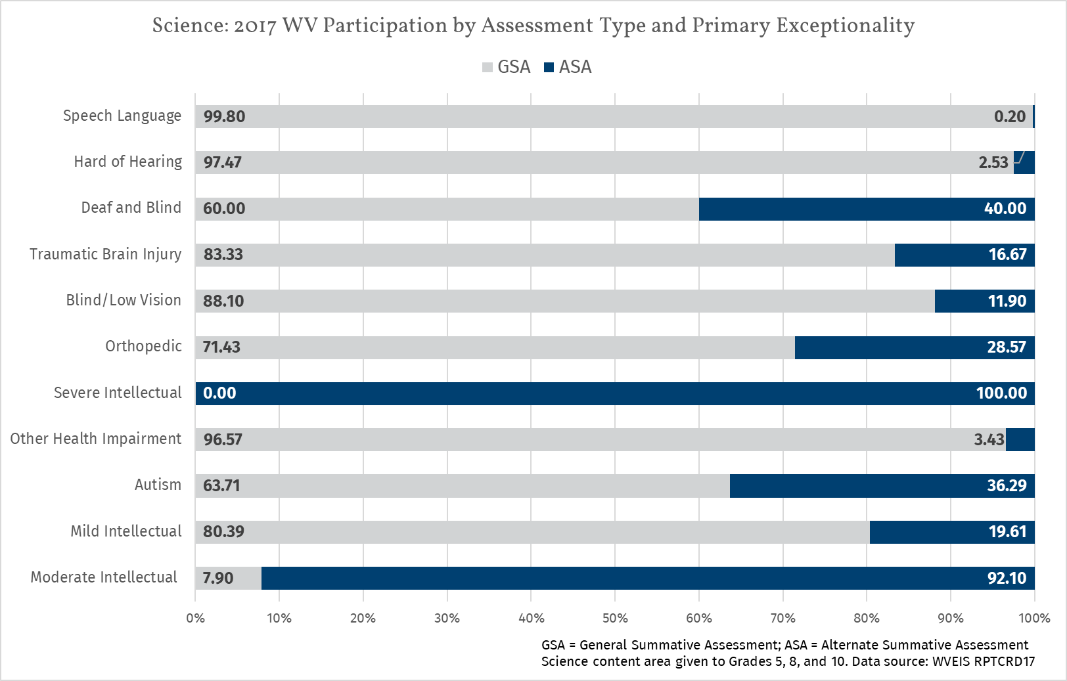
Notes:
Science participation, while testing fewer grade levels, follows similar patterns as math and ELA.

Slide 13
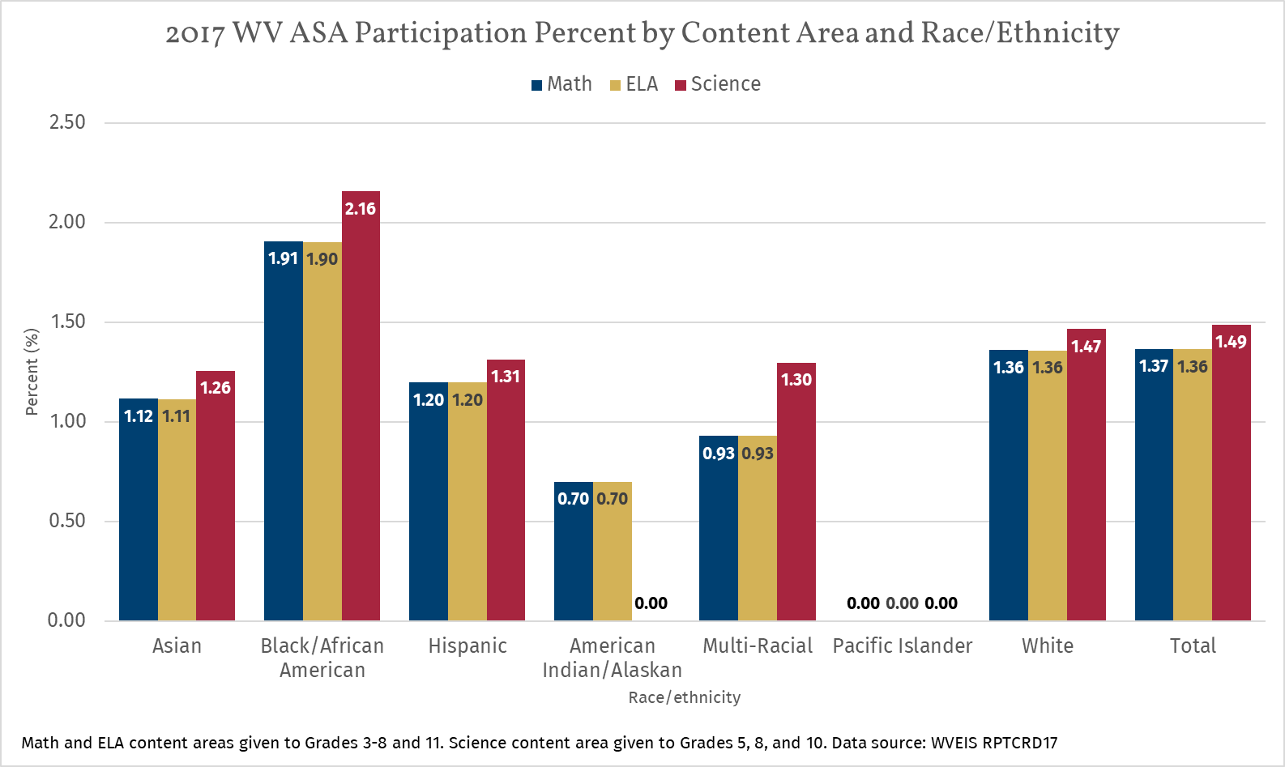
WV target = 1.0%
Notes:
Disproportionality among students identified as Black/African American.

Slide 14
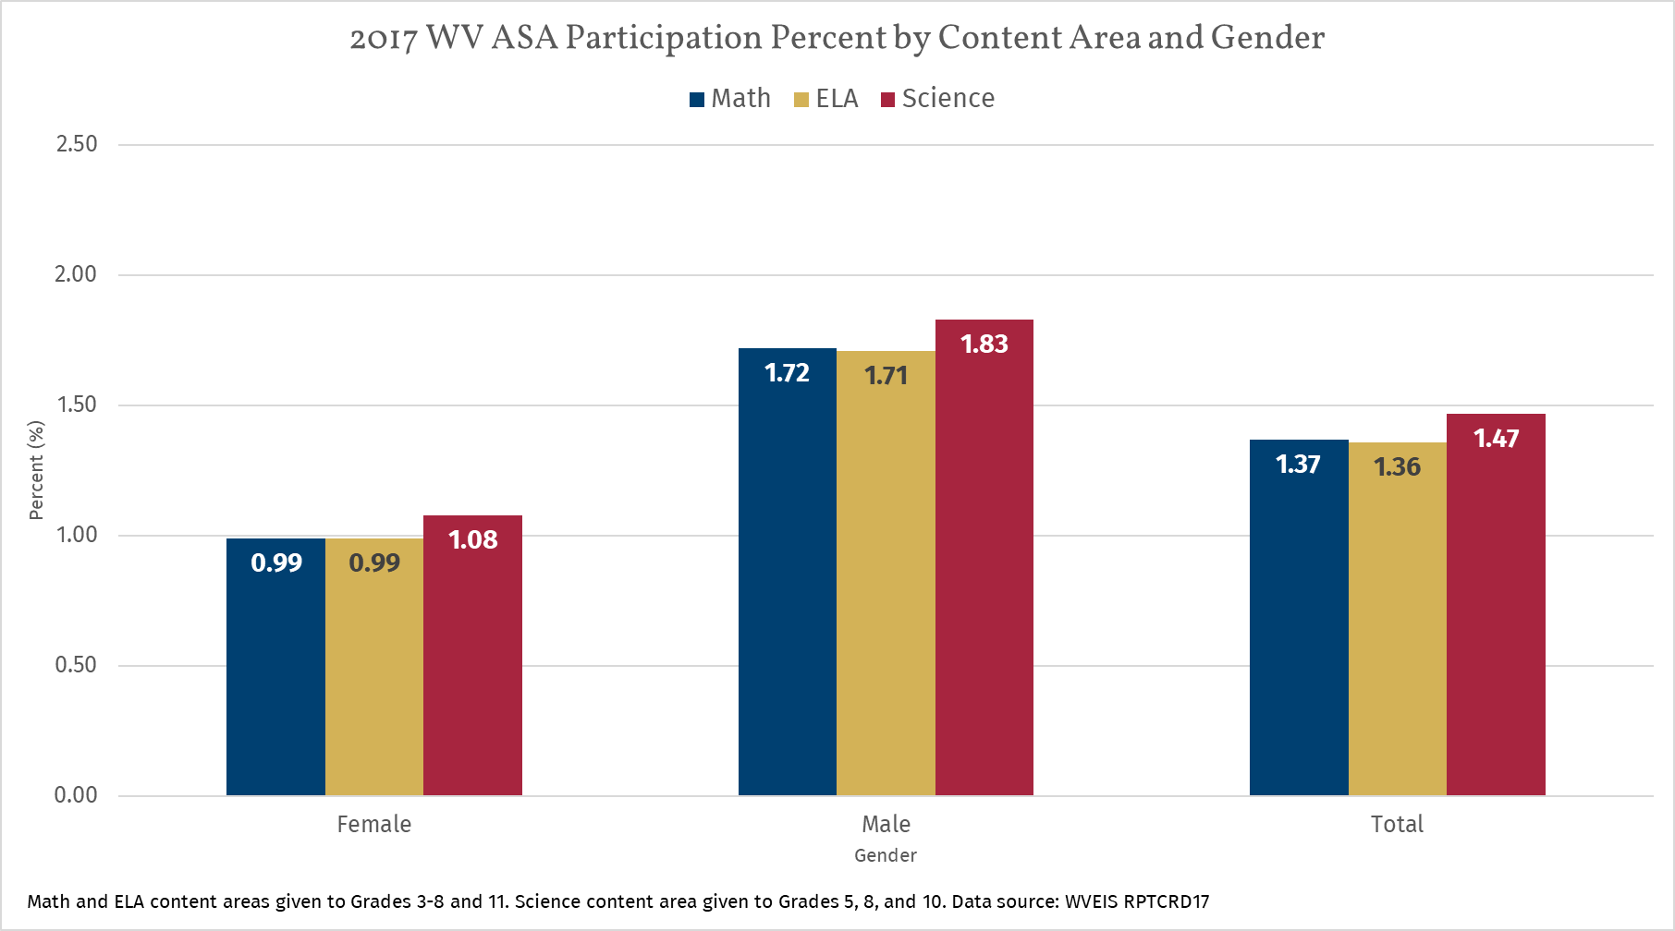
WV target = 1.0%
Notes:
Disproportionality among students identified as Male.

Slide 15
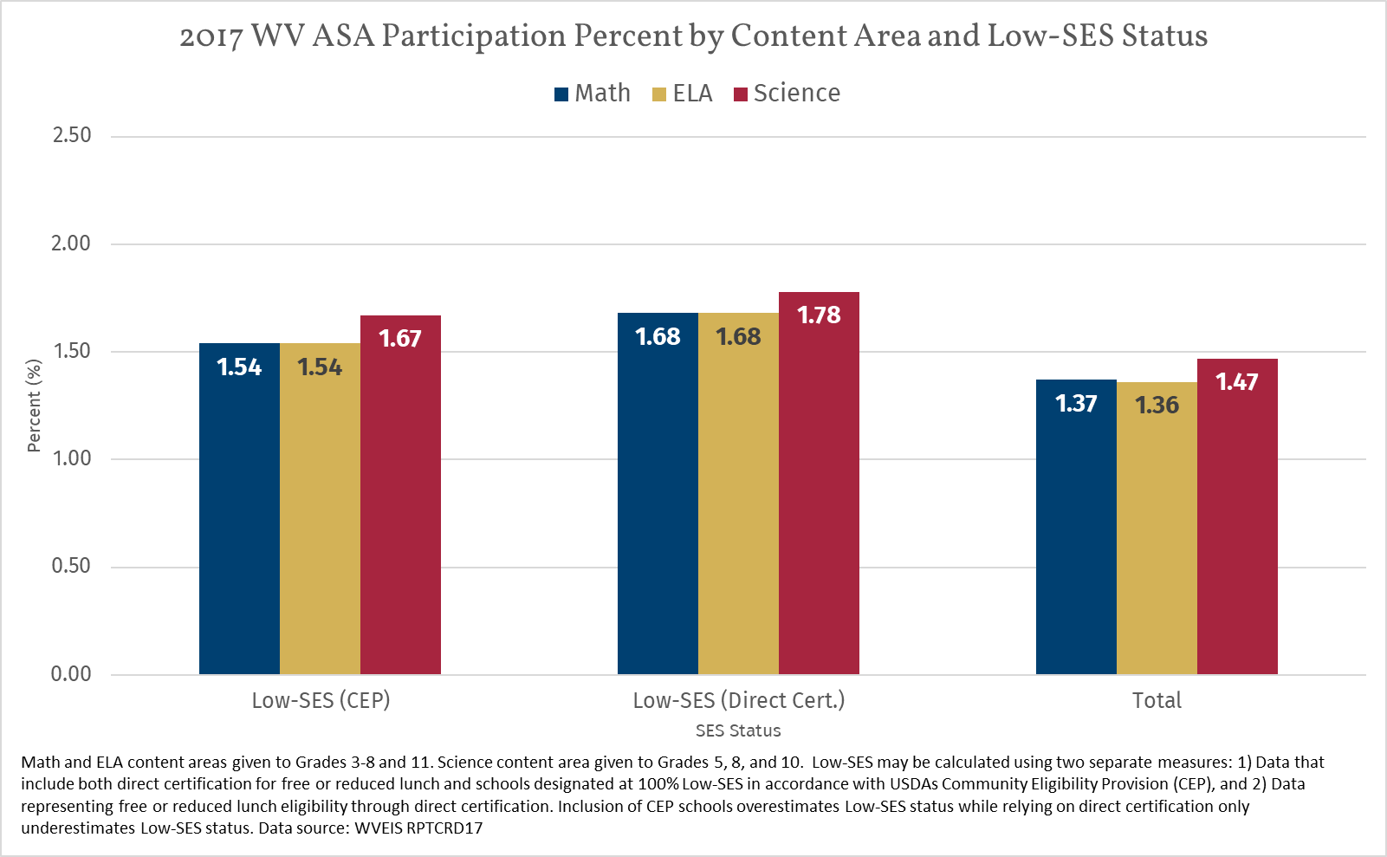
WV target = 1.0%
Notes:
Disproportionality among students identified as Low-SES (in both ways of measuring SES).

Slide 16
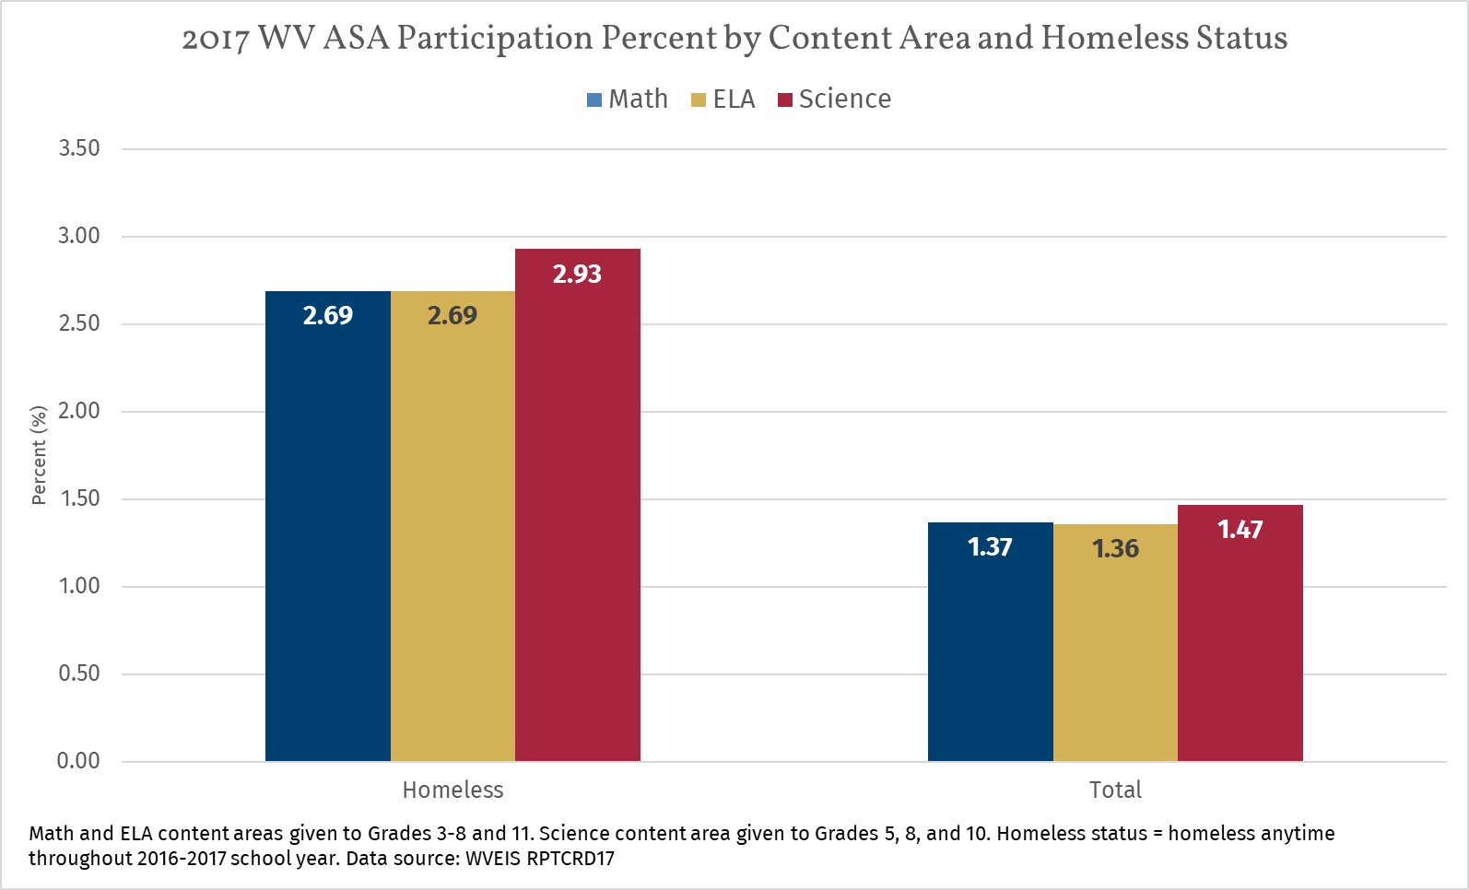
WV target = 1.0%
Notes:
Disproportionality among students identified as having homeless status at anytime throughout the school year.

Slide 17
Alternate Diploma Criteria
Be Standards-Based
Be Aligned with State Requirements for a Regular Diploma
Be Obtained During FAPE Period

Slide 18
Standards Based IEPs
Students with disabilities should have the opportunity to learn the same curriculum as their peers without disabilities, one that is “based on the State’s academic content standards” for the grade in which a student is enrolled (U.S. Department of Education 2015a).
WV Alternate Academic Achievement Standards (Policy 2520.16) provide alternate standards that are aligned to the WVCCR Standards.
A scaffolding document/Performance Level Descriptors (PLDs) will be available July 2018 as a companion document to support teachers in selecting appropriate alternate standards.
Notes:
Criteria #1
Standards Based IEPs must take THE STANDARDS INTO CONSIDERATION.
Grade level alternate standards (2520.16) should be utilized during the planning of an IEP.
Then, after taking the standards into consideration, goals and objectives are written
The scaffolding document will make it easier to look at a standards and identify where a particular student is on a continuum toward reaching that standard

Slide 19
Standards-Based IEPs
Entire courses are not expected to be taught. Instruction is provided based on appropriate alternate academic achievement standards.
Annual goals are developed to address the student’s needs in each content area, build on strengths and preferences, and promote learning in multiple state alternate standards for that content area.
IEPs do not address everything that is taught to a student. Therefore, specific content/courses are addressed, but individual goals and objectives do not have to be written for each subject.
Notes:
Students are receiving an alternate diploma, therefore the entirety of a course is not required to be taught. Schedules need to reflect the courses to assure that standards from each content area are being addressed. Credits are being “earned”, but ESSA explicitly says that the requirements could/would be different for students receiving instruction on alternate standards, graduating with an alternate diploma.
Annual goals and objectives are written to address each academic area.
An IEP does not address every single thing that is taught to a student.
Therefore, goals and objectives do not need to be written for every subject area. BUT THROUGHOUT THE IEP DOCUMENT CONTENT IS MENTIONED
IEPs spell out the support that is necessary for a student to make progress towards grade-level standards (alternate standards)

Slide 20
Present Level of Academic Achievement and Functional Performance
General Information- Background information
Evaluation Information:
Intelligence testing- verbal comprehension 52, perceptual reasoning 54, working memory 62, processing speed 75, Full Scale 50
Achievement testing- reading 61, math 55, written language 58
Adaptive Assessment- social, conceptual, practical
Notes:
This information is supporting the LATER DECISION as to whether the student needs instruction on alternate standards and is eligible for the Alternate Assessment.

Slide 21
PLEP Statements
Grade Level Expectation- Grade 9
Present Level (cognitive) ELA, Math, SS, Science
Areas of strengths
Areas of weaknesses
Present Level (adaptive) Social, Conceptual, Practical
Areas of strengths
Areas of weaknesses
Notes:
Grade level expectation IS ALWAYS the grade that the student is currently in- not the students functioning level
Present level should address both cognitive and adaptive strengths and weaknesses

Slide 22
Impact Statement
Due to Sam’s cognitive deficits in reading and comprehension, Sam requires ______________ in English, Social Studies, and Science. His cognitive deficits impedes his ability to _______________.
Due to Sam’s social, practical and conceptual deficits, Sam would benefit from ______________________. His adaptive deficits impact his ability to maintain relationships, ________________________________.
Notes:
Again, notice that the impact statement is supporting decisions towards alternate vs WVCCR standards and assessment
The impact statement is one place, possibly the first place where all content areas are mentioned.
The mentioning of the content areas will continue through out the IEP document

Slide 23
Annual Goals/Objectives
Goals and objectives are written to address grade-level STANDARDS in all subjects.
For example-
An ELA goal that addresses comprehension will support science and social studies content.
So as part of comprehension goal- mention science and social studies.
Notes:
Goals and objectives are written to address STANDARDS
You are writing goals that are pointing towards the grade-level alternate standards in all subjects.
For example:
You could have a ELA goal that addresses comprehension that supports Science and Social Studies content.
So as part of the goal, mention other curricular areas (science, social studies)

Slide 24
.
A. Supplementary Aids, Services/Program Modifications | Location of services | Extent/Frequency | Initiation Date | Duration m/y
Have materials read out loud
Summarized texts
Picture Supports
Text to speech adaptations
B. Special Education Services | Location of Services | Extent/Frequency | Initiation Date m/d/y | Duration m/y
English 9 Alternate Standards | SEE
Math 1 Alternate Standards | SEE
World Studies Alternate Standards | SEE
Biology Alternate Standards | SEE
Daily Living Skills | SEE
Vocational Skills | SEE
Social Skills | SEE
C. Related Services | Location of Services | Extent/Frequency | Initiation Date m/d/y | Duration m/y
Notes:
Here is one example of a service page for a student with a significant cognitive disability.
In this example each subject area is listed with the notation that the student is receiving instruction based on alternate standards
Notice too that daily living, vocational, and social skills are also listed because if the student has a SCD, then there are deficits in these areas as well
If not deficits in these areas- no SCD = No alternate standards/ alternate assessment

Slide 25
.
A. Supplementary Aids, Services/Program Modifications | Location of Services | Extent/ Frequency | Initiation Date | Duration m/y
Have materials read out loud
Summarized texts
Picture Supports
Text to Speech adaptations
B. Special Education Services | Location of Services | Extent/Frequency | Initiation Date m/d/y | Duration m/y
Functional Academics ( ELA 9, Math I, Biology, World Studies) | SEE
Daily Living Skills | SEE
Vocational Skills | SEE
Social Skills | SEE
C. Related Services | Location of Services | Extent/Frequency | Initiation Date m/d/y | Duration m/y
Notes:
Second option is to go ahead and list Functional Academics and then put the course names in parenthesis
Just make sure that the service page mirrors the student’s schedule/transcript

Slide 26
INDIVIDUALIZED EDUCATION PROGRAM
_______________County Schools
Student’s Full Name ________________ Date___________________
PART X: PLACEMENT– Ages 6-21
Explain the extent, if any, to which the student WILL NOT participate in the general education classroom and/or extracurricular and other non-academic activities. Present levels of academic achievement and functional performance must explain why full participation is not possible.
English 9, Math I, Biology, World Studies, PE, Health, Art
Notes:
Here is where you list the exact course names that would match the student’s schedule
Again, entire courses are not taught.

Slide 27
Student Schedules and Transcripts
The second federal requirement for State-defined alternate diplomas to count toward ACGR for Title 1 accountability is that they must be aligned with State requirements for regular diplomas.
The number of required courses (credits) in required content areas should be aligned across diploma options.
Notes:
Criteria #2

Slide 28
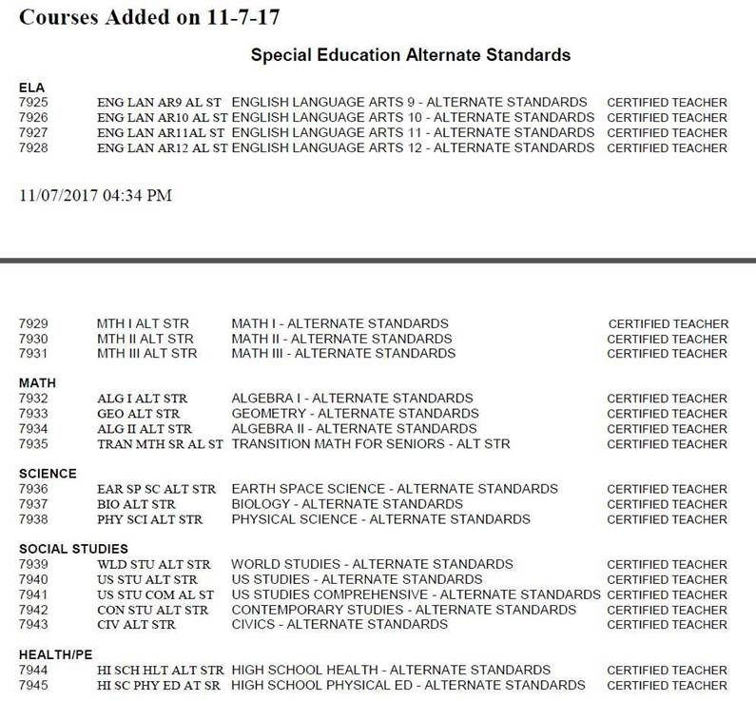
Alternate Course Codes

Slide 29
Year | 2017-2018 | 2018-2019 | 2019-2020 | 2020-2021
Diploma Type | Modified Diploma | Modified Diploma | Modified Diploma | Alternate Diploma
Academic Standards | Current Standards 9th graders- updated IEPs and Schedules | New Standards Policy 2520.16 Alternate Academic Achievement Standards | New Standards Policy 2520.16 Alternate Academic Achievement Standards | New Standards Policy 2520.16 Alternate Academic Achievement Standards
Alternate Assessment | Current Alternate Summative Assessment | Current Alternate Summative Assessment | Current Alternate Summative Assessment | New Alternate Summative Assessment

Slide 30
So what has to be done?
Pull each 9th grade alternate assessment IEP.
Update IEP to reflect appropriate support for grade level alternate standards in each subject (English, Math, Social Studies, Science).
Include each subject area on the service page (2 options).
On the placement page, list the subjects in which the student WILL NOT participate in the general education classroom and/or extracurricular and other non-academic activities.
Update 9th grade schedules to reflect the same course names as general education schedules, utilizing the alternate course codes that have been provided.
Notes:
#2 SUPPORT for the standards is what is addressed in an IEP, not a list of every standard taught

Slide 31
WV Alternate Assessment Rubric Updates
Updates include:
Additional criteria information to include 3 or more standard deviations below the mean etc…
The addition of item involving students PLEP information
The addition of item involving the level of support and instruction and level of documentation in the evaluation portion of the student goals and objectives
The elimination of assistive technology item
A determination section
A signature section

Slide 32

Dawn Embrey-King
dembreyking@k12.wv.us
304-558-2696

