Slide 1
The Book Thief
By Markus Zusak

Slide 2
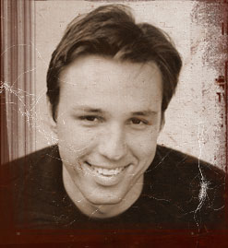
Markus Zusak’s background
Parents born during WWII –
He was born in Australia
Born in 1975 (yes, he is younger than your teacher), Zusak grew up hearing stories about
  Nazi Germany
  the bombing of Munich
  about Jews being marched through his mother’s small German town
Literary Success: Zusak has already asserted himself as one of today’s most innovative and poetic novelists. Zusak is the award-winning author of four previous books for young adults: The Underdog, Fighting Ruben Wolfe, Getting the Girl, and I Am the Messenger

Slide 3
Pre-reading Questions
Take two minutes to jot down your ideas for the following questions before you share with your group and as a class:
What does it take to be a survivor?
What are the specific attributes?

Slide 4

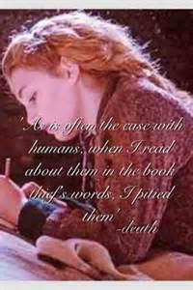
Concept of Death
Narrated by Death, who finds the story as he walks through Munich after it has been bombed
Death envisions War as the boss who asks for the impossible, making him (Death) work to the brink of exhaustion
Most would infer that Death and War work in conjunction with one another (the logical explanation); however, this is not the case
Throughout the novel, the discussion of dying comes to the forefront. This is a very apparent theme due to the fact the narrator is Death (who even experiences difficulties with the sheer amount of brutality)
World War II is also in the background, which denotes that death is all around Liesel
The source of all of Liesel's and Max's nightmares are the deaths of their family members

Slide 5
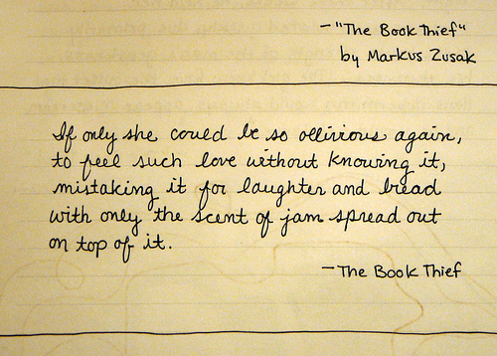
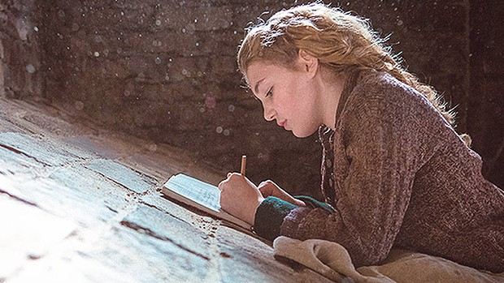
Protagonist of The Book Thief
Liesel Meminger is the book thief of the story who is a foster child growing up in Munich, Germany
The title of the book stems from her because she steals her first book, The Gravedigger’s Handbook, at the grave site of her brother

Slide 6
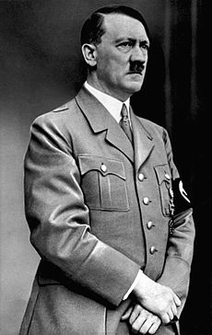
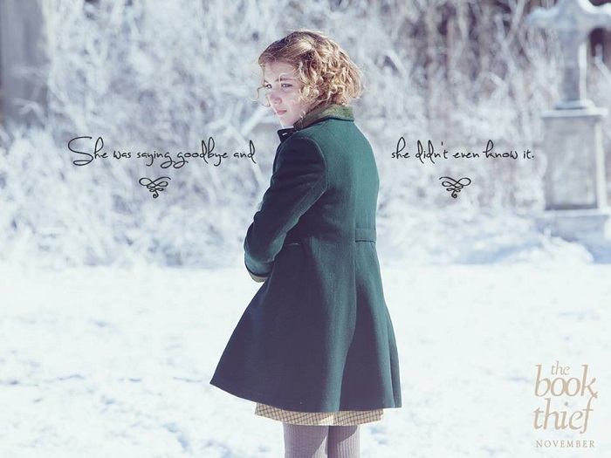
The Power of Words
May be used as a tool for hope or destruction
The story is about the power of words and how these can affect a nation and a person
Hitler uses words to assert power and wreak havoc, while Liesel uses words to cope with a difficult life
Liesel learns the value words – these enable her to have a voice and know how to read
She also realizes words are what hold the country under the power of Hitler and the Nazi party
As well as being the source of her strife, words in the form of literature also become her escape from her bleak life

Slide 7

Essential Information
Themes
Symbolism
Power of Words
Integrity
Fear
Stealing/Thievery
Books
Swastika
Mein Kampf
Accordion
Cigarettes
The Key
The Duden Dictionary

Slide 8
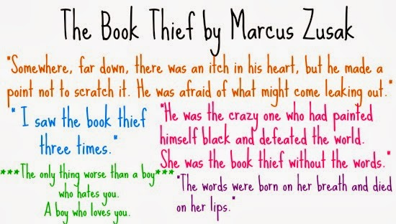
The Significance of Color
A reoccurring motif in Death’s narration of the story
Death associates color with the souls he collects
Death also values colors throughout the book as a means of expressing the scene
Colors are a means for escape from the horror of death, as well as a confirmation of it

