Slide 1
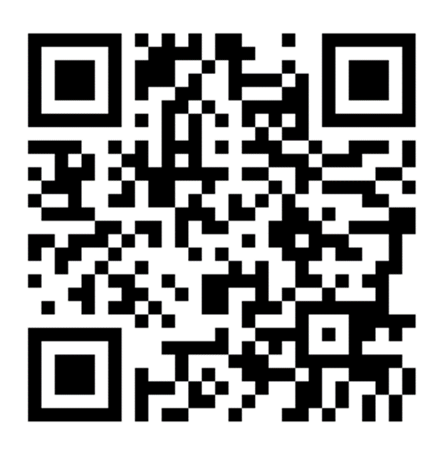
Executive Functioning Strategies
Anna Carlisle, Ed.S.
Mountain Brook Elementary School, AL
@mbecounselor
carlislea@mtnbrook.k12.al.us
https://tinyurl.com/m6x7ksc

Slide 2

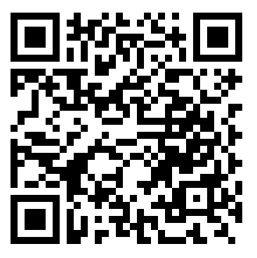
https://tinyurl.com/mphbn6n

Slide 3
Learning Objectives
Explain how executive functioning skills support student success
Identify symptoms of weakness in executive functioning skills
Strategize ways to support executive functioning development

Slide 4
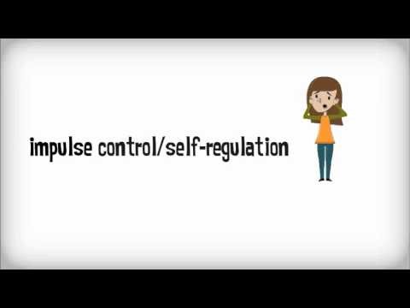

Slide 5

a diverse group of cognitive processes that act in a coordinated way to direct perception, emotion, thought and action
a set of cognitive abilities that control and regulate other abilities and behaviors and are necessary for goal-directed behavior

Slide 6


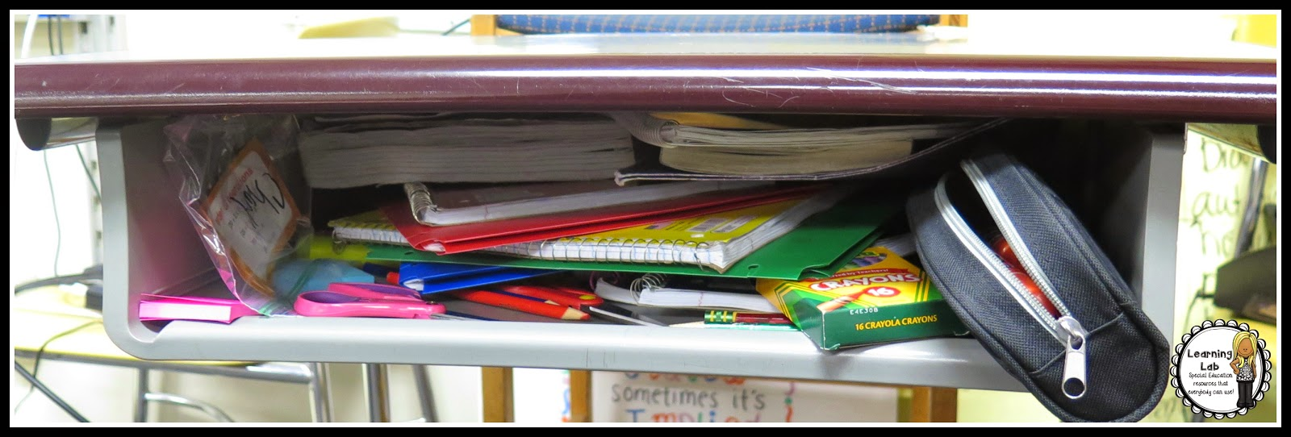
Emotional Control
Impulse Control
Self-Monitoring
Flexibility
Organization
Problem Solving
Working Memory
Metacognition
Planning/
Prioritizing
Task Initiation

Slide 7
Cognitive Processes and Executive Functioning
If we have some knowledge of how the brain works, we can better identify accommodations.

Slide 8

Top-Down Approaches
What is top-down processing?
  External strategies to calm emotions
Intentional, explicit instruction of top-down strategies can improve:
  Emotional Control
  Impulse Control
  Self-Monitoring

Slide 9
How are Top-Down Strategies Implemented?
Identify a strategy
Teach, Model, Practice, Repeat
Reduces arousal
Improves affect and motivation

Slide 10


Top-Down Examples
Progressive Muscle Relaxation
Breathing Exercises
Bubbles
Water

Slide 11

Bottom-Up Processes
Our brain’s natural ability to:
  Reduce sensory input
  Attend to a task
  Ignore distractions

Slide 12
Signs of Bottom-Up Deficits
Emotional/Impulse control
Inattention
Self-Monitoring
Working Memory
Planning

Slide 13
Get out your Math journal and homework folder.
I can’t find my journal!
What are we supposed to be getting?
Oh, look! Here’s my library book…

Slide 14
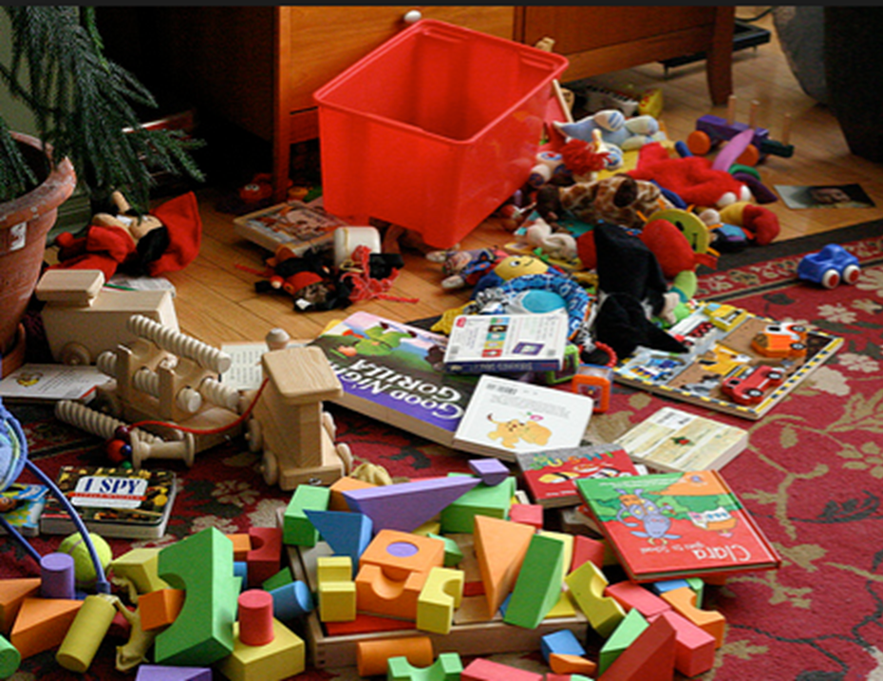

Slide 15



Slide 16
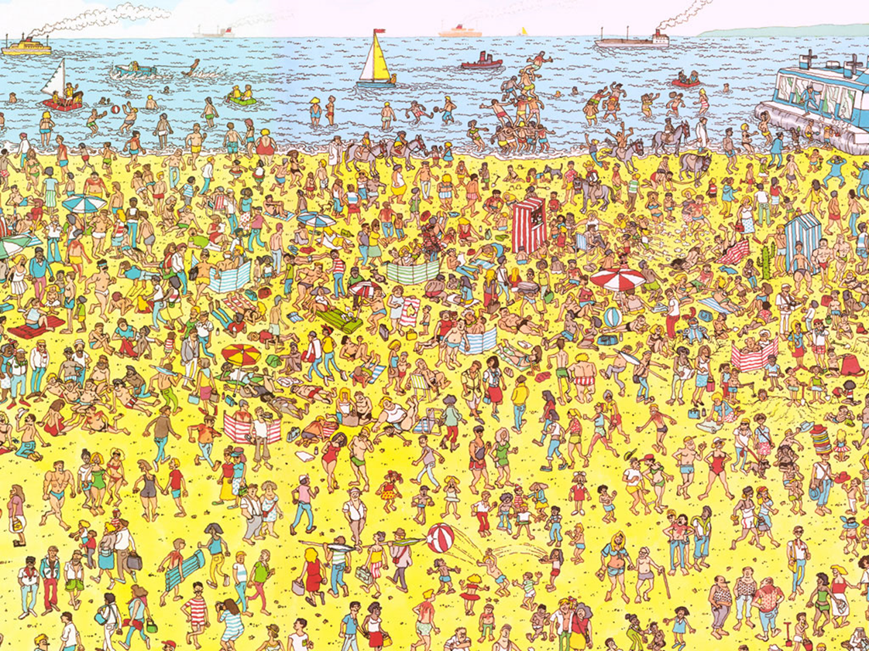

Slide 17
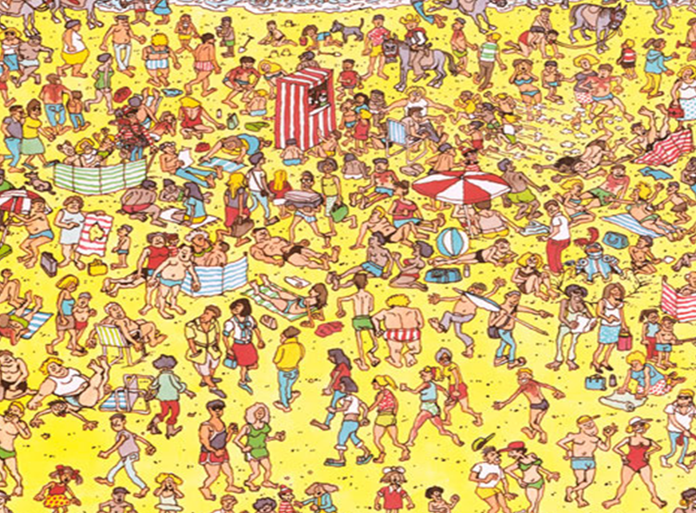

Slide 18
Environmental Accommodations
Remove distracting materials
Reduce visual stimuli
Larger font
Fewer items on a page
Reduce the number of problems
Provide a checklist
Use reminders

Slide 19
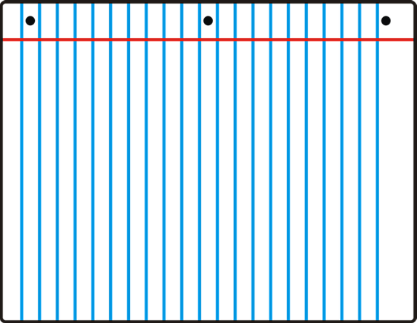
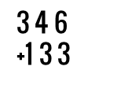
Environmental Accommodations to Improve Organization
Organize Materials
  3-ring binder
    Use dividers with labels
    Reinforced Paper
    3-hole punch all worksheets
    Writing materials
    Minimize!
Organize Actions
  Provide a list for:
    Class Routines
    Homework

Slide 20
Impulse Control Emotional Control
Planning Prioritizing
Task Initiation
Cue student randomly to identify if they are on task
Provide limited number of opportunities in a class for questions
Provide only enough support for success
Utilize rubrics to break down large assignments
SBI

Slide 21
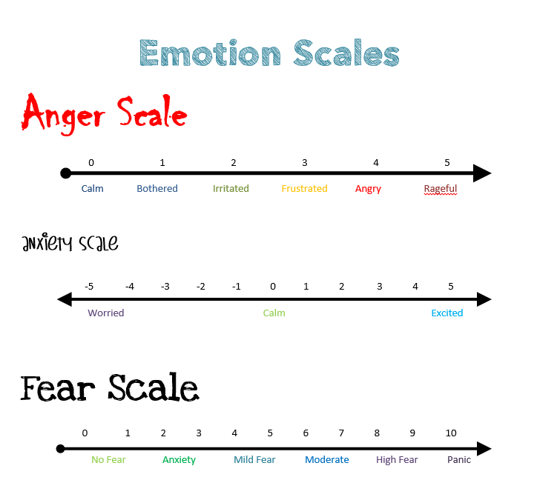
Objectives of SBI
Specific behavioral strategy
What was the feeling/goal?
Motivational level on a scale from 1 - 10?

Slide 22
Assumptions of SBI
Everybody is doing the best they can.
Behavior is not incomprehensible or random.
“Behavior follows patterns, which reveal themselves to the curious observer free of prejudice or blame or theory.”

Slide 23
SBI Strategies
"How exactly did you do that?"
"How did you know it was time to ____?"
"How long had you been thinking about ___?"
NOTE: We are asking "HOW?" not "WHY?"

Slide 24
SBI Strategies
Body double
Give one direction at a time
Utilize technology
Time timer
Random cues
Each designed to increase self-awareness

Slide 25
Right to Left
New to old information
Reduce
  Novelty
  Need for Flexibility
Ability to revise plans in the face of:
  Obstacles
  Set backs
  New information
  Mistakes
  Changing conditions
Notes:
Driving at 16 vs. driving now. The new information is no longer new and has become an automatic process.
Obstacles - traffic

Slide 26
Accommodations
  Advance familiarization/Pre-teaching
  Provide experiences in smaller structured setting
    Role play
    Advance warnings (fire drills, tests, being called on in class)
    Systematic, gradual exposure to new situations

Slide 27
Help the child reframe the situation
Modify the nature of the task:
  Mental effort (3/10)
  Decrease speed, volume or complexity of information
  Break down tasks
  Make tasks close ended
  Provide templates and rubrics

Slide 28
Help the child understand inflexibility
Teach them to recognize when they are inflexible
Teach coping strategies (top down processes)
  Use relaxation strategies, scaling, thought stopping, or attention diversion
Plans or rules for specific situations that arise frequently (Social Stories)
Develop default strategies that they can fall back on
Use scripts in problem situations
Teach them that people make mistakes

Slide 29
Working Memory
Ability to hold information in the mind while performing complex tasks
  Teacher provides multi-step instructions together, then student is able to break them part
  Copying information from the board
  Thinking of homework list and deciding which materials are needed to complete each
Incorporates the ability to draw on past learning or experiences

Slide 30
Working Memory
Cuing Devices (Time Timer):
  Arrange for verbal/auditory reminders
  Visual cues prominently displayed
Naturally occurring cues
Storage Devices:
  Agenda books or calendars
  Notebooks or binders
  Electronic device

Slide 31
Metacognition
Take a bird’s eye view of oneself in a situation
Allows you to observe how you problem solve
Self-monitor or self-evaluate through self-talk, either aloud or silently, to help focus on the task at hand
Very broad skill
Several of the strategies we have discussed will help to develop metacognition, specifically SBI.

Slide 32
Strategies for Homework
Review upcoming and long-term assignments at the beginning of each week
Schedule a time for homework each day
Consider using mornings for homework
Physical space should reflect school work environment
Estimate time required
  Not enough time? What is priority?
  Extra time? What will you do now?
Pomodoros (specified work time followed by short break)

Slide 33
Online Tools and Support
educationtothecore.com
Graphic Organizers
  inspiration.com
  powertyping.com
  readwritethink.org
  typingclub.com
literacymathideas.blogspot

Slide 34
Online Tools and Support, cont.
Understood.org
  Go to link School & Learning → Learning at Home for links to tools for use at home and school
  https://www.understood.org/~/media/040bfb1894284d019bf78ac01a5f1513.pdf
worksheetworks.com

Slide 35
Sources
Barkley, R.A. (2012). Executive Functions.
  www.RussellBarkley.org for videos on ADHD and EF
Dawson, P., & Guare, R. (2009). Smart but scattered: The revolutionary "executive skills" approach to helping kids reach their potential.
DrNowell.com - Executive Functioning: Practical Strategies for Students with ADHD, Presentation by Dr. David Nowell
  Go to link School & Learning → Learning at Home for links to tools for use at home and school
Moyes, R.A. (2014). Executive Dysfunction: Strategies for Educators and Parents

