Slide 1
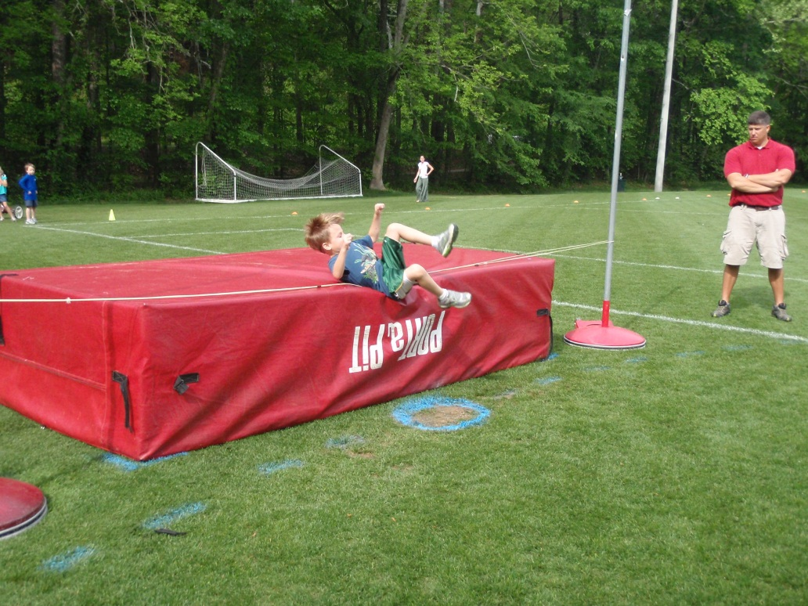
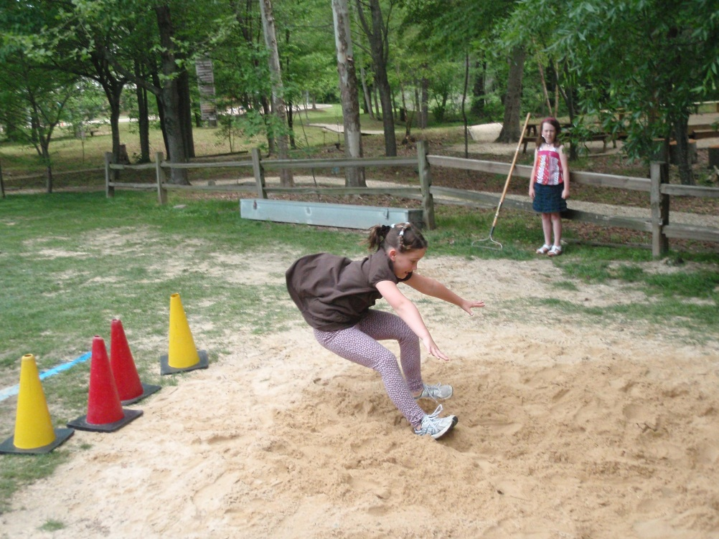
TRACK AND FIELD
ELEMENTARY SCHOOL PHYSICAL EDUCATION

Slide 2
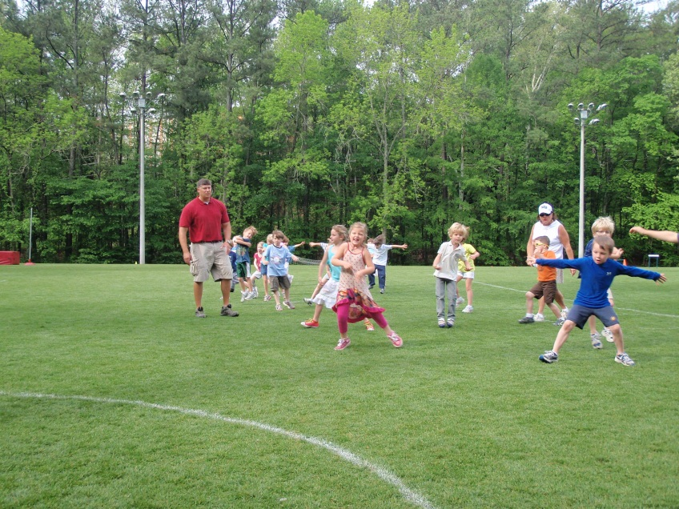
Track and Field
Dynamic Warm Ups
Form running
High knees
Bootie Kicks
High Knee Skips
Basketball Slides
Carioca
50% Sprints
100% Sprints
Intro to Track and Field
Expectations
Safety Issues
Overview of unit
Skill and Events
Rotation of Skill Learning and Practicing
Options for Sick and Injured
____________________________
100 Meter Trials to determine practice groups
(Motivates students to perform to “be with friends”)

Slide 3
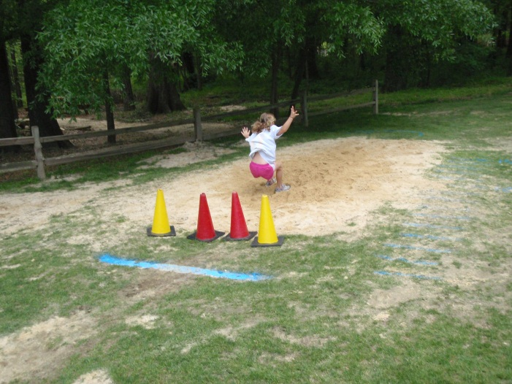
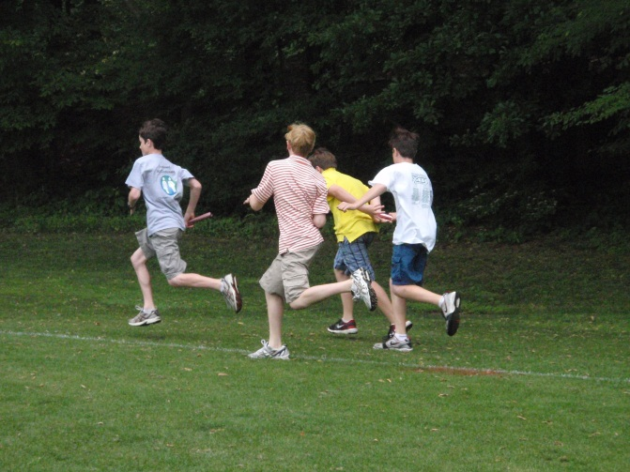
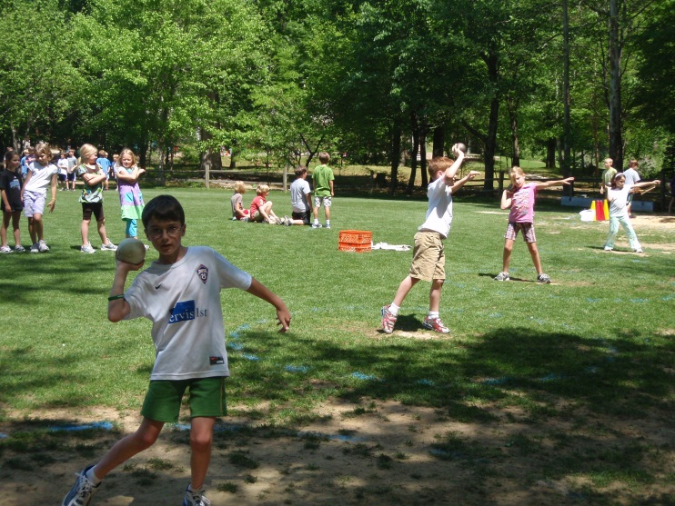
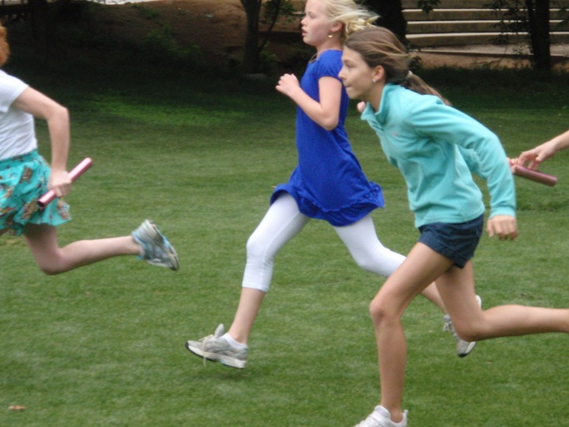
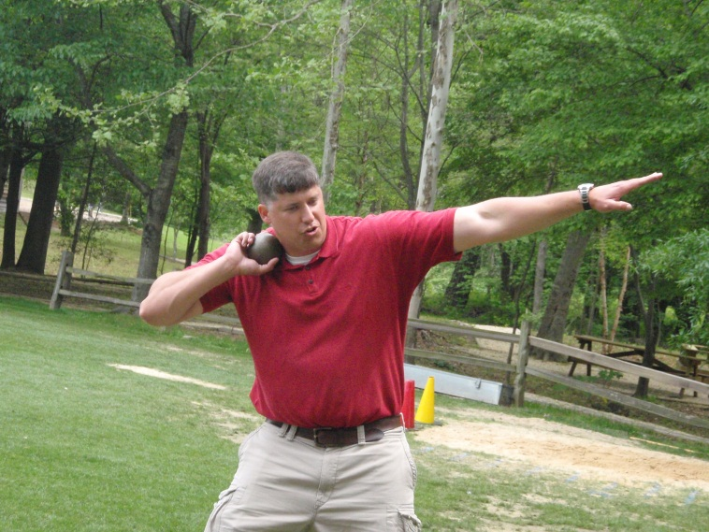
Divide for instruction
Dynamic Warm-ups
Relay Hand-Offs
“Go Stick”
Dynamic Warm-ups
Running Long Jumps
Shot Put

Slide 4
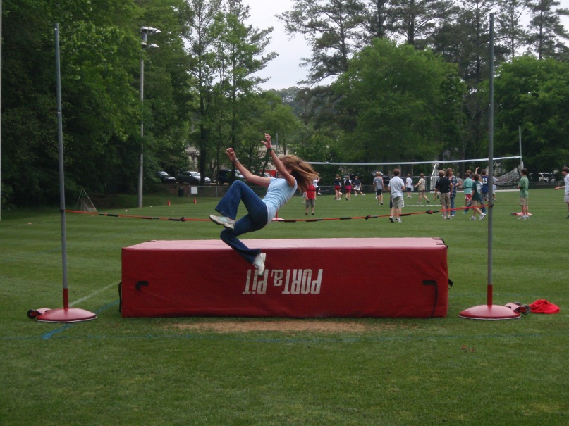
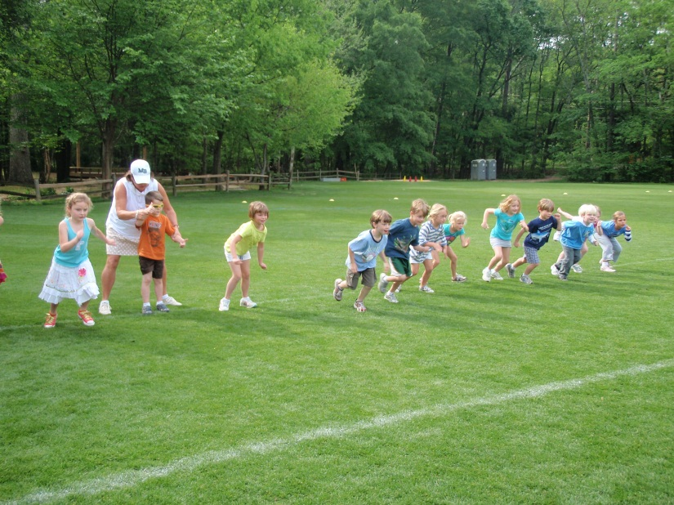
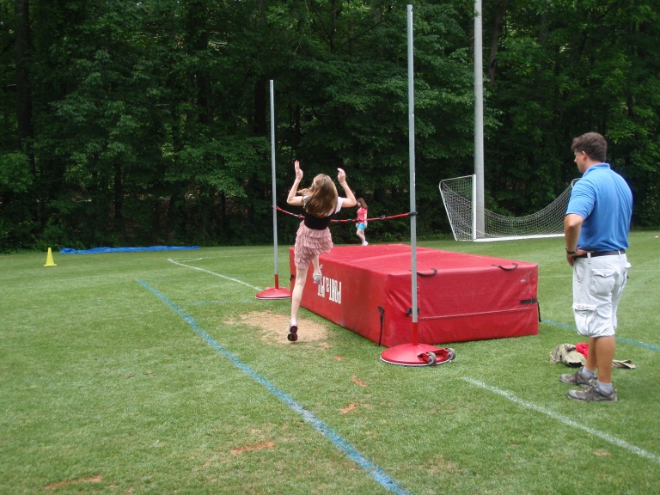
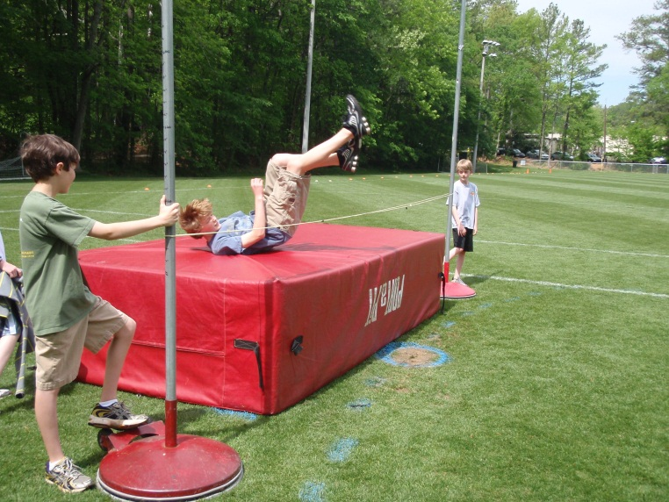
Instruction
Dynamic Warm-Up
Fast Standing Starts
Running techniques
Running through finish
Dynamic Warm-Up
High Jump

Slide 5
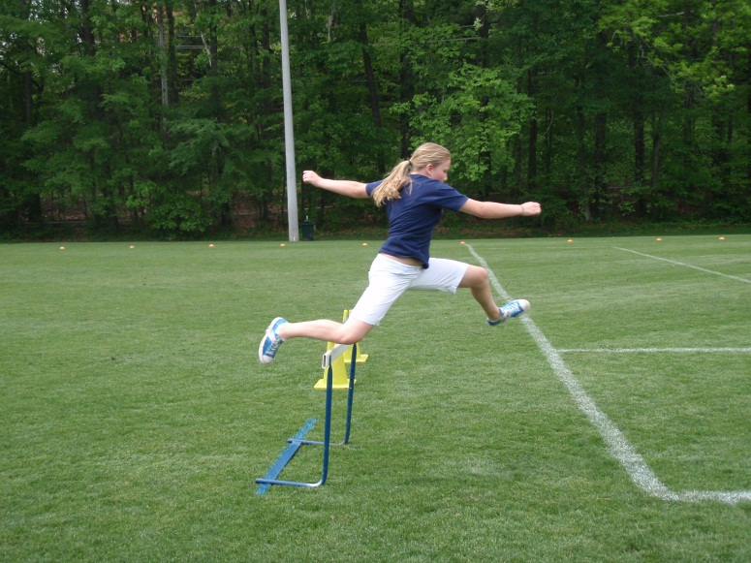
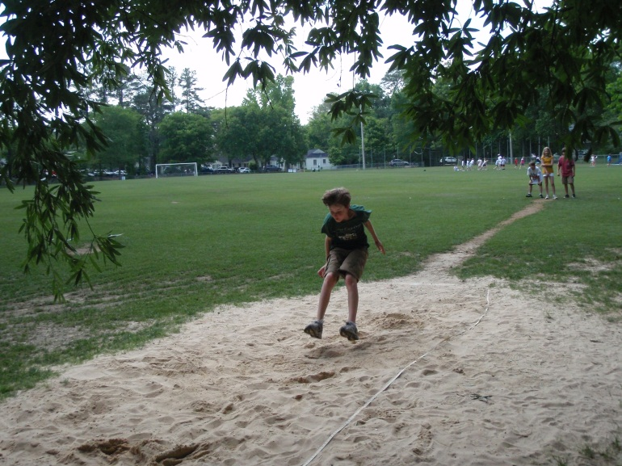
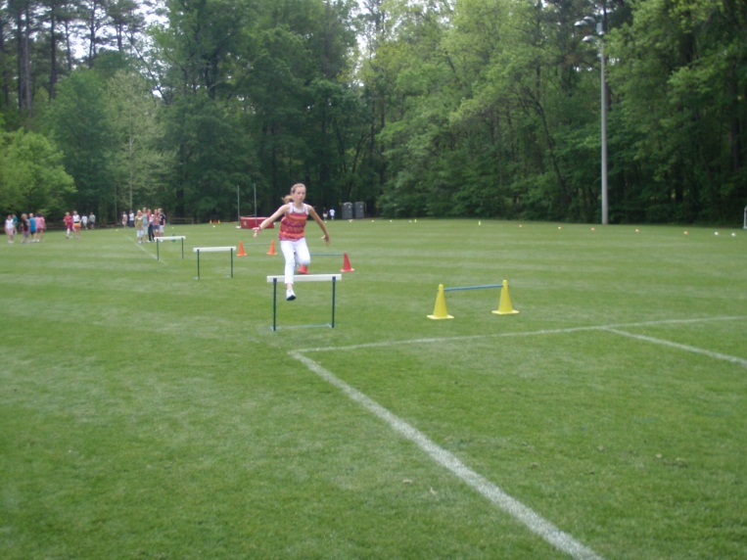
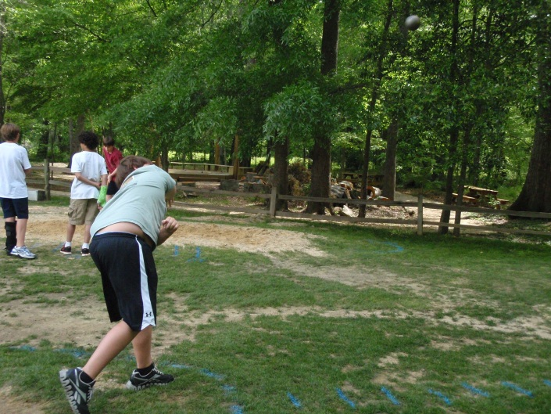
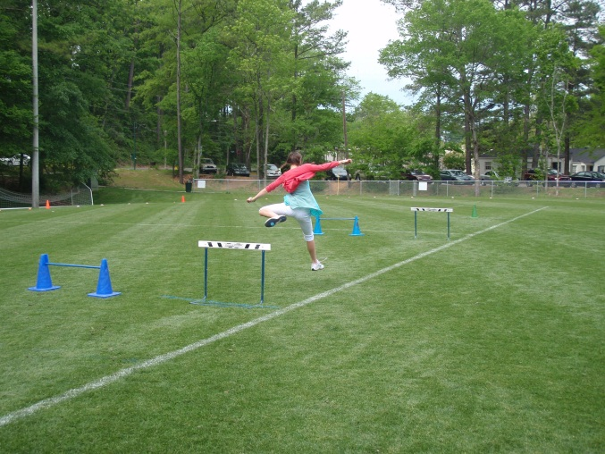
Instruction
Dynamic Warm-Up
Hurdles
Dynamic Warm-Up
High Jump
Long Jump
Shot

Slide 6
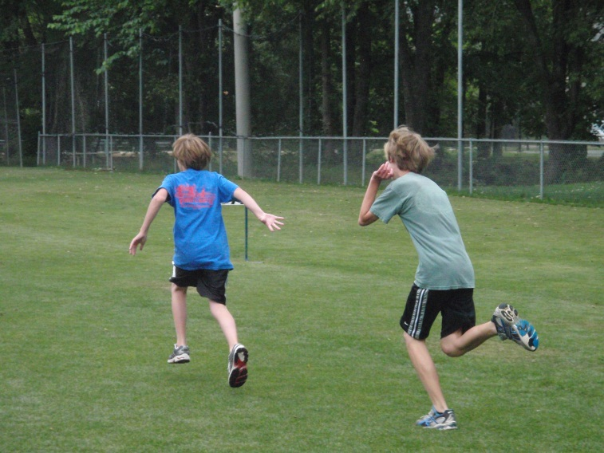
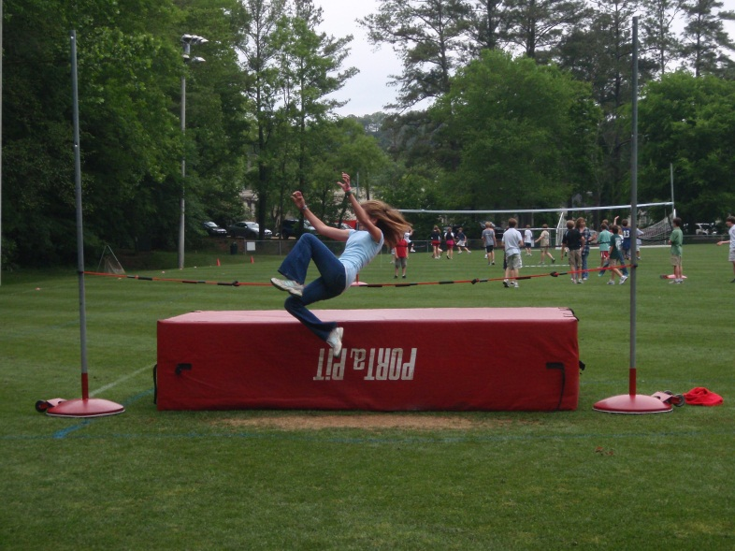
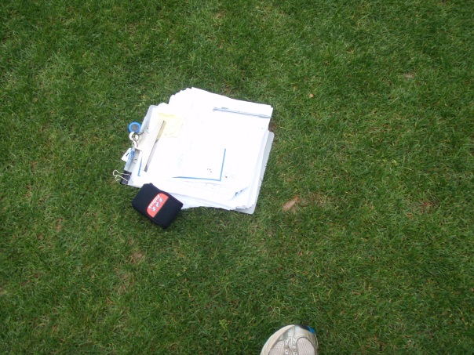
Track and Field Station Rotation
Relays
50 Meter
100 Meter
400 Meters
Hurdles
Shot Put
Running Long Jump
High Jump
Tandem Pulls
Parachute Runs

Slide 7
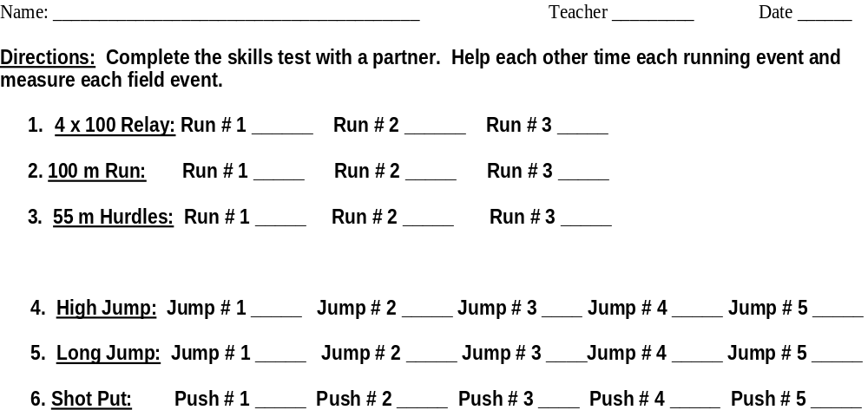
Track and Field Station Rotation Check List

Slide 8
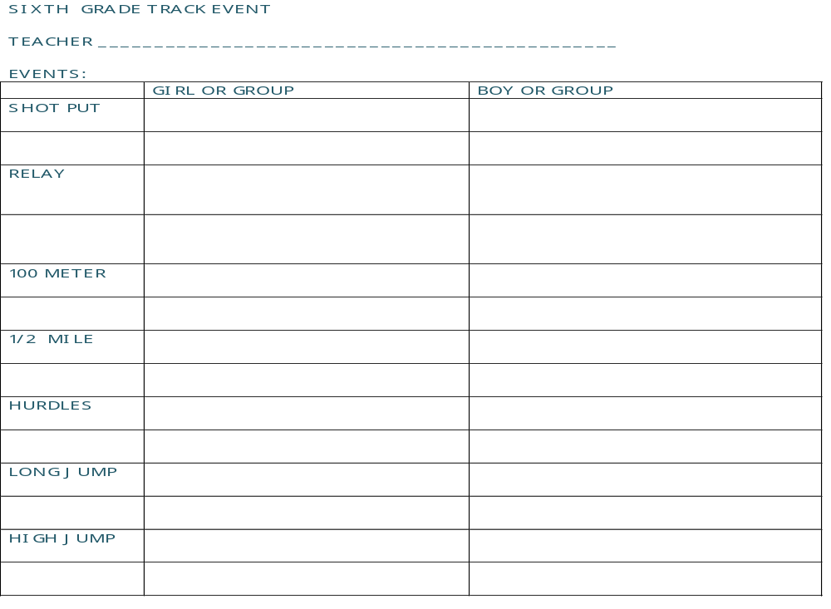
Track and Field Sign-up Day

Slide 9
Day of Track Meet
Teachers are encouraged to attend and possibly assist with wayward students.
Students know which events they have chosen.
Matt watches and scores high jump, long jump, shot put
Cherry watches and scores hurdles, 4X100 Relays, 100 Meter or 50 Meter Runs.
Students assist in recording results on prepared forms.
Students not presently competing practice their events, watch the others compete or assist with recording and competition.
No more than 12 students are competing in each event (2 relay teams per homeroom).
After class, all result forms are collected and transferred to overall grade level score sheets.
Certificates are printed and presented at the next class.
Teachers have kept their class certificates for years.

Slide 10
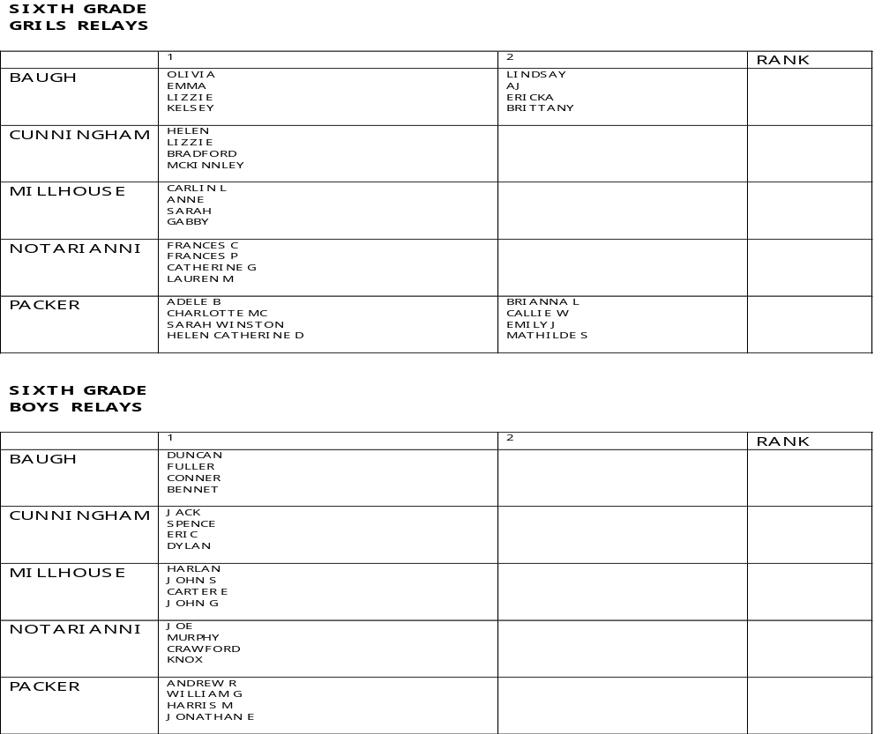
Score Sheets During Event

Slide 11
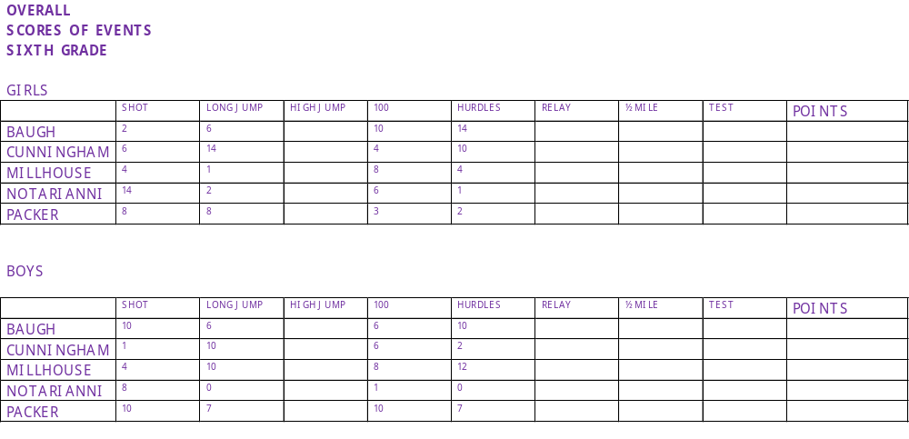
Final Score Sheets

Slide 12
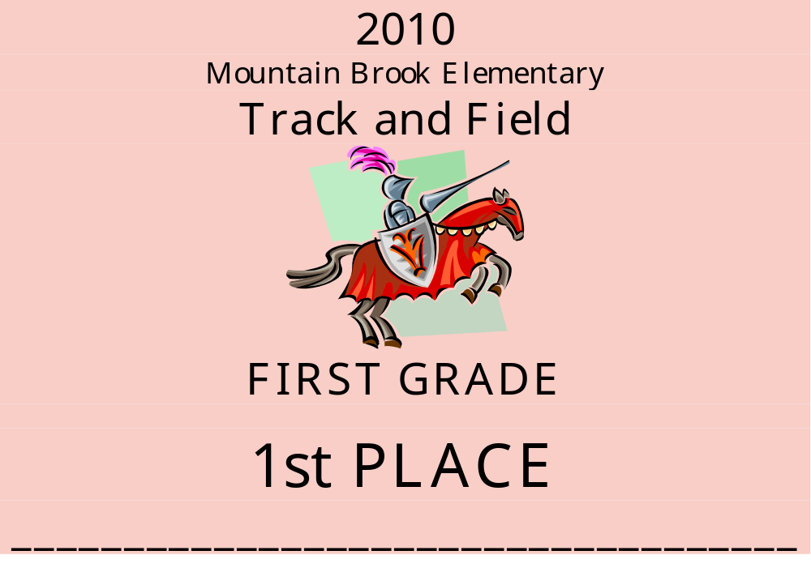
Awards

Slide 13
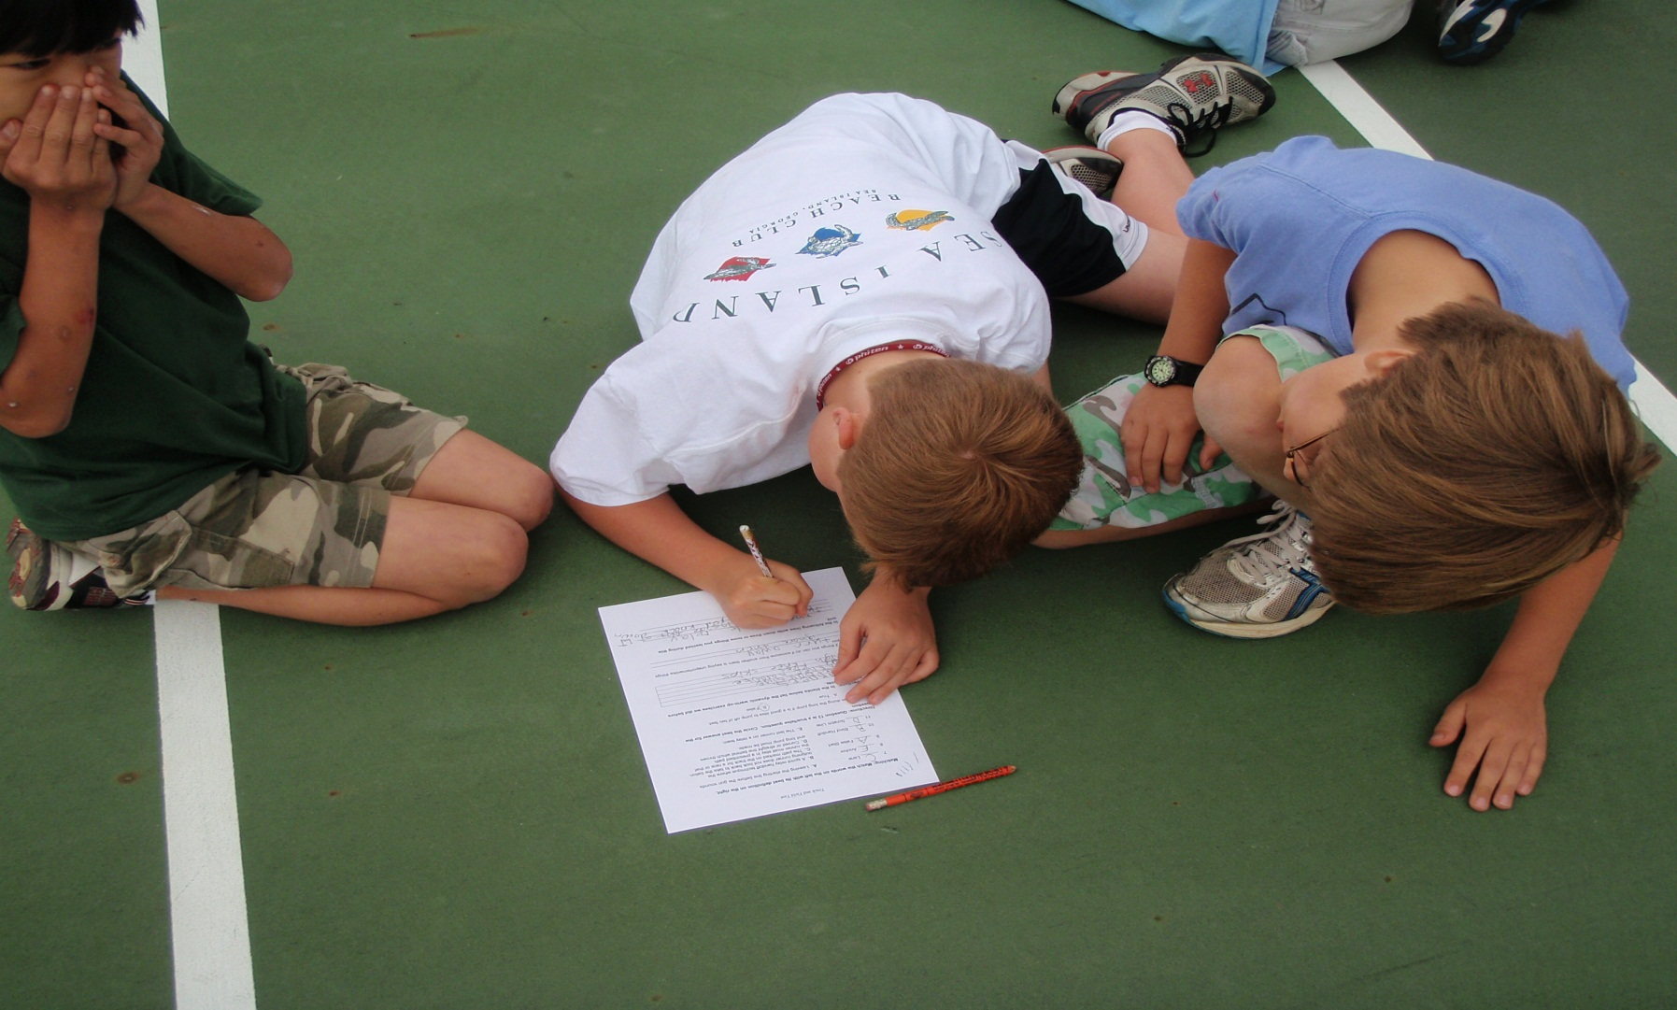
Group Testing

Slide 14
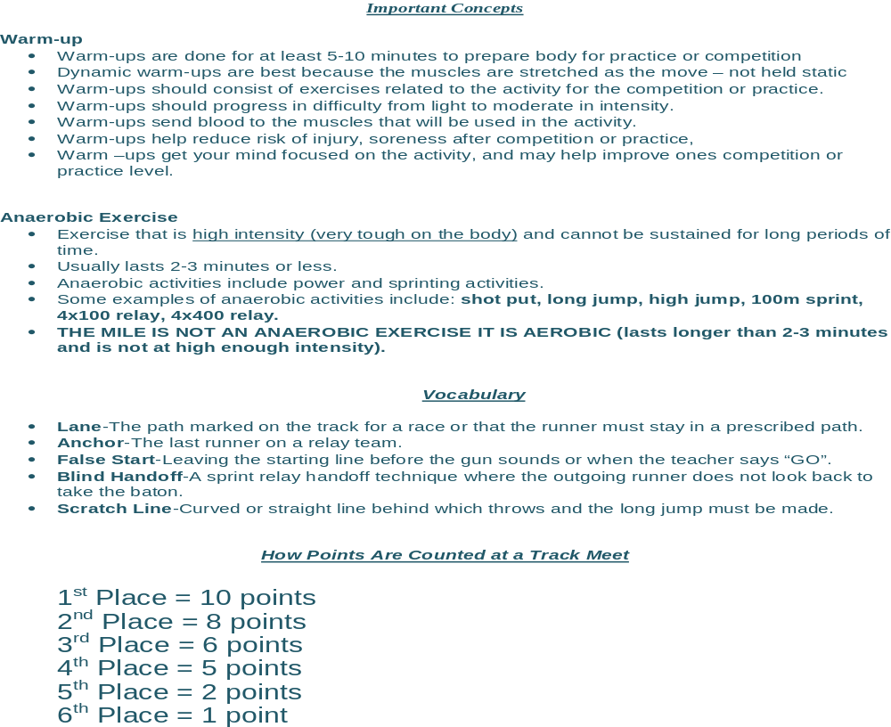
Study Guide

Slide 15
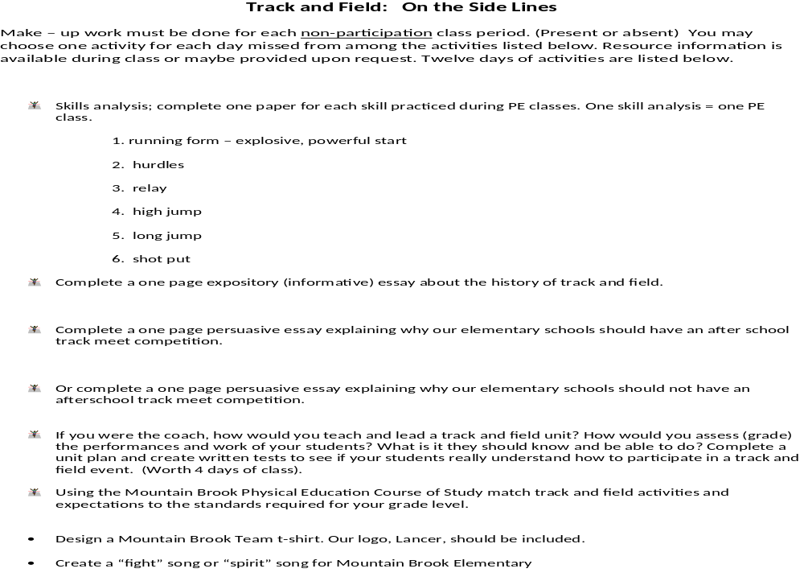
On The Sidelines

Slide 16
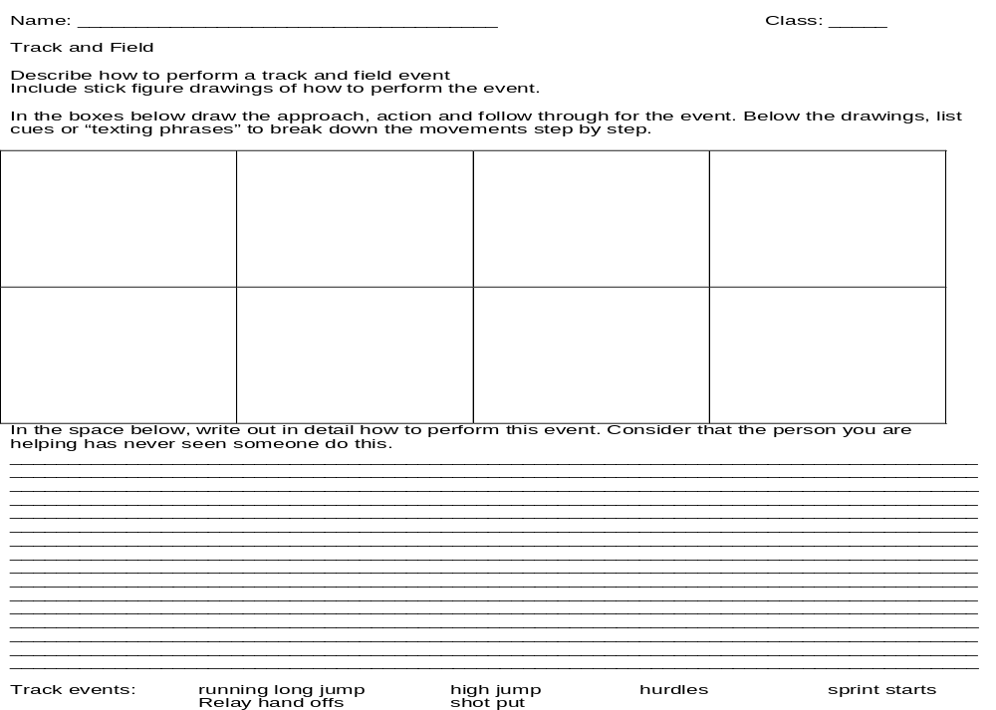
Skill Analysis

Slide 17
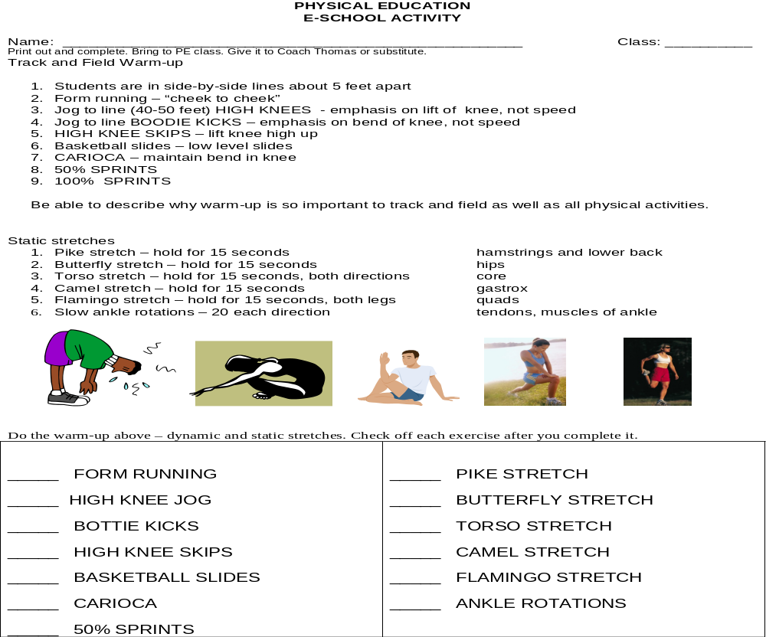
Track and Field E-Day

Slide 18
Cue Cards
Standing Start
Feet Shoulder Width Apart
Favorite foot back
Toes pointed forward
Weight down
Body lean Forward Arms bend 90 degrees, same side foot forward
Head up
Eyes focused 30 feet ahead
Power low to high
Explode forward
Running
Eyes focused 30 feet ahead
Run on balls of feet
Pose, Fall, Pull
Body is lined up over plant foot
Forward lean from ball of foot
Pull trail foot up and forward
Hands relaxed
Cheek to cheek

Slide 19
RELAY HAND-OFF
Approach Receiver with baton in right hand
Say “GO” about 15 feet back
Receiver begins running
Run to catch up with receiver
Say “STICK” when close enough to reach receiver's palm
Receiver sticks hand back, palm up
Receiver grasps baton when felt and sprints ahead
DO NOT LOOK BACK-FOCUS DOWN THE TRACK

Slide 20

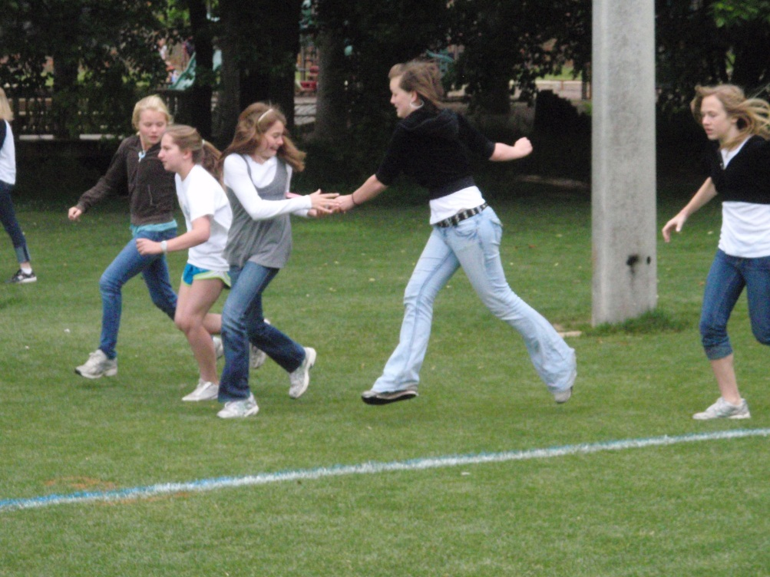
RELAY HAND OFF
Right way Wrong way

Slide 21
SHOT PUT
Hold shot in palm with thumb, pointer and middle fingers
Tuck ball under chin beneath ear
Opposite arm bent at elbow and held at shoulder level
Stand back in the circle sideways to direction of put
Squat down for explosive force
Weight is on back foot
Explode into crow-hop(step, slide, step)
Explosive force begins with hips
When weight has shifted forward, push ball above head (up and out at 45 degree angle)

Slide 22
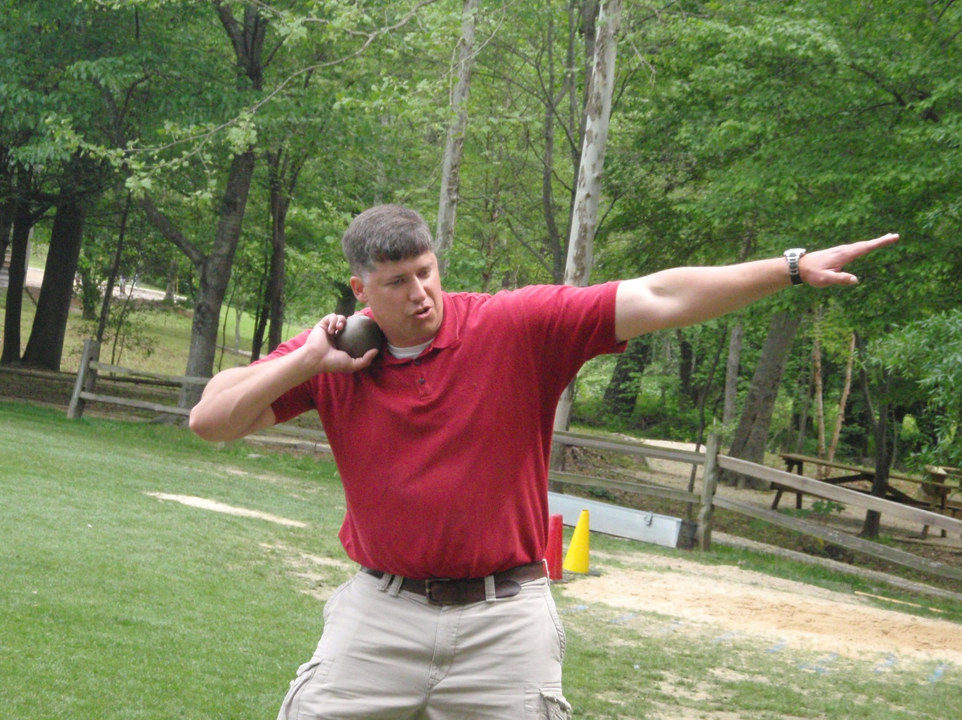
SHOT PUT

Slide 23
RUNNING LONG JUMP
Begin 10-16 strides from takeoff
Sprint
Stride long-short just before take-off
Drive body up and forward
Point chest to the sky
Drive arms up, then forward
Land on both feet
legs in front
land on heels
reach forward
weight moves forward

Slide 24
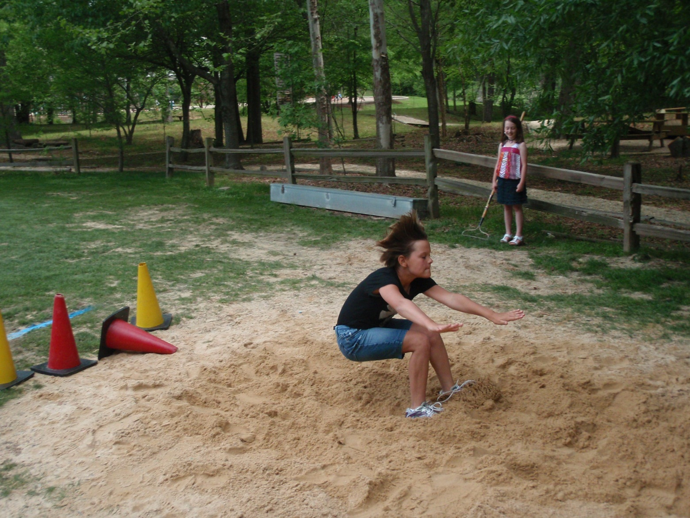
RUNNING LONG JUMP

Slide 25
HIGH JUMP
Start from 8-12 strides away
Use J-Curve to approach mat
Accelerate at J-Curve
Plant outside foot/inside foot (heel) parallel and 3-4 feet away from mat
Rotate force to toe of outside foot
Thrust inside knee up and across body at take-off
Thrust both arms upward once your back is to the bar
After hips clear, drop hips and lift arms and legs to clear bar
Land on shoulders and back

Slide 26
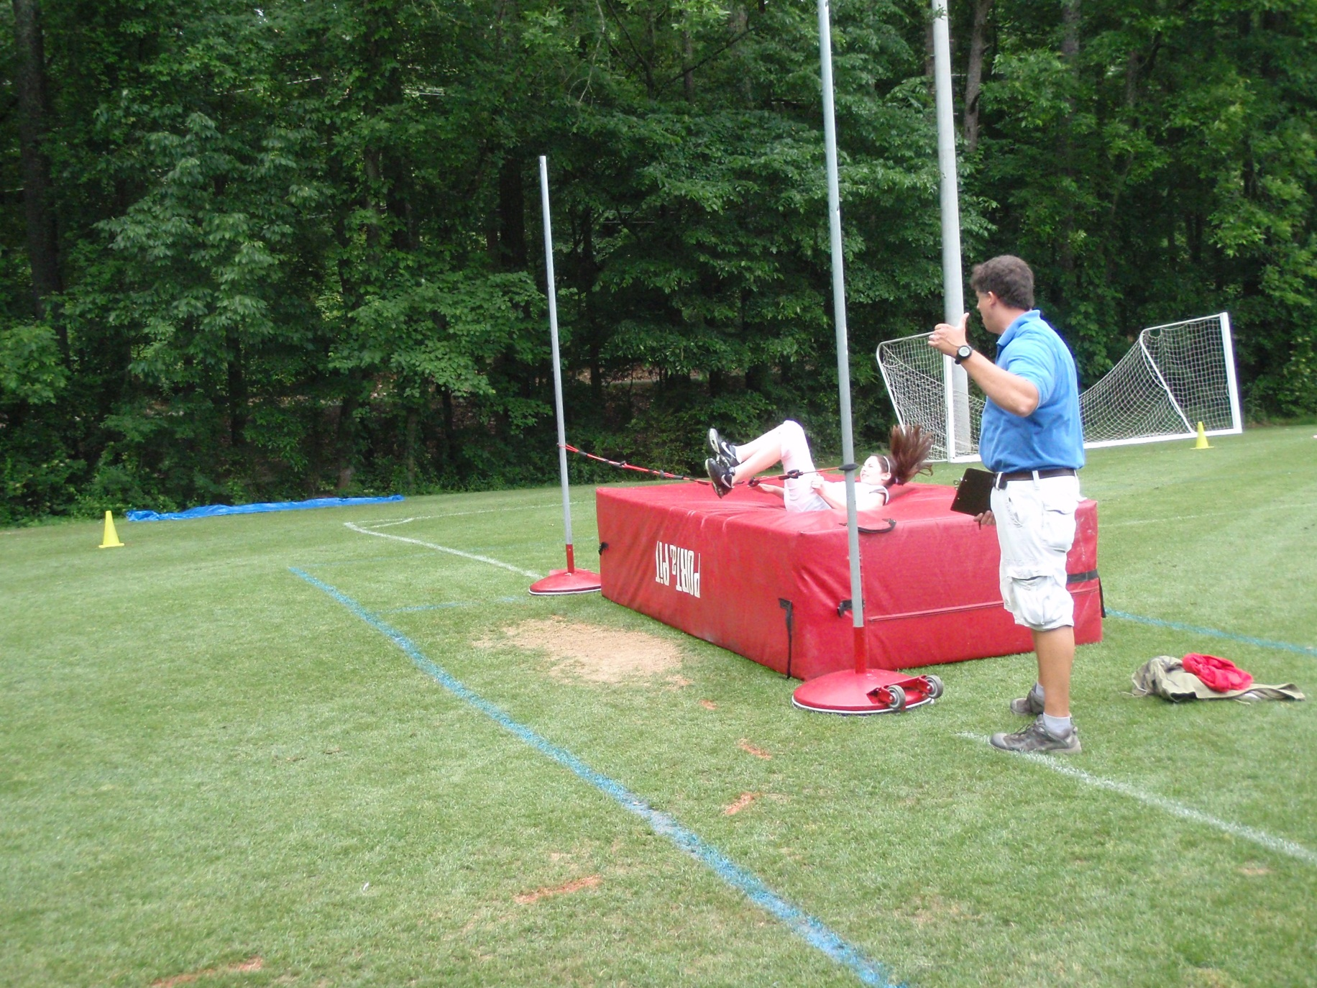
HIGH JUMP

Slide 27
HURDLES
Sprint start
Lead leg in front
8 strides to 1st hurdle
Lead leg lifted from hip, toe up
Trail leg driven up and around, toes pointed out
Drive lead arm forward at shoulder level
Lean forward after clearing hurdle
Use 5-7 strides between hurdles
Best to use same leg as lead leg
Sprint through finish

Slide 28

HURDLES

Slide 29
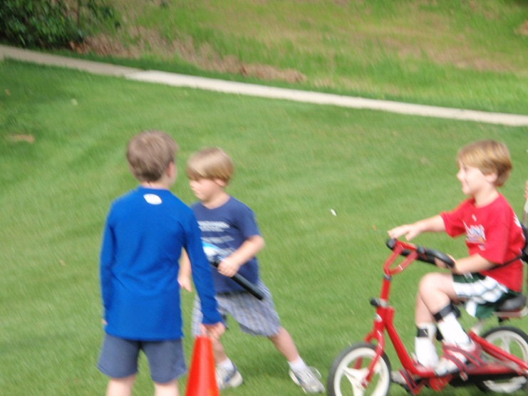
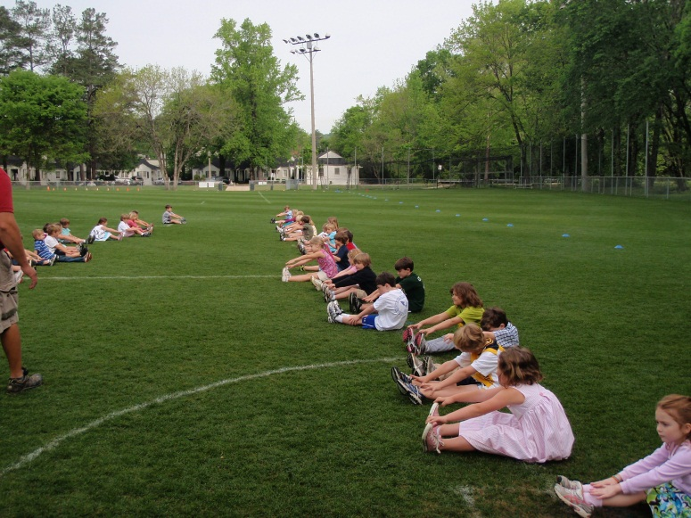
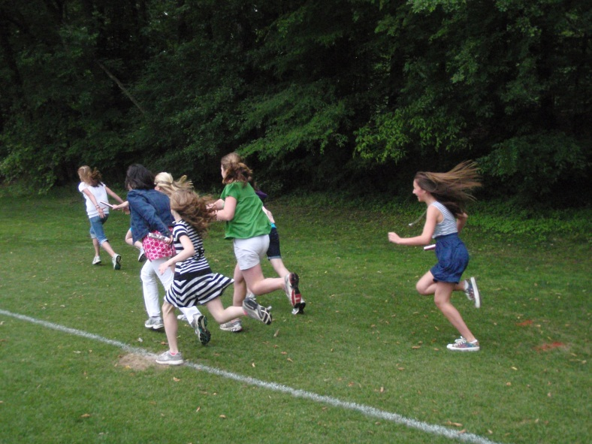
Elementary Track and Field
Cherry Thomas
Matt Cain
Mountain Brook Elementary School
ASAHPERD FALL CONFERENCE 2011

