Slide 1

Careers in Floral Design
Unit 1

Slide 2

What is floral design?
Floral design
  is the art of using plant materials and flowers to create a pleasing and balanced composition.

Slide 3
Floriculture
  “culture of flowers”
  The art and science of growing flowers
  An international, multibillion dollar industry based on flowering and foliage plants.

Slide 4
Floriculture business
  Production of floral crops
  Distribution of crops from grower to consumer
  Processing of crops before sale

Slide 5
Common Floral businesses
  Floral Shops
  Floral Supply Companies
  Production Greenhouses

Slide 6
Ornamental horticulture
  The practice of growing and using plants for decorative purposes
  Floriculture is a major part of this industry
  Nursery/landscape is another major part

Slide 7
Floral production
  Involves the growing of flowering or foliage crops to sale size or maturity

Slide 8



Factors influencing production
  Profit
  Climate
    Amount of sunlight
    Average temperature
  Nearness of the market
    Cut flowers can be far from market
    Potted/bedding plants must be very close to market

Slide 9
Floriculture crops
  Cut flowers and foliage
  Potted flowering plants
  Foliage plants
  Bedding plants

Slide 10

Cut flowers & foliage
  Supplying cut flowers to wholesale florists
  Common Flowers
    Roses
    Carnations
    Chrysanthemums
    Orchids
  Common Foliage (greens)
    Leatherleaf
    Lemonleaf
    Huckleberry

Slide 11
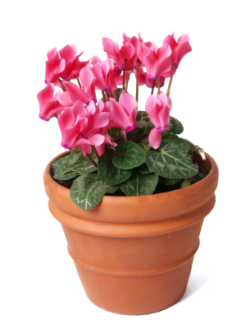
Potted Flowering Plants
  Plants are grown to flowering stage in a greenhouse
  The entire plant and pot are then shipped to market
  Common Plants
    Pointsettas
    Chrysanthemums
    Easter Lilies
    African Violets

Slide 12
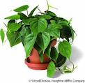
Foliage Plants
  Plants grown for their leaves rather than their flowers
  Also called house plants
  Commonly grown in Florida
  Common Plants
              Philodendrons
              Dieffenbachias
              Figs
              Scheffleras
              Dracaenas

Slide 13
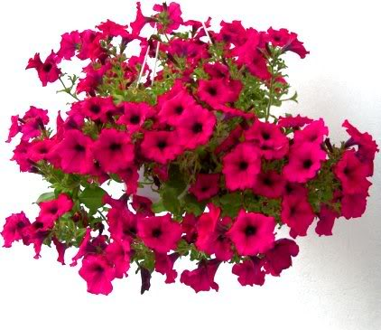
Bedding Plants
  Grown in the spring for outdoor planting
  Herbaceous, annual flowers & vegetables
  Unable to survive cold temperatures
  Common Plants
              Impatiens
              Petunias
              Marigolds
              Tomatoes

Slide 14
Growers
  Producers of flowers and foliage
  Produced through plant propagation
    The reproduction of plants from a seed or portion of a plant
  Most are produced in greenhouses
  Provided florists with flowers

Slide 15

Florists
  Wholesale
  Retail

Slide 16
Wholesale Florists
  Purchases cut flowers, cut foliage, and hard goods from a number of suppliers
  Are buyers
  Must be very knowledgeable
  Resell and distribute goods to retail businesses or other wholesalers
  (not to the public)

Slide 17
Wholesale Florists
  Wholesale Floral Manager
    Oversees operations of business
    Supervises staff
    Estimates retail demands
    Prepares long-range plans
  Salesperson
    Has direct and frequent contact with retail florist
    Takes orders and arranges delivery of products

Slide 18
Retail florists
  Sell to consumers
  Provides floral design services, cut flowers, and other floriculture crops
  May be independent or in a retail outlet

Slide 19
Retail florists
  Retail Floral Manager
    Coordinates the operations of the business
    Manages personnel, work with budgets, maintains store inventory
  Floral Arranger
    Makes and copy floral designs
  Floral Designer
    Creates and designs unique floral art

Slide 20
Floral Distribution
  Shortest sale route
    From local grower to consumer
  Longest sale route
    Via the international flower market
                Producer
                Exporter
                Wholesaler
                Retailer
                Consumer

Slide 21
International flower market
  Cut flowers are perishable making it critical that floral products are delivered to the market as soon as possible
  Regular air traffic linking the world today, makes an international market possible
  80-90% of the fresh cut flowers entering the United States pass through the Miami International Airport
    They make up the airport’s largest single commodity

Slide 22
World’s cut flower industry

Slide 23
U.S. Cut Flower industry
  Columbia stands out as the primary supplier of cut flowers to the United States
  California and Florida lead the way in floral production
  Wholesale value of floral crops in the US is around $4 billion

