Slide 1


What is TAB?
Teaching for Artistic Behavior (TAB) is, in the words of the co-founder Diane Jaquith, “a philosophy that believes in the child as the artist.” It is a flexible approach that’s designed to be adaptable, so it works for all ages and in different settings. http://teachingforartisticbehavior.org/ is a great website to help you with any other questions.
Benefits
TAB allows students to use their own ideas and practice thinking and behaving as an artist. We practice this, connecting it through the Habits of Mind and the Studio Habits of Mind.
TAB allows more time for students to explore and create their own ideas. It also allows for more time for teachers to mentor students through projects. TAB allows students the opportunity to collaborate with their peers and work in groups.
In a choice-based art room
there are 3 main ideas:
You are an artist
This is your studio
What do artists do?
ARTISTS ARE EXPECTED TO:
Come up with an idea (brainstorm, sketch, plan, research, experiment)
Select and gather materials and tools
Set up a workspace
Create (Types of studio work: W.O.W piece, take home piece, skill builder, and explore and practice)
Engage and Persist (work on an idea for 2 or more art classes)
Clean up and store artwork
Revise, edit, reflect (Critique, write an artist statement)
Meet deadlines
Share work
T.A.B
Teaching for Artistic Behaviors
Art Education
Information Guide
Seaford Manor School
Ms. LaSota
Follow:
@mslasota_art
@seaford_art_department

Slide 2
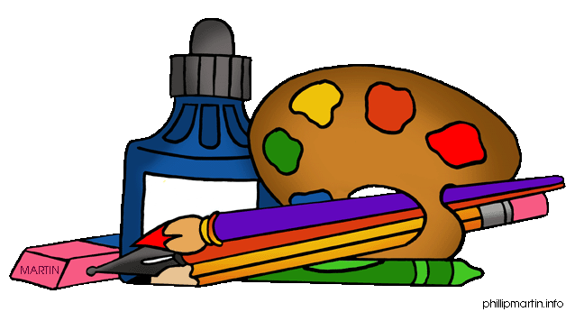

Class Structure
As students enter the art room they choose the center they wish to work in for the day. The teacher will keep track of center choices to ensure students experience all centers. Because there is a maximum number of students allowed for each center, if students do not get to their first choice that day, they will have first choice the following class.
Demonstrations
The teacher will conduct a demonstration or mini-lesson at the beginning of class. This instruction may be an art technique, a new skill, an artist, or new material. Students have the choice to use this new information in their current work, or at a later time.
Planning
Students are required to complete a project planning page (or sketch) where they fill out information about a piece they want to create. Students bring this completed sheet to the teacher to discuss their idea, inspiration, materials and techniques they wish to use. Together they set the plan for potential WOW pieces.
Work time
With TAB, students have the choice to choose an idea and create something meaningful or new they want to explore. They can do this by following their own planning process and work at their own pace. The teacher facilitates student progress throughout class by conferencing individually or in small groups to provide feedback and answer questions.
Clean up
Students are responsible for cleaning up their own materials, project, and work space. Students will finish projects at different times, without issue. They can move on to the next step independently, which might include: begin a plan for another project, create a series, complete a reflection, write an artist statement, and frame their work. Students complete this within the framework and expectations set by the teacher.
Lessons
Teaching looks different in a TAB classroom because it’s more about developing a student’s ability to plan and make art, using artistic behaviors than it is about the end product or picture. Each student is working to complete W.O.W. pieces (Wonderful Original Work of art).
Students generate their own idea for their artwork, problem solve solutions when a situation arises, and finish a piece independently.
Artwork will look differently now. Students create their own ideas, instead of following the same steps for the same outcome as the teacher. They are learning to think and work as an artist!

