Slide 1
People with Autism at the Ignite Studio
At Fishers Public Library

Slide 2
What is the Ignite Studio?
Located at Fishers Public Library, in the newly renovated basement area
A very cool, state of the art place for anyone to unleash their inner artist, collaborate, and learn.
A place for people with ASD.

Slide 3
Our Group
A small, informal group of young adults and teens with ASD (and support persons)
Not a HEPL or Ignite program

Slide 4
Our Goals
To try new activities
To socialize with peers and make new friends
To learn new skills
To make age-appropriate art
To make objects to sell
To ultimately become a group lead by those with ASD

Slide 5
The Fablab
The Fablab is a room in the studio which is equipped with:
  Laser Engraver
  3D Printer
  Vinyl Cutter
Make intricate work perfectly in the Fablab, even with impaired fine motor skills.
Highly rewarding

Slide 6
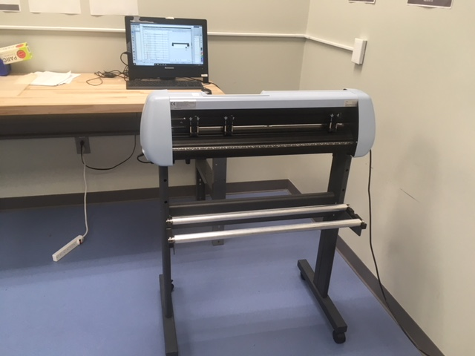
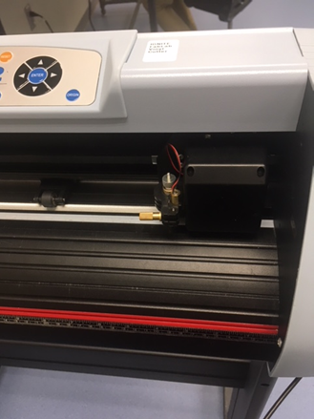
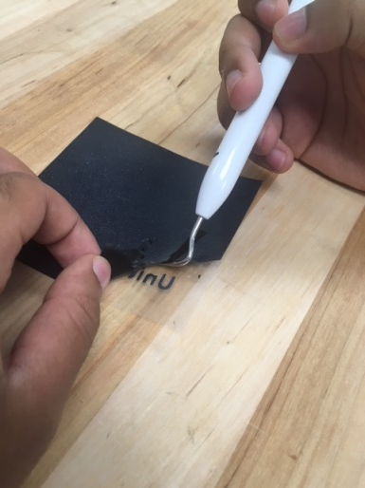
Vinyl Cutter
Design on a laptop available at the studio
Design >Vinyl Cutter> Hand work to finish
Some members will complete the cutter certification!
Others would benefit from a “learners’ permit”

Slide 7
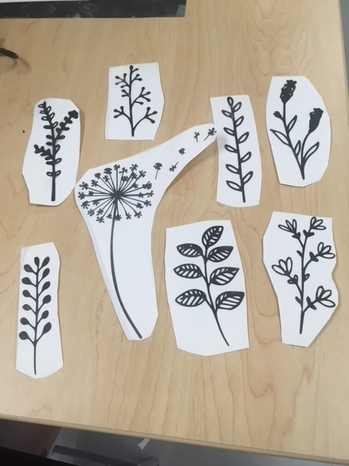
Examples

Slide 8
Small Business Opportunity!
Members are inspired to make items to sell
Opportunities for people with ASD to sell items at community events include:
  Autism Speaks Walk 2019
  Autism Society Expo
  Fuse Expo
  Craft Fairs

