Slide 1
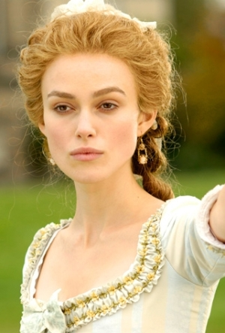
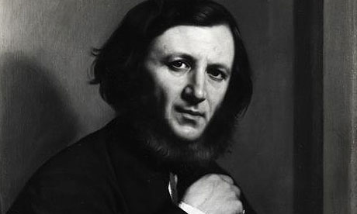
My Last Duchess
By Robert Browning
Alex & marlee

Slide 2
Reading of My Last Duchess
http://www.youtube.com/watch?v=8xIVg0qwTj4

Slide 3
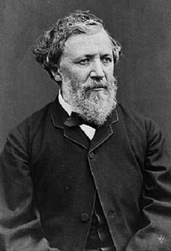
About Browning
Robert Browning was an English poet and playwright
He wrote during the Victorian period
His mastery of dramatic monologues made him one of the greatest poets of his time

Slide 4
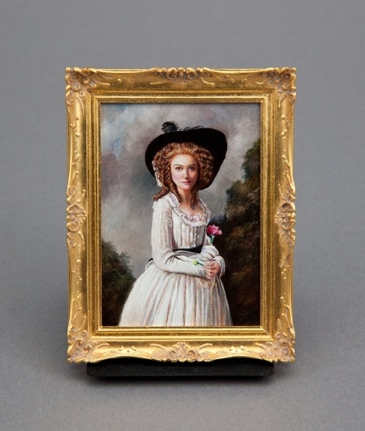
The Poem’s Message
In My Last Duchess, the Duke values art but can not appreciate beauty in reality. The overall message of the poem is that reality contains far more beauty than art.

Slide 5
Poetic Devices
Imagery- (Lines 17-19) Imagery is used to help imagine the way the painter may have complimented the duchess.
Indirect Language- (Lines 23-24) the indirect language helps imply that the duchess is too flirtatious without saying so directly.
Paradox- (Line 36) used when saying he doesn’t have “skill in speech” even though he is speaking skillfully to say so.
Synecdoche- (Line 46) Used when he admits to murdering the duchess but instead o saying he killer her, he says “All her smiles have stopped.”
Assonance- (Line 42-43) The duke repeats himself at communicating with the duchess would be “stooping”, browning uses assonance to bring emphasis to the lines.

Slide 6
What themes in the poem relate to the Victorian era beliefs?
The Victorian era centered around an established social order. This belief is reflected in the Duke’s determination to wed none but the finest women. Also, the poem reflects the Victorian belief in male dominance. This is portrayed in the way the duke speaks of the Duchess, as if she were to be of service to him.

Slide 7
Song Connection
http://www.youtube.com/watch?v=PiLKkwZdZtg
Two Black Cadillacs is a song about two women finding out that they are both being cheated on. The women decide to kill the man and keep it a secret. This relates to the Duke’s reaction towards his unfaithful Duchess.

