Slide 1

Welcome To CHS Registration!
For more information visit our web site: http://www.centralia.k12.wa.us/Page/1854

Slide 2
Introduction
    Goals:
    Have a preliminary knowledge of Skyward online registration.
      Give a checklist
      Show tutorials
      Go over grad requirements
      Explain student led conference day
    Answer any questions. .

Slide 3
Who is doing online registration?
Class of 2017 current sophomores>juniors
Class of 2018 current freshmen> sophomores.
Who is NOT doing online registration:
  Class of 2016 registers with counselors in offices
  Class of 2019 (current 8th grade>Freshmen) register on paper at CMS

Slide 4
Registration Process
Before Registration, Students should:
  Log in to their Skyward account
    Password or Login issues? See counselor.
  Check credits and failed classes
  See Course Availability Forms
  Check graduation requirements (on back of CA form)
  View Skyward Registration website and tutorials
  Participate in Student Led Conference
    Talk with parent and advisor about future using HS & Beyond Plan or registration checklist
    Fill out colored course availability sheet
    During student led conferences, go to computer lab and forecast for 12 classes.
    Counselor signs off.

Slide 5
Course Description Sample:
Web site: http://www.centralia.k12.wa.us/chs/site/default.asp
ENGLISH 11 A & 11 B Skyward Code: ENG301& ENG 302
Grades: 11
Course Length: Two Semesters
Prerequisite: None
Credit Type: English
Junior English is a survey study of American literature with emphasis placed on how literature is a reflection of American culture. Included in the course are various forms of literature that span three centuries. Of equal importance in this class is the continuing development of writing skills. Essays tied to the literature are the primary focus, but other forms of writing will also be assigned including writing tasks for practical purposes and a small research paper.

Slide 6
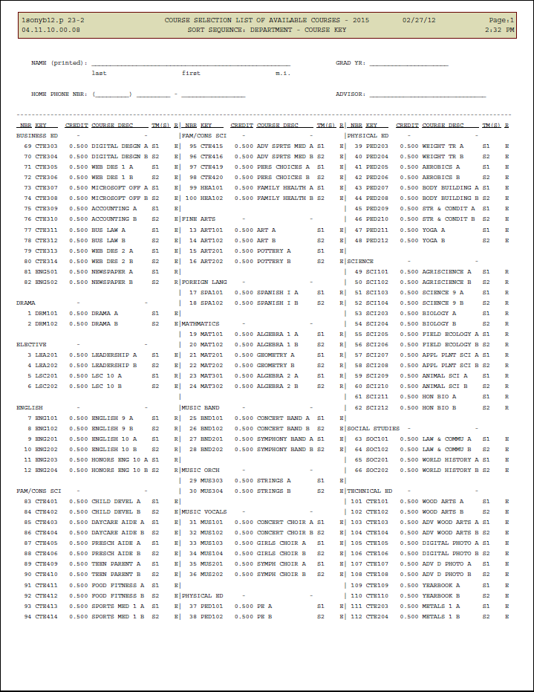
Course Availability List 2015

Slide 7
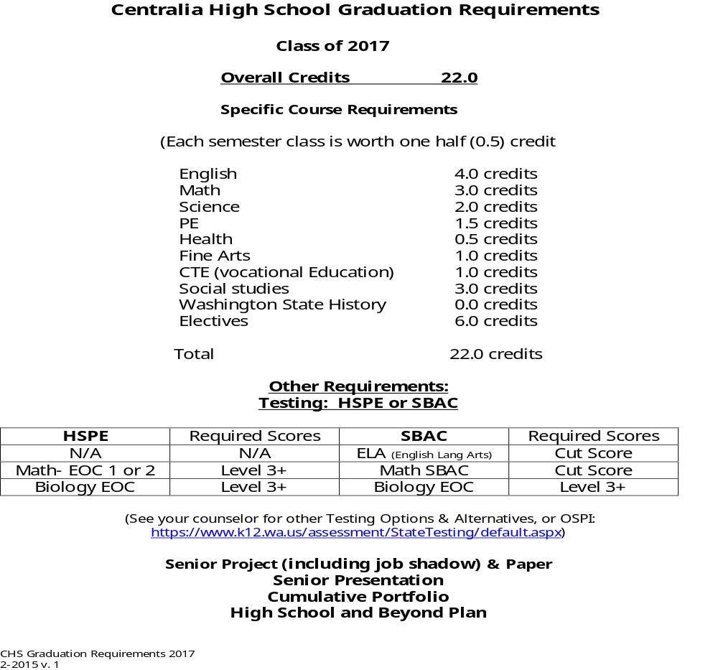
Graduation Requirements Sample

Slide 8
Senior C.o. 2016 Requirement Reminders
You need English all year! Yes, 4 years of English!
See choices for English classes: Sports Lit, Shakespeare, Film as Lit, Creative Writing
  One must be Senior paper English 12A or 12.1 A or 12.1B , one can be any other English Option
New History Offerings:
  One must be CWP, others as electives. American Experience, Modern Govt, Global Issues, Human Geog.
    All EWU College credits, may have to pay fee, earn college credit.
As of this date, senior requirements are all in place: paper, portfolio, presentation, HS & Beyond Plan.

Slide 9
Registration webpage
http://www.centralia.k12.wa.us/Page/1854
CHS>Departments>Counseling>Skyward Registration Information.
  View Page
  See Tutorial Sample
  Answer Questions

Slide 10
Registration Process
Student Led Conference:
    Talk with parent and advisor about future classes using HS & Beyond Plan or registration checklist
    Fill out colored course availability sheet
    Choose 12 classes (both semesters!) plus 2 alternates
    Immediately after you ‘re completed with conference, go to computer lab and forecast for 12 classes.

Slide 11
Choose Classes (Sophomore Ex.)
English: Ex: English 10 A & 10 B: ENG 201 & ENG202
Math: Ex: Geometry A & B: MAT201 & MAT202
Science: Ex: Biology A & B: SCI 203 & SCI 204
World History: Ex: World History A & B: SOC 201 & SOC 202
PE: Ex: PE A & Strength & Fitness B
Fine Art: Ex: Pottery A & Art B: ART201 & ART102
Vocational/Occupational: Ex: Wood Art A & Food & Fitness B

Slide 12
Choose Classes (Junior Ex.)
English: Ex: English 11 A & 11 B: ENG 301 & ENG 302
Math: Ex: Algebra 2 A & B: MAT 301 & 302
  Math Models A & B (with permission): MAT 309 & MAT 310
Science: Ex: Chemistry A & B: SCI 301 & SCI 302
  Agriscience A & B: SCI 101 & SCI102
US History: Ex: US History A & B: SOC 301 & SOC 302
PE: Ex: PE A & Strength & Fitness B (if needed)
Fine Art: Ex: Pottery A & Art B: ART201 & ART 102
Vocational/Occupational: Ex: Wood Art A & Food & Fitness B
World Language: SPA 101 & SPA102
Other

Slide 13
What if ?
Cannot login to Skyward when SLC parent is here?
Scheduled at another time?
If you cannot log in to Skyward?
  Students are IEP? (your case manager will help you schedule)
  Running Start? (pick classes you want at CHS, then write RST on CA form)
  Want zero hour? (Write on CA form)
  Skills Center? (add only three periods, write NMVSC on form)
  TCVA, Nova Net, TA? (write on bottom of print out or CA form)

Slide 14
Questions?
Jim Parker; A-G
  jparker@centralia.wednet.edu
Matt Whitmire; H-O
  mwhitmire@centralia.wednet.edu
Deb Everley: P-Z
  deverley@centralia.wednet.edu

