Slide 1

WELCOME TO
MEMORIAL HIGH SCHOOL
Class of 2026

Slide 2
MHS Administration
Mr. Dave Oldenberg Principal
Ms. Laura Nicolet Asst. Principal
Mr. Travis Hedtke Asst. Principal
Mr. Kevin Thompson Athletic Director /Asst. Principal

Slide 3
Counselors at Memorial
A-C Mrs. Kapanke
D-I Mr. Hochstetler
J-Mo Mrs. Moss
Mr-Sn Mrs. Corning
So-Z Mrs. Herbenson
Partnership Coordinator
Mrs. Kimberly Winkelman

Slide 4

ACADEMICS
PERSONAL/SOCIAL

Slide 5
Memorial Graduation Requirements
English 4.0 credits
Social Studies 3.0 credits
Math 3.0 credits
Science 3.0 credits
PE 1.5 credits
Health 0.5 credits
Electives 8.5 credits
TOTAL 23.5 credits MINIMUM!

Slide 6
4-Year College Minimum Course Admission Requirements
English 4.0 credits
Social Studies 3.0 credits
Math 3-4 credits*
Science 3.0+ credits
*All University of Minnesota schools require 4 credits of Math to be eligible for admission and minimum of 2 years World Language

Slide 7
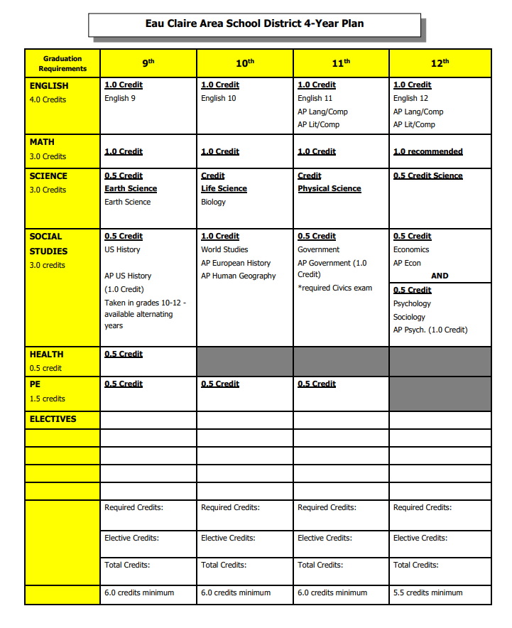

Slide 8
PE Level One or Health 9
Summer Option
Physical Education Level One:
  June 13-July 21
  6:30 am – 9:30 am
  Face to face at the high schools
Health 9:
  June 13-July 21
  10:00 am – 1:00 pm
  Face to face at the high schools
  Interested 8th graders will register for either of these courses through summer school enrollment by February 11.
  These summer courses are in place of former online courses.

Slide 9
Resources
Memorial Academic Resources
  Teacher(s)
  Extended Learning Time (ELT)
  Skill Center
  MHS Math Open Lab (Library: M, T, Th- 3-4:00 pm)

Slide 10
Registration Process
January 5th & 6th – Course Books were distributed to South and Delong
January 12th – South students sign up for classes
January 13th & 14th – Delong students sign up for classes
By February 1 -Any other non-EC students will enroll at central office and get in course requests
Parents and Students will be able to view the selected courses through Skyward in July

Slide 11
Additional opportunities for the evening (Optional)
Open house to meet staff & gain information
Located in Commons: Language Arts, Math, Science, Social Studies, World Languages, Athletics
Located in Classrooms: Art, Business Marketing & IT ,Family Consumer Science, Music Technology & Engineering, Theatre, Special Education
6:20-6:50 pm Counselor presentation(Little Theater)
“Earning College Credit in High School”

Slide 12
Opportunities
Break out session on Dual credits in Auditorium
Core departments located in Commons
  Language Arts
  Math
  PE
  Science
  Social Studies
  World Language
Elective departments located in Classrooms
  Art
  Family and Consumer Science
  Business
  Music
  Technology Education
  Theatre
Link Leaders available for directions and tours

Slide 13
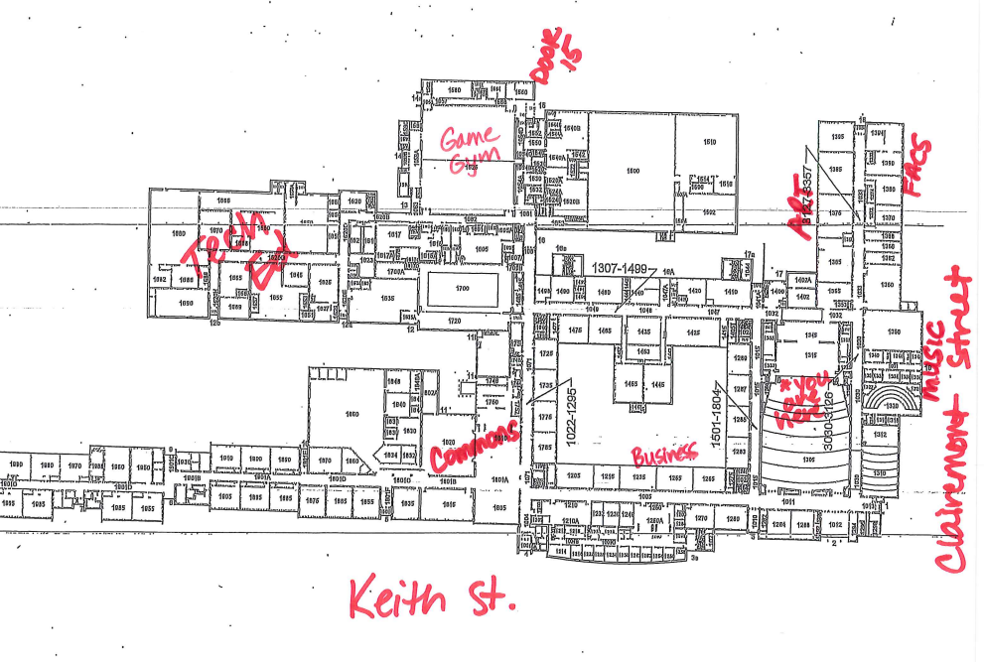

Slide 14
Special Education Questions – room 1210
New to ECASD – visit Student Services table in Commons

Slide 15
Thank you for coming!
Enjoy the evening!

