Slide 1
Title: Early Man Adapts!
(Video Notes)
Directions: As you watch the video on early humans, take notes for discussion on 1-5 facts or details that that helped early humans survive hostile environments (doing this will help you remember what you watch).

Slide 2
What did you learn?

Slide 3
Class Notes
9/11 Title: Early Humans Adapt
Factors that helped early hominids (bipedal human ancestors) adapt to their environment and survive:

Slide 4
1. Physical Adaptations – developed over many millions of years! (pick two examples):
Stereoscopic Vision: accurate judging of distance (two forward facing eyes – made them better hunters).
Opposable Thumb: allows an animal to grasp and hold objects firmly – this will lead to the ability to make TOOLS!
Walking Upright: see farther away while on the ground (watch for predators) and migrate (to find more food!)
  Walking on two legs frees the hands for tool & weapon use – better hunters.
Brain Sizes: Think and solve problems – invent things! It is believed that as early hominids became more efficient hunters, adding lots of meat to their diet, their brains began to slowly (over 2-3 million years) get larger!

Slide 5
2. TOOLS & Technology
Key change:
→ A lot of animals use Tools but humans can MAKE tools.
Now with larger brains early hominids can not only use tools (like modern chimps) but can make their own!
  A TOOL is anything we use which makes our lives easier. (ex: hammer, smart phones, cars, etc.).
  The first tools were made ~2.5 million years ago!
  Bone Needle – tailored clothes – survive the cold!
  Technology: ways of applying knowledge, tools and inventions to meet our needs.

Slide 6
3. Use of Spoken Language (words):
Complex spoken communication can now take place.
Why Important? → pass down knowledge, technology, and survival skills! The First history classes begin!!!!! (~1 million yrs).
→ Group coordination on hunts.

Slide 7
4. FIRE:
Fire is a tool, the knowledge to create it = technology!
discovered perhaps ~500,000 years ago
Cooked food (healthier → kills bacteria), keep warm, scare away dangerous animals!
Cooking food helps digestion and allowed the development of larger brains.
Knowledge, like how to make fire, can be passed down through generations because we have complex communication (language), with each generation contributing something new! (building on the past – history class!).

Slide 8
5. Domesticated (Tamed) Animals
Harvesting the power of animals to do jobs more efficiently than humans can alone.
  First Domesticated Animal = The Dog
    Tamed wolves raised to guard & hunt.

Slide 9
B. Why is being able to adapt to changing circumstances an important human characteristic?
  B/C The World is ALWAYS CHANGING!
  You must be able to adapt to changing environments or you go extinct! (dinosaurs)
  Life = problems → need solutions → IF you solve the problem you SURVIVE → IF you don’t you may not!
  School = a new environment where you’ll need to adapt to be successful!

Slide 10
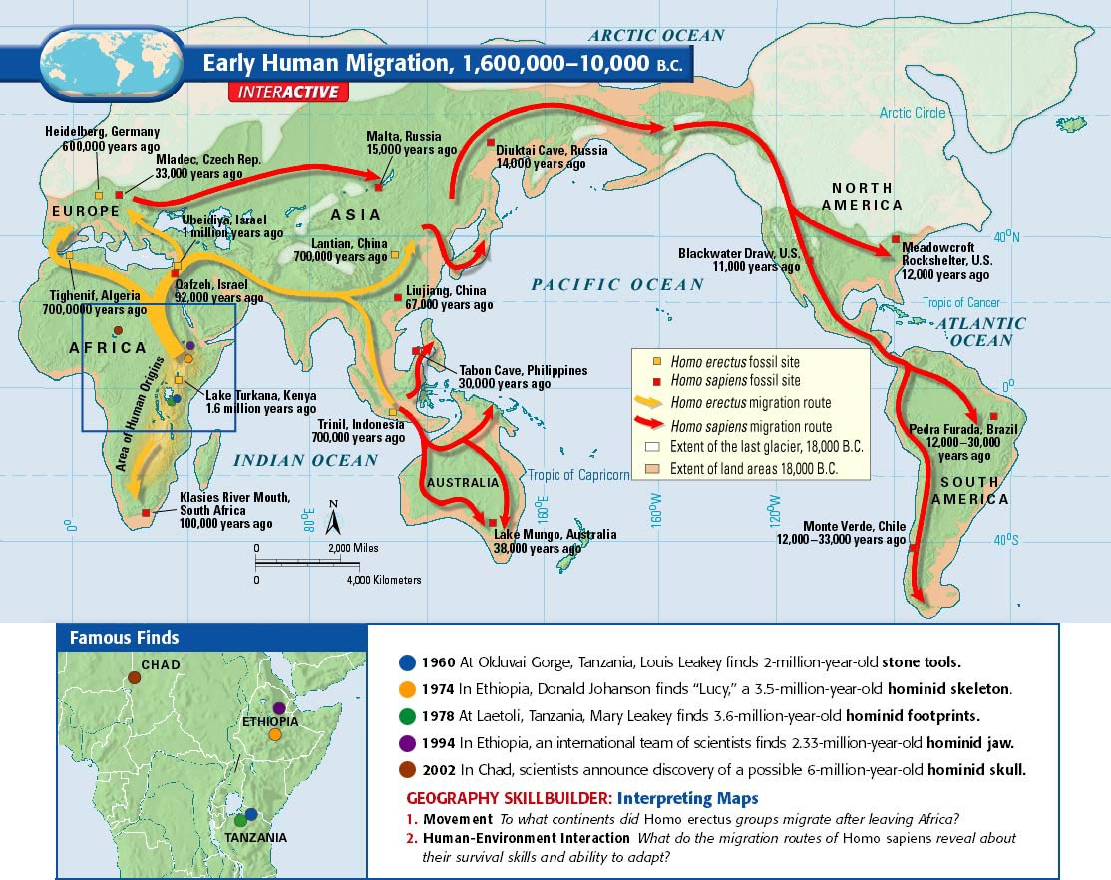
New Title: Map Skillbuilder
Early Human Migration: 1.6 M – 10,000 B.C.
Directions: Use the map in 1.1 (p 10) to answer the skillbuilder Qs 1-2 – use complete sentences!

Slide 12
Geo Skillbuilder: Answers
Homo erectus groups migrated to Europe & Asia after leaving Africa.
2. Homo sapiens’ migration routes reveal that their
survival skills and ability to adapt were superior.
  Why? B/C Homo Sapiens were able to travel through areas of greater extremes like in the Glacier covered north (cold weather) or across oceans (need boats) when migrating to Australia!

Slide 13
9/19 Title: Cave Art
Directions: Copy the following Q’s in your notebook under the above title.
1. What can we learn about a group of people from the art they have left behind?
  (skip about 5 Lines)
2. Why was Art an Important Human Achievement?
As you watch the virtual tour of the cave at Lascaux – try to answer question 1
Youtube: https://www.youtube.com/watch?v=3_aTEcsksZI

Slide 14
Cave Art (continued)
What can we learn? About CULTURE!
→ A people’s art reflects their values, what they believe is important.
→ Examples: religious beliefs, lifestyle, environment, & economic status.

Slide 15
2. Why was Art an Important Human Achievement?
Art is symbolic and a record of events (you can pass down knowledge.
Art is the 1st Step in the development of writing!
The Letters of our alphabet are just standardized artistic symbols.
ART= the FIRST WRITING!

