Slide 1
Constitutional Underpinnings CR-1
AP U.S. Government
Ch. 1, 2, 3

Slide 2
Ch. 1 The Democratic Republic
Politics: “who gets what when and how”
Government: institution in which decisions are made that resolve conflicts or allocate benefits and privileges (provides structure)
Institution: an ongoing organization that performs certain functions for society

Slide 3
Why Is Government Necessary?
3 fundamental political values
Order
Maintaining peace and security by protecting members of society from violence and criminal activity is the oldest purpose of government.
Liberty
The greatest freedom of individuals that is consistent with the freedom of other individuals in the society; can be promoted by or invoked against government. (limit govt.)
Equality
Idea that all are of equal worth

Slide 4
Must have Authority and Legitimacy
authority: the right and power of a government or other entity to enforce its decisions and compel obedience. (right to enforce compliance)
legitimacy is popular acceptance of the right and power of a government or other entity to exercise authority. (appropriate use of power -> compliance)
power- ability to cause others to comply (conform) by force? by legitimacy?

Slide 5
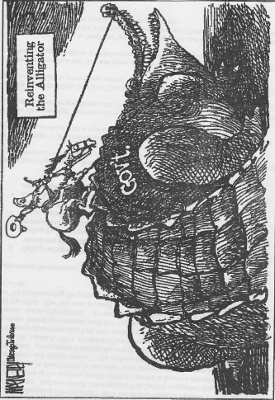

Slide 6
Who Governs?
Types
  Totalitarian
  Authoritarian
  Aristocracy
  Democracy
    Direct- Political decisions are made by the people directly, rather than by their elected representatives
      Direct Democ. today- initiative, referendum, recall
      Danger? mob rule and what about minorities?

Slide 7
Continued
Democratic Republic
  Democratic republic and representative democracy really mean the same thing—government based on elected representatives
    Democratic Republic- based on popular sovereignty (will of the people)
    Representative Democracy- elected by the people
  Principles of Democratic Government
    universal suffrage
    majority rule
  Constitutional Democracy.
    limited government

Slide 8
What Kind of Democ. Do We Have?
Majoritarianism- Majority rules
Elite theory- Privileged minority rule
Pluralism- indiv. interests will be protected by groups that represent them
  Interest group->conflict->compromise
  Do we need all three?

Slide 9
Fundamental Values
Political culture- set of ideas/values about govt. and politics
Political socialization- beliefs passed/transmitted to children and others (family, educ.)
Values ?
  Liberty v. order
  Equality v. liberty

Slide 10
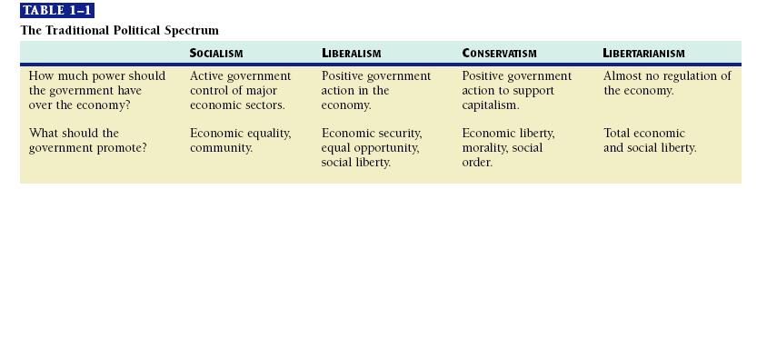
Political Ideologies- page 17
(Many value moderation)

Slide 11
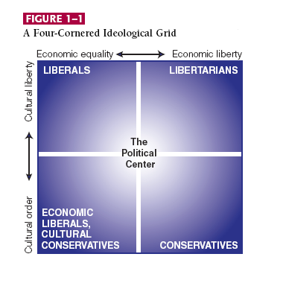
4-Cornered Ideological Grid- p. 18
(Many things divide the electorate)

Slide 12
FRQ Practice Question
Scholars disagree over who has power in the United States.
a. Select two of these theories: Pluralism, elitism, and majoritarianism. For each describe who has power.
b. Identify and explain which one of these theories you think is most consistent with a specific core value in American political culture. Be sure to describe that value.
c. Identify and explain which one of these theories you think is least consistent with another core value (different from the one you selected for “b”) in American political culture. Be sure to describe that value.

Slide 13
Ch. 2 The Constitution
  The Articles of Confederation (U.S. 1st form of Govt.)
    States retained most of the power and the central government had a very limited role in the governing process. The loyalty most citizens had was to their state first and foremost.

Slide 14
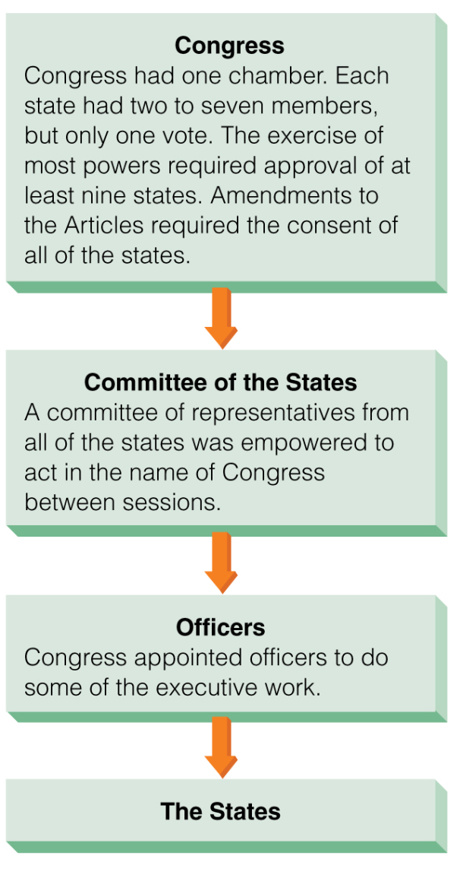
Confederal Govt. Structure p. 37

Slide 15
WTP, Lesson 10, Art. of Conf. Weaknesses and Solutions
Weaknesses
Solutions (found in Constitution)

Slide 16
Framing the Constitution
Shay’s Rebellion
VA Plan
NJ Plan
Great Compromise (Connecticut plan->bicameral congress)
3/5 Compromise

Slide 17
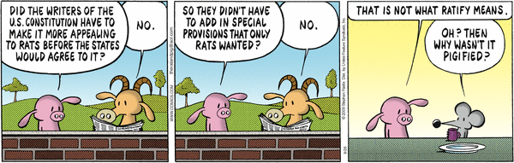
Constitutional Convention
Who? 55 delegates, p.39
What? Purpose- to revise Articles
When? May 25, 1787
Where? Indep. Hall, Philadelphia, Penn.
Why? Weaknesses of the articles
James Madison kept a journal
Pearls Before Swine, 09.26.09

Slide 18
Ratification page 48 Chart
9/13 states
Last state to ratify Constitution, Rhode Island- May 1790
Bill of Rights- Dec. 1791

Slide 19
Federalist v. Antifederalist
WTP Lesson 16-17
Identify Positions
Federalist
Antifederalist

Slide 20
Woll Reading
  Federalist paper #51, p. 44
  Federalist paper #39, p.66
  Federalist paper #10, p. 176

Slide 21
Federalist #51 (Woll)
Separation of Powers-p. 44 Separate and distinct exercise of different powers
Checks and Balances- p. 45 each check the other with legislature divided by different modes of election to ensure check of power
Federalism- Division and sharing of power between local, state and national govt.

Slide 22
Federalist #10
Important concept: parties and interest groups inherently dangerous to political freedom and stable govt.?
Why? Most important! Preventing factions advocates large republic. P. 177 lists 2 methods to cure the “mischief of factions”
  1. removing causes- remove liberty?
  2. controlling effects- every citizen the same opinions, passions and interests?
  P. 178 no cure? “A republic in which the scheme of representation takes place” P. 179 (p.183)

Slide 23
Federalist #39 Woll p. 68-69
Federal- form of govt. in which a union of states recognizes the sovereignty of a central authority while retaining certain residual powers of govt.
National- belonging to a nation as an organized whole
Federal system- power is divided between a central govt. and regional subdivided govt. (each with some level of domain and policies to guarantee its authority)
  The Senate is considered Federal, the House- National, and the President- Mixed character.

Slide 24
Chapter 3, Federalism
3 systems
  Unitary- central govt. gives power to sub-national govt. ex: local govts. (no reserved powers)
  Confederal- power is retained by local or regional govts. ex: EU
  Federal- divide power between the national and lower level govts.

Slide 25
Federalism
For:
  Functions are delegated ( benefit for large countries)
  More direct access to govt. agencies and policies
  State govts.- training ground for Nat’l. leaders
  States- test new initiatives, ex: welfare, homeland security
  Political subcultures

Slide 26
Federalism
Against
  Increase power of state and local interest will block progress of Nat’l. plans
  Smaller political units dominated by single political groups
  Inequality across states, ex: achievement, crime prevention, safety
  Quote by Ronald Reagan p. 84

Slide 27
Division of Powers (Handout)
National Powers-delegated powers (3)
  Expressed (enumerated)- directly stated in Constitution
  Implied- not specifically listed (based on elastic clause/necessary and proper)
  Inherent- exercised simply because it is the gov’t (such as diplomatic relations and immigration)
States Powers
  Reserved powers- reserved to the people (not delegated to Nat’l gov’t)
  Supremacy Clause
National and State gov’t exercise concurrent powers independently (taxing)
Constitution lists powers denied to both National gov’t and State
States guaranteed:
  A republican form of gov’t
  Protection from invasion and domestic violence http://www.usatoday.com/news/nation/2003-07-13-911-families-cover-usat_x.htm
  Respect for territorial integrity http://www.npr.org/templates/story/story.php?storyId=87877844
Courts umpire: Supreme court settles disputes between State and Nat’l gov’t. http://www.foxnews.com/politics/2011/08/01/justice-department-sues-alabama-over-controversial-immigration-law/
Interstate relations- Article IV
  Constitution requires each state to recognize the laws and legal proceedings of all other states. (In civil not criminal matters) Ex: Driver’s License age-South Dakota 14 yrs, South Carolina 15 years, Alabama 16 years
  Treat citizens equally with its own citizens (full faith and credit)

Slide 28
Division of Powers continued
Know cases: (National Govt. supremacy)
  McCulloch v. Maryland- Necessary/proper clause
    Yes, Congress has power to incorporate a bank
    No, the State may not tax an institution created by Congress (the bank)
  Gibbons v. Ogden- Interstate Commerce
    No, States may not regulate interstate commerce or grant exclusive rights to use state navigable waters

Slide 29
Division of Powers
Dual Federalism
  Layer Cake
Cooperative Federalism
  Marble Cake
Picket-fence Federalism

Slide 30
Methods to implement Federalism
Categorical grants- Fed.->State, expenses targeted for specific programs (welfare, unemployment, medicaid)
Block grants- Fed.->State for general functional areas (criminal justice, mental health programs)
Federal mandates- Fed. Legislation that forces states to comply (Health care programs, voter registration)

Slide 31
FRQ
For two of the following: (p 97-99)
  a. Identify the term
  b. Give a specific example
  c. Explain how it affects Policy-making with the states
      Categorical Grants
      Block Grants
      Mandates

Slide 32
FRQ
Dual federalism and cooperative federalism are two different models of federalism
  a. Describe both of these models
  b. Which of these characterizes today’s system? Explain how and why federalism has changed from one to the other
  c. Describe ONE of the following and explain how it is an example of dual OR cooperative federalism
      Plessy v. Ferguson decision p. 153
      Medicaid p.99
      Grants-in-aid p. 97-98

Slide 33
