Slide 3
Anatomy
Anatomy
  Study of the structure and shape of the body and its parts
  Observation is used to see sizes and relationships of parts

Slide 4
Anatomy
Gross anatomy
  Large structures
  Easily observable

Slide 5
Anatomy
Let’s look at an example of gross anatomy using the digestive system organs

Slide 6
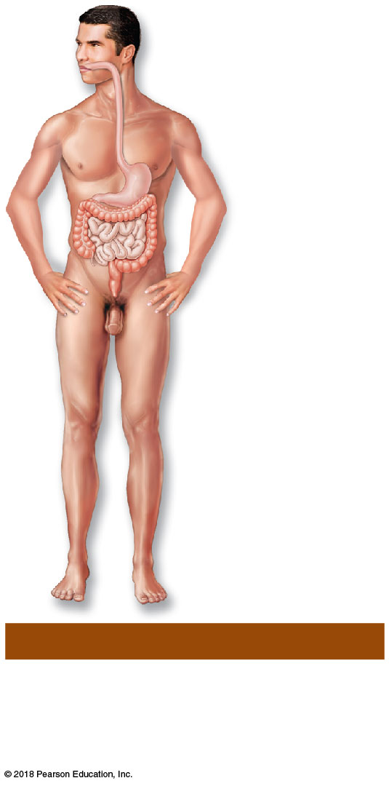
Figure 1.2i The body’s organ systems.
Oral cavity
Esophagus
Stomach
Small
intestine
Large
intestine
Rectum
(i) Digestive System
Breaks food down into absorbable
nutrients that enter the blood for
distribution to body cells; indigestible
foodstuffs are eliminated as feces.
© 2018 Pearson Education, Inc.

Slide 7
Anatomy
Microscopic anatomy
  Structures are too small to be seen with the naked eye
  Cells and tissues can be viewed only with a microscope

Slide 8
Anatomy
Let’s look at an example of microscopic anatomy using a digestive system organ, the stomach

Slide 9
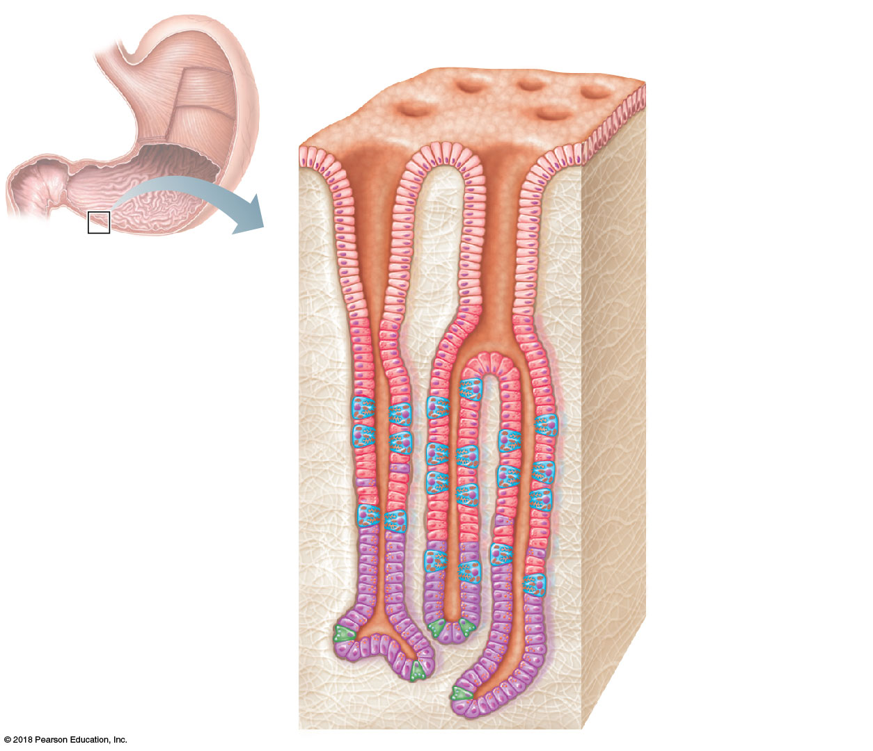
Figure 14.4c Anatomy of the stomach.
Gastric pits
Surface
epithelium
Gastric pit
Pyloric
sphincter
Mucous
neck cells
Gastric gland
Parietal cells
Gastric
glands
Chief cells
(c)

Slide 10
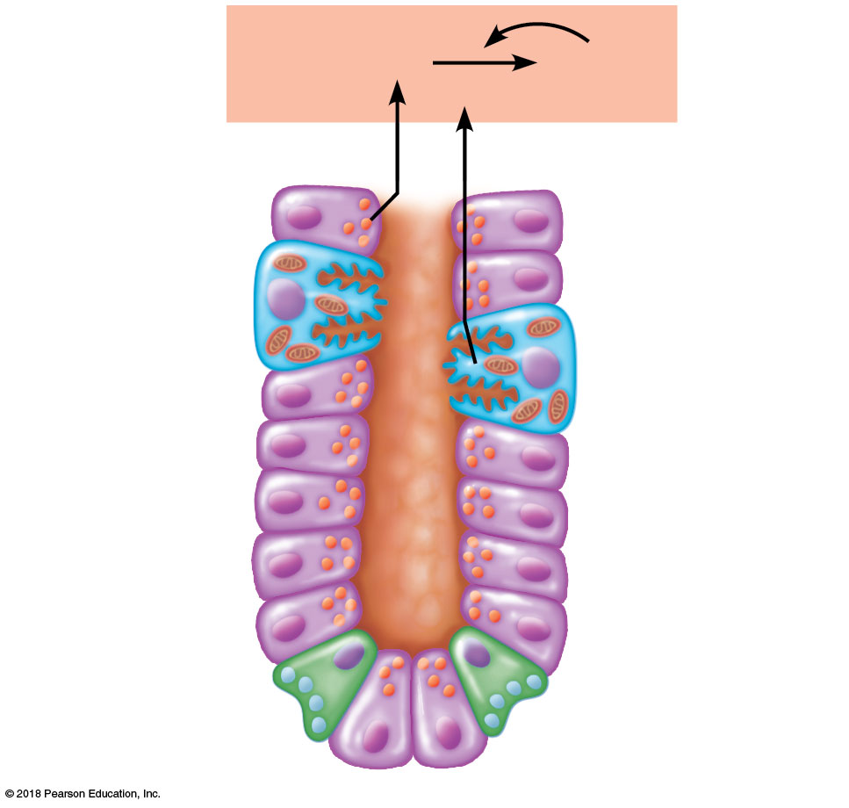
Figure 14.4d Anatomy of the stomach.
Pepsinogen
Pepsin
HCl
Parietal cells
Chief cells
Enteroendocrine
cell
(d)

Slide 11
Physiology
Physiology
  Study of how the body and its parts work or function

Slide 12
Physiology
Structure determines what functions can occur
For example, the air sacs of the lungs have very thin walls, a feature that enables them to exchange gases and provide oxygen to the body

