Slide 1
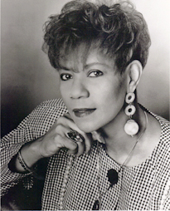

ALL About Wilma RUDOlph
By: Matthew
Grade 3
Mrs. McGarry’s Class

Slide 2


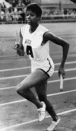

Life Growing With Wilma Rudolph!
Did you know all about Wilma’s life when she was young? Well her story is amazing and thoughtful. She was born on June 23rd 1940. Wilma weighed between six and eight pounds when she was born. Her family was poor and African-American. Back in the days Blacks had to stay away from Whites. Blacks had to use different water fountains, stores, hospitals, and movie theaters. While growing up Wilma suffered a leg injury and had to wear a leg brace for the rest of her life. But in 1949 she decided to discard the leg brace because she thought it looked fine. Sadly, in 1994 Wilma had throat cancer and passed away. Overall, that is about Wilma’s amazing story.

Slide 3



Fun Facts About Wilma Rudolph!
Waaah! That is the sound of Wilma being born and here are some interesting and fun facts about Wilma Rudolph. She attended Tennessee State University through 1957 and 1961. Also, did you know she got married to a man called William Ward in 1961. But then they were divorced. She later married Robert Eldridge in 1963. They had four children. They two were later divorced. A 1977 T.V. movie about her life was directed by Bud Greenspun and starred actress Shirley Jo Finney as Wilma Rudolph. Overall, that is some interesting and fun facts about Wilma Rudolph.

Slide 4

Why Do We Remember Wilma Rudolph?
Do you know why we remember Wilma Rudolph? We remember her because she was the fastest runner in the world. She also broke so many records. Then, she was the first person ever to win three gold medals in the Olympics. My last reason that we remember her is because, she ran so fast for us in races and she won so many races. In conclusion, that is why we remember and honor Wilma Rudolph.

Slide 5

Bibliography
Naden, Corrine and Blue, Rose Wilma Rudolph Raintree 2004
“Wilma Rudolph” http: // Greatwomen.org/ women-of-the-hall/ search-the-hal… 2/6/14

