Slide 1
Today in Algebra 2
Go over homework
Notes
  Linear Equations Definitions
  Standard form of linear equation
  x- and y-intercepts
Study Guide
Homework

Slide 2
Linear Equations
An equation whose graph is a line is a linear equation
The standard form of a linear equation is
Ax + By = C,
where A,B, and C are real numbers and A & B are not both zero.

Slide 3
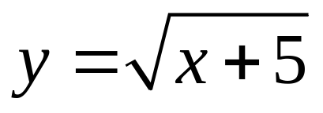
Examples: 5x – 3y = 7
x = 9
6s = -3t – 15
Not Linear: 7a + 4b² = -8
x + xy = 1

Slide 4
Write the following equations in standard form:
y = -5x + 6
5x = 25 + 10y

Slide 5
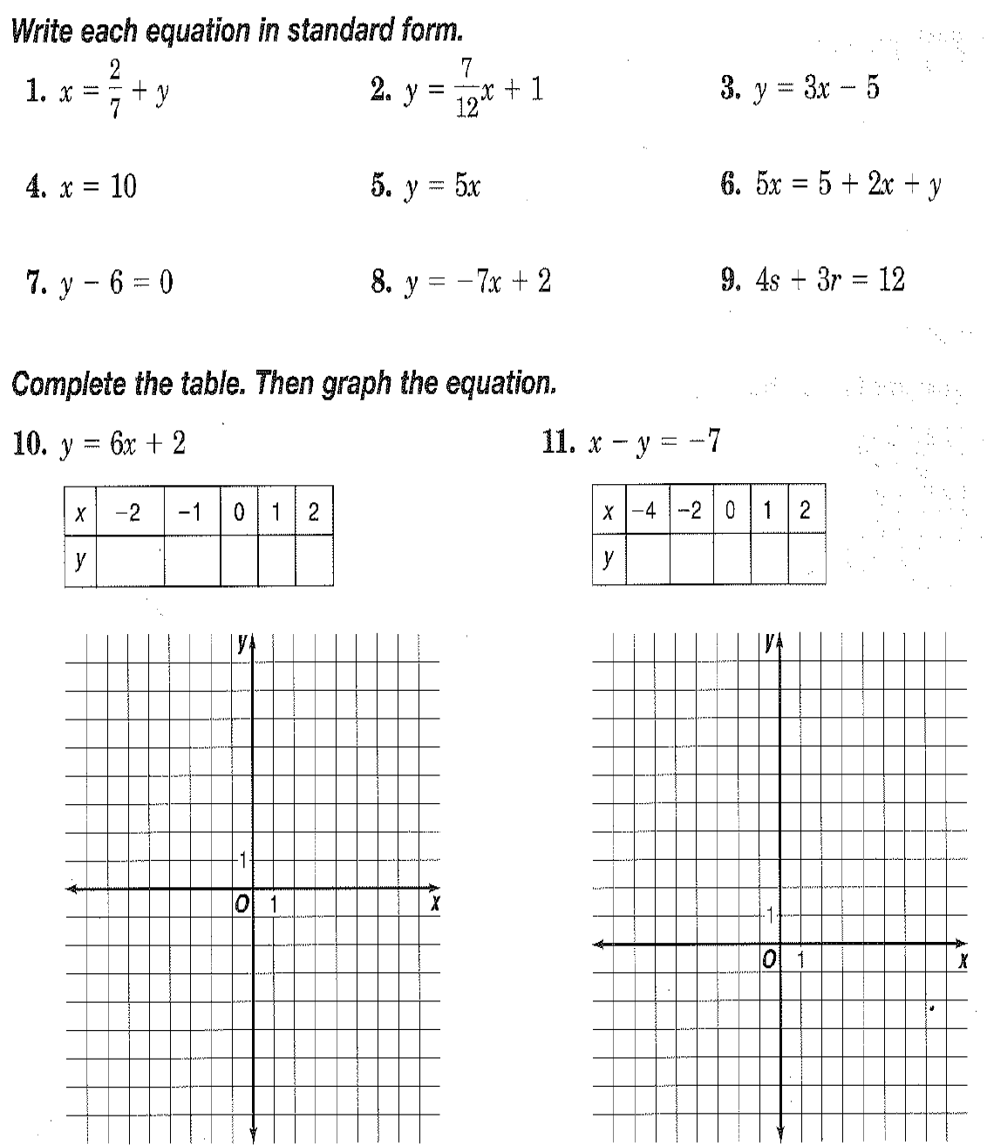

Slide 6
Intercepts
The y-intercept is where the graph touches or crosses the y-axis. So where x = 0
The x-intercept is where the graph touches or crosses the x-axis. So where y = 0

Slide 7
Find the x- and y-intercepts for 5x – 3y = 15
y-intercept let x = 0 5(0) – 3y = 15
-3y = 15
y = -5
y-intercept is (0, -5)
x-intercept let y = 0 5x – 3(0) = 15
5x = 15
x = 3
x-intercept is (3,0)

Slide 8
Homework
Pg 77: 18,19, 29-39odd.

