Slide 1
Greatest Mathematicians
Colton Ratliff

Slide 2
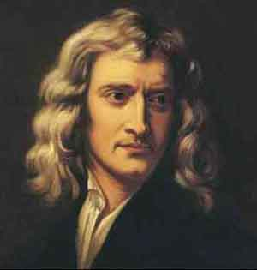
Sir Isaac Newton
Sir Isaac Newton was Born on January 4, 1643, in Woolsthorpe, England
Isaac Newton was established physicist and mathematician, and is credited as one of the great minds of the 17th century Scientific Revolution.
Isaac Newton developed the principles of modern physics.
Sir Isaac Newton died in London on March 31, 1727.

Slide 3
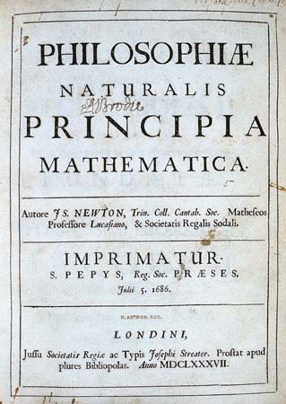
Isaac Newton.
In 1687, he published his most acclaimed work, Philosophiae,
Natrualis, Principia
Mathematica which has
been called the single-most
influential book on
physics. Also known
as Mathematical
Principles of Natural Philosophy.

Slide 4
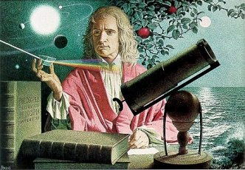
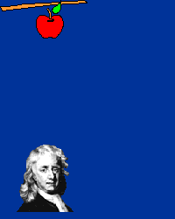
Isaac Newton
During Newton’s Years at Cambridge University, he would keep a second set of notes . He call them Certain Philosophical Questions.
The "Questions" revealed that Newton had discovered the new conception of nature that provided the framework for the Scientific Revolution.
There was a Great Plague that forced the university to close, So Newton began studying on his own once he got home.
It was during this 18-month hiatus that he conceived the method of infinitesimal calculus, set foundations for his theory of light and color, and gained significant insight into the laws of planetary motion
. Legend has it that, at this time, Newton experienced his famous inspiration of gravity with the falling apple

Slide 5
Isaac Newton
Newton's study of optics was aided with the use of a reflecting telescope that he designed and constructed in 1668 -- his first major public scientific achievement
Robert Hooke wrote to Newton and brought up the question of planetary motion suggesting that a formula involving the inverse squares might explain the attraction between planets and the shape of their orbits.
Then Later he began to publish his laws of motion. We now know them as Newton’s 3 Laws of Motion.
1) A stationary body will stay stationary unless an external force is applied to it
2) Force is equal to mass times acceleration, and a change in motion is proportional to the force applied
3) For every action, there is an equal and opposite reaction.

Slide 6
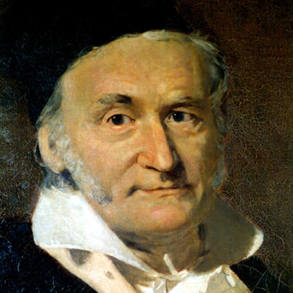
Johann Carl Friedrich Gauss
Carl Friedrich Gauss was born April 30, 1777, in Brunswick, Germany
He published over 150 works and made such important contributions as the fundamental theorem of algebra, the least squares method, Gauss-Jordan elimination, and the bell curve, or Gaussian error curve
At the age of 7 Carl Gauss was noticed by his teachers when he summed the integers from 1 to 100 instantly by spotting that the sum was 50 pairs of numbers each pair summing to 101.
Died February 23, 1855

Slide 7
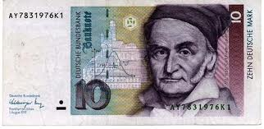
Johann Carl Friedrich Gauss
1798 he had made one of his most important discoveries - the construction of a regular 17-gon by ruler and compasses
Gauss was, the first mathematician to prove the fundamental theorem of algebra, and he proved it four different ways over the course of his lifetime.

Slide 8
Johann Carl Friedrich Gauss
1799: Dissertation on fundamental theorem of algebra
1801: Gains fame by correctly predicting the position of asteroid Ceres
1809: Treatise on the motion of celestial bodies
Early 1800s: Non- Euclidean geometry (later publications by Bolyai). Discussion of statistical estimators. Geodesy / Heliotrope
1828: Main work on differential geometry; Gaussian curvature
1830s: Theory of magnetism

Slide 9
Johann Carl Friedrich Gauss
at the age of 18 Gauss became the first person to prove the Law of Quadratic Reciprocity, a theory of math that allows us to determine whether quadratic equations can be solved.
Gauss went through a depression when his father, new wife and second died.
In 1818 He published over 70 papers over the next 12 years, including one that won the Copenhagen University Prize.

Slide 10
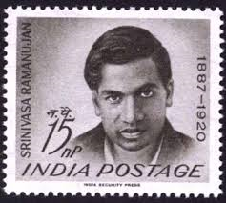
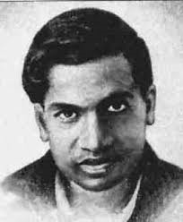
Srinivasa Ramanujan Iyengar
At the age of 10 Srinivasa was give books on advanced trigonometry written by S. L. Loney
At the age of 12 he had mastered those books and even discovered theorems of his own
By 17, Ramanujan conducted his own mathematical research on Bernoulli numbers and the Euler–Mascheroni constant
He died of illness, malnutrition and possibly liver infection in 1920 at the age of 32.

Slide 11
Srinivasa Ramanujan Iyengar
Ramanujan had his first paper published, a 17-page work on Bernoulli numbers that appeared in 1911 in the Journal of the Indian Mathematical Society.
Still no one was quite sure if Ramanujan was a real genius or a crank
Twice he wrote with no response; on the third try, he found Hardy.

Slide 12
Srinivasa Ramanujan Iyengar
One remarkable result of the Hardy-Ramanujan collaboration was a formula for the number p(n) of partitions of a number n.
Example:
p(4) = 5 because 4 can be written as 1+1+1+1, 1+1+2, 2+2, 1+3, or 4.
Ramanujan used to ask about the value of zero divided by zero and then answer that it can be anything since the zero of the denominator may be several times the zero of the numerator and vice versa and that the value cannot be determined

Slide 13
Srinivasa Ramanujan Iyengar
Much of Ramanujan’s mathematics comes under the heading of number theory
The number theory is the abstract study of the structure of number systems and properties of positive integers
People tend to speculate what Ramanujan would have achieved if he had not died or if his exceptional qualities were recognised at the very beginning.

Slide 14
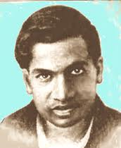
3 Great of the greatest Mathematicians
Srinivasa Ramanujan Iyengar
Sir Issac Newton
Johann Carl Friedrich Gauss

Slide 15
Sources
http://fabpedigree.com/james/mathmen.htm
www.crystalinks.com
http://www.newton.ac.uk/newtlife.html
http://www.biography.com/people/isaac-newton-9422656
www.britannica.com
http://www.csep10.phys.utk.edu
http://www-history.mcs.st-and.ac.uk/Biographies/Gauss.html
http://www.biography.com/people/carl-friedrich-gauss-9307799
http://www.idsia.ch/~juergen/gauss.html
http://www.rare-earth-magnets.com/t-johann-carl-friedrich-gauss.aspx
http://www.princeton.edu/~achaney/tmve/wiki100k/docs/Srinivasa_Ramanujan.html
http://www.usna.edu/Users/math/meh/ramanujan.html
http://www.imsc.res.in/~rao/ramanujan/raoindex.html
http://www.vigyanprasar.gov.in/scientists/ramanujan.htm

