Slide 1
MCAS vs. PARCC
Dedham School Committee
December 16, 2015
Adapted from DESE “Guidance for school and district leaders”
November 23 and 24, 2015

Slide 2
Transition plan for student assessment
2016 transition year
  Districts default to test administered in 2015 unless a change is registered:
    MCAS districts in 2015 can choose to switch to PARCC in 2016 and select their mode of administration (CBT or PBT)
    PARCC districts in 2015 can choose to change their mode of administration (CBT or PBT)
2017 and beyond
  Next-generation MCAS
The Commissioner’s recommendation, as approved by the Board of Elementary and Secondary Education, is available through here.

Slide 3
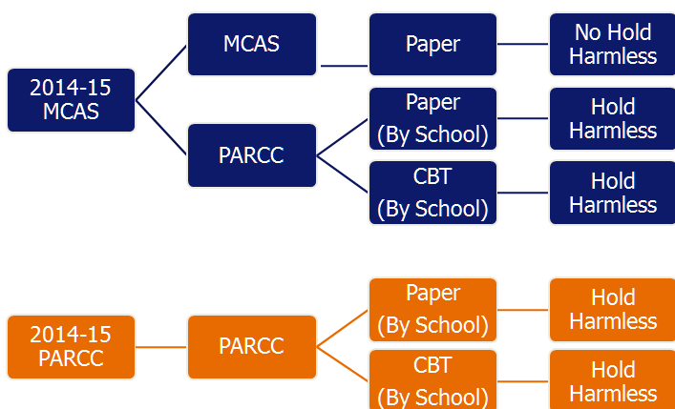
District Choices for Grades 3-8 in 2015-16

Slide 4
Additional 2016 Administration Details
PARCC
  Districts can assign students to either the grade 8 math test or Algebra I test.
MCAS (augmented with a small number of PARCC items)
  As part of the PARCC portion of the ELA test, students will write in response to text in all grades.
  Elimination of the ELA Composition (grades 4 &7)

Slide 5
All districts will continue to administer:
Grade 5 and 8 MCAS Science and Technology/Engineering tests
Grade 10 MCAS ELA and Mathematics tests
High school MCAS Science and Technology/Engineering tests
High school MCAS retests
MCAS-Alt

Slide 6
Districts that did MCAS in 2015 (Dedham) may:
Choose MCAS
OR
Choose PARCC
  Choose mode of administration for each school (CBT or PBT).
  Choose grade 8 math test and/or Algebra I test for grade 8 students.

Slide 7
December 18 Deadline for Decisions
Districts that do not register their decision by December 18 will default to 2015 assessments
  MCAS will be default for MCAS schools
  PARCC mode of administration (CBT or PBT)
  PARCC Algebra I or grade 8 math exams

Slide 8
Accessibility and Accommodations Overview
MCAS:
2015-2016 Participation Requirements remain in effect: www.doe.mass.edu/mcas/participation/?section=all
PARCC:
Many “accommodations” for MCAS are built into computer-based PARCC tests as accessibility features for all students.
Many test administration considerations are available to any student, at discretion of principal.
Accommodations are available only to students with disabilities and English language learners.
MCAS-Alt:
For all students designated for alternate assessment.

Slide 9
Comparison of PARCC and MCAS Accessibility Policies
PARCC | MCAS
CBT schools can use paper-based testing as an accommodation | Paper-based
Timed tests, with extended time for students with disabilities and ELLs | Untimed tests for all students.
Individualized graphic organizers and reference sheets may not be used | Individualized graphic organizers and reference sheets allowed with ESE approval
Expanded accessibility for all students; more accommodations available for ELLs | Accommodations only available to students with disabilities; limited accommodations available for ELLs
PARCC Emergency Accommodation Form for students with temporary or recently-occurring disability (i.e., fracture). | 504 Plan developed for student with temporary or recently-occurring disability.

Slide 10
What did 127,000 MA students say after taking the PARCC online tests in 2015?
92% said they had enough time to finish, 6% “rushed” and 2% did not finish in time
38% (ELA) and 47% (Math) said the test was harder than their normal school work
27% Experienced problems logging into the test; 25% experienced technical problems during the test; 23% reported the computer “worked slowly”
65% said they prefer taking the test online to paper
Source: Online surveys compiled by HumRRO, Sept. 2015

Slide 11
What devices did Massachusetts students use for online testing?
Device | %
Desktops | 30%
Laptops | 55%
Tablets w/ Keyboards | 12%
Tablets no Keyboard | 3%
Source: Online surveys compiled by HumRRo, Sept. 2015

Slide 12
Preparing students for computer-based testing
  Provide plenty of opportunities across the curriculum for students to gain fluency with computers and digital tools
    Basic computer skills such as the correct use of a computer, using a mouse, starting and exiting a program, switching between two open programs, working with windows (dialogue boxes) in a program, scrolling, etc.
    Keyboarding skills such as identifying, locating, and using letter, number, and punctuation keys to enter characters; using special keys (e.g., enter/return, spacebar, delete, backspace, tab, number pad, etc.)
    Word processing skills such as using keyboards to type words/sentences/stories; locate and enter punctuation marks; insert or replace letters/words; using shift key for capitalization; checking spelling, etc.
    Text-reader or screen reader skills such as highlighting text, reading highlighted text, using speech options, reading selected text, reading specific words/paragraphs, start/stop/pause reading, navigate tables, etc.
  Take practice tests to become familiar with the TestNav environment
    PARCC sample sets and tutorials: http://practice.parcc.testnav.com/#

Slide 13
2016 Reporting on PARCC
As in 2015, DESE plans to:
  Link PARCC and MCAS results
    Based on 2016 or 2015 representative samples and resulting concordance tables
  Report achievement and growth results (where available) for students, schools, districts, and state
    PARCC and MCAS achievement levels
    PARCC and MCAS scaled scores
    Composite Performance Index (CPI) scores
    Student Growth Percentiles (SGPs)

Slide 14
Notes:
In calculating the transitional CPI, we are essentially putting the new PARCC results on our old MCAS scale. To do this we used an approach called equipercentile linking. For instance, we will find a score on the new test that is most like a 240 on the old scale, and similar points at various MCAS scaled scores where equivalent proportions of students scored on PARCC.

Slide 15
2016 Accountability
Schools & districts administering PARCC will have their 2016 accountability and assistance level “held harmless” (i.e., the level will stay the same or improve from 2015, but cannot decline)*
Applies to all districts & schools that administer PARCC—even if they took PARCC in 2015
Schools administering MCAS will be classified into a level as usual, and will not be “held harmless”
* Exception for Level 5 classifications

Slide 16
Resources
PARCC
Released Items from Spring 2015
  https://prc.parcconline.org/assessments/parcc-released-items
Technology System Check and Requirements
  http://parcc.pearson.com/technology-setup/
Test Administration Resources
  http://www.doe.mass.edu/parcc/testadmin/
Practice Tests
  http://parcc.pearson.com/practice-tests/
Contact us:
assessment@doe.mass.edu
(781) 338-3625

Slide 17
Superintendent’s Perspective:
Recommend we adopt PARCC for spring 2016
Computer based (CBT) for middle school (grades 6-8);
Paper based (PBT) for all elementary schools (grades 3-5)
Choose Grade 8 math test (not Algebra 1)
Why?
“Next Generation” MCAS (2.0) will be quite “PARCC-like”; now that BOE decision is made, need to prepare students & teachers
Overwhelming support via anonymous vote from Dedham Leadership Team
Last chance for Grade 8 students to experience exam before high-stakes in Grade 10 (two years from now – spring 2018)
Changes will be needed for accommodations pages on IEP’s
DMS students familiar with Chromebooks; shift to CBT now
Elementary students need time to practice with technology
Expect a “learning curve” and probable dip in SGP for 2016
Most “kinks” worked out; time to get on board with the future

Slide 18
Questions?

