Slide 1
PRMS Math Placement
Information
Notes:
Tiff - introductions
*** For 2020 - mention there’s no set percentages or number of kids that are allowed in each course*****

Slide 2
Why do we do math placement?
Adolescent brains are under construction
Middle School Students have a wide range of rate and mastery for mathematical thinking
It’s about Readiness, not intelligence
We focus on building a deep conceptual understanding instead of memorizing facts and formulas
Notes:
Mike - It is our goal to identify an appropriate and challenging learning experience for every child.

Slide 3
NJSLS Mathematical Practices
Make sense of problems and persevere in solving them
Reason abstractly and quantitatively
Construct viable arguments and critique the reasoning of others
Model with mathematics
Use appropriate tools strategically
Attend to precision
Look for and make use of structure
Look for and express regularity in repeated reasoning
Notes:
Tiff

Slide 4
Courses offered in each grade
Grade 6 Math 6 Math 6, accelerated | Grade 7 Math 7 PreAlgebra PreAlgebra, accelerated Algebra 7 | Grade 8 Math 8 Algebra 8, Part 1 Algebra 8 Algebra 8, accelerated Algebra II
Notes:
Dan H

Slide 5
Additional Requirements for Algebra 7 and Algebra 2
At the end of first marking period, students must have an 85% average on assessments to remain in the course.
At the end of second marking period, students must have an 85% average on assessments to remain in the course.
Students enrolled in Algebra 7 must pass the Algebra 1 NJSLA-M in order to take Algebra 2 as an 8th grader.
Notes:
Dan R

Slide 6
Math Placement Rubrics
Teacher Recommendation
Assessment (Tests and Quizzes) Average for the year
Mid-Year and Final Benchmark Average
MAP scores
Higher Order Thinking Skills
Work Habits/Preparedness
Current Math Class
Notes:
Paul- .NOT USING NJSLA-M (as of right now) .New Jersey Student Learning Assessments-..Not all used for every grade

Slide 7
Placement Timeline
Late May - Math placement emailed to parents
June - questions about your child’s placement are directed to his/her math teacher
Summer math packets posted on PRMS website in early July
Notes:
Tiff - Blank rubrics posted towards the end of the year

Slide 8
Alternate placement requests
Students may waive into a different course ONLY if he/she is one point away from moving to the next course on the placement rubric .
Historical data shows the process works!
Waiver forms (if applicable) are due June 15, 2020 - 1pm
Notes:
Tiff

Slide 9
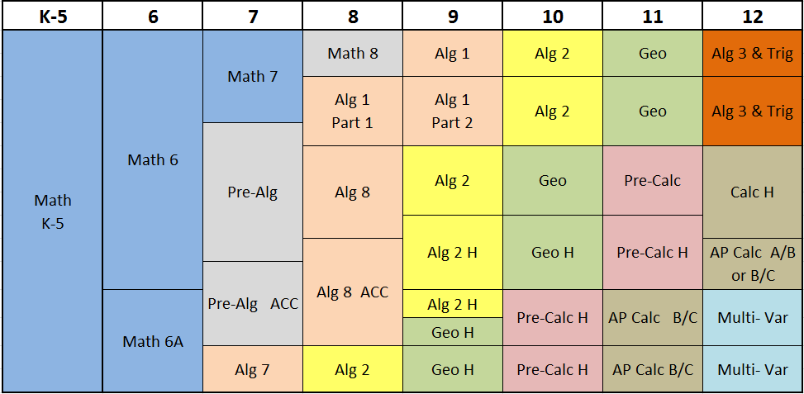
Common Possible Math Paths - this isn’t all of them!!
**Meeting or Exceeding Expectations on the Algebra 1 NJSLA-M is a graduation requirement
Notes:
Dan H/Tiffany
Tawrye- SAT/ACT

Slide 10
We ALL want what’s best for our students
Middle School Math Placement does not define your child’s future success!
College Admission Selection Factors:
High School Courses, Grade Point Average, Upward Trend, Standardized Test Scores, Activities, Essay, Letters of Recommendation
College Admission Planning:
There is an institution for every student
Best Fit versus Best School
Individual Approach
Notes:
Laurie

