Slide 1
Algebra 1 Review
Systems of Linear Equations Using Substitution
LEQ: How do you solve Linear Systems using substitution?

Slide 2
What is a Linear Equation?
An equation containing an x and a y variable.
When graphed a linear equation makes a line.

Slide 3
What is a System of Linear Equations, a.k.a. Linear System?
A collection of 2 (or more) linear equations.

Slide 4
What is a solution of a system of linear equations?
Since a system is a set of linear equations.
The solution of a system is the coordinates where the lines would intersect when graphed.
So, the solution is an ordered pair, if there is one.

Slide 5
Substitution is an algebraic method for solving a linear system.

Slide 6
Solving A Linear System By Substitution
Step 1
Pick one of the equations and isolate the variable that is the easiest to isolate.
Step 2
Take that isolated equation and substitute it into the other equation for the variable you just isolated and solve for the remaining variable.

Slide 7
Step 3
Take the answer from step 2 and plug it into the equation you got from step one to get the 2nd coordinate for your ordered pair.
Step 4
Plug your point back into the original equations to see if they are true.

Slide 8
The graph of a system with “infinitely many solutions” is one line, and the graph of a linear system with “no solution” is two parallel lines.

Slide 9
Example 4: Solve the Linear System
x + y = 3
4x + 4y =8

Slide 10
Substitution Video

Slide 11
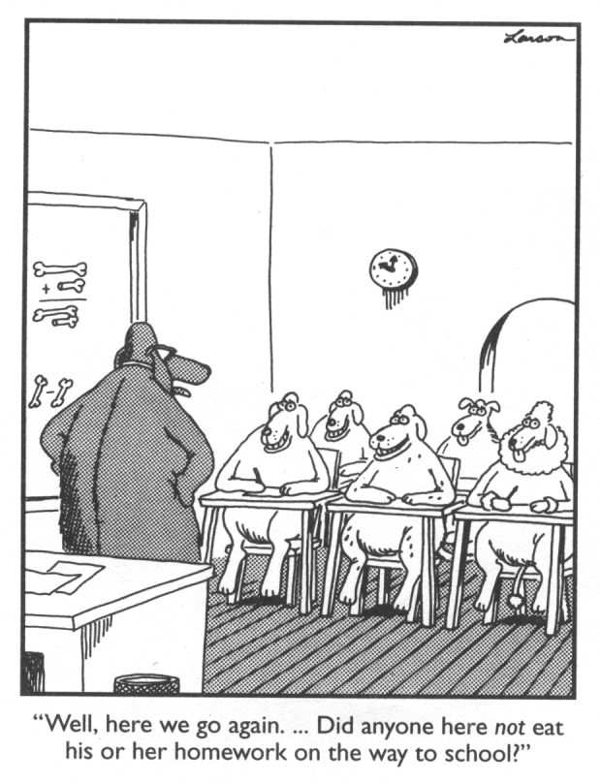
Homework:
Pg. 209 #s 1-9 all.
Pg. 209 #s 2-8 even.

