Slide 1
Materials
DE Marker
15 Small White Boards
Reminders

Slide 2
Get out your agenda if you see your name below. You need to come to my room tomorrow.
Period 2 |  | Period 7
Anthony N. Myranda M. |  | Jacob B.

Slide 3
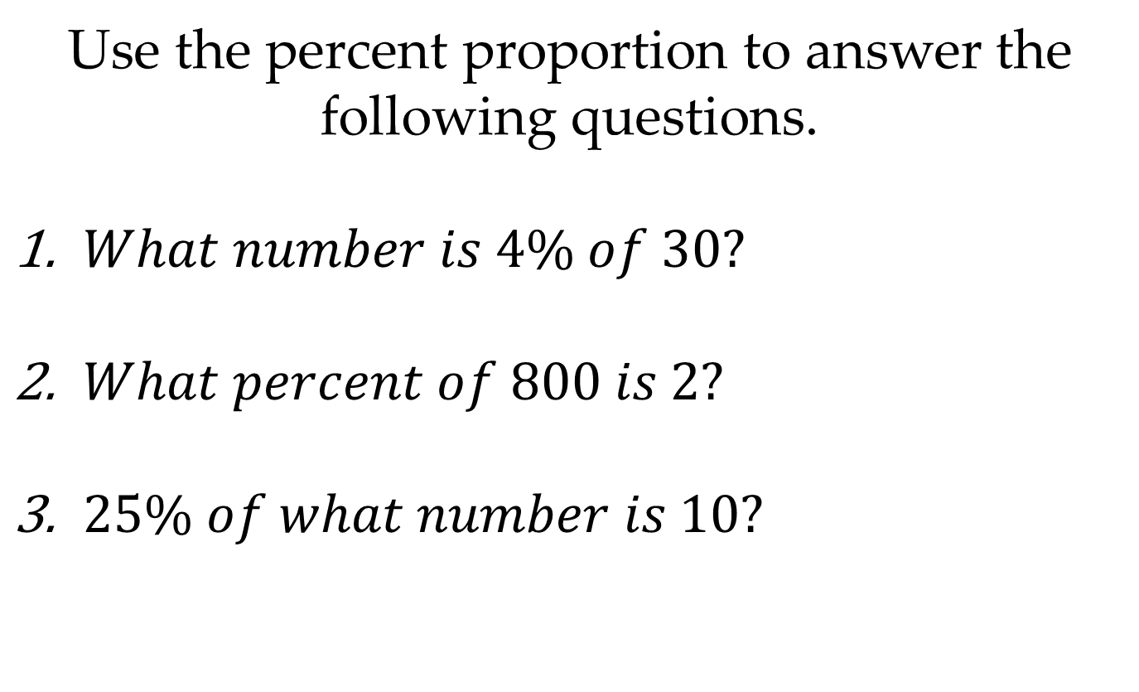
Musical Math
Use the percent proportion to answer the following questions.
$What number is 4\% of 30?$
$What percent of 800 is 2?$
$25\% of what number is 10?$

Slide 4
Cornell Notes
Topic:
5-7 Algebra: The Percent Equation
Essential Question(s):
How do I solve problems using the percent equation?

Slide 5
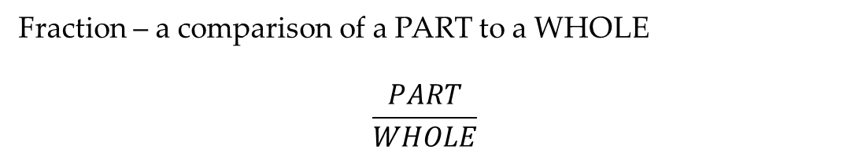
Questions:
Notes:
Cornell Notes
What is a fraction?
Fraction – a comparison of a PART to a WHOLE
$$\frac{PART}{WHOLE}$$
What is the percent equation?
Percent Equation – an equivalent form of the percent proportion in which the percent is written as a decimal
Part = Percent (as a decimal) x Whole

Slide 6
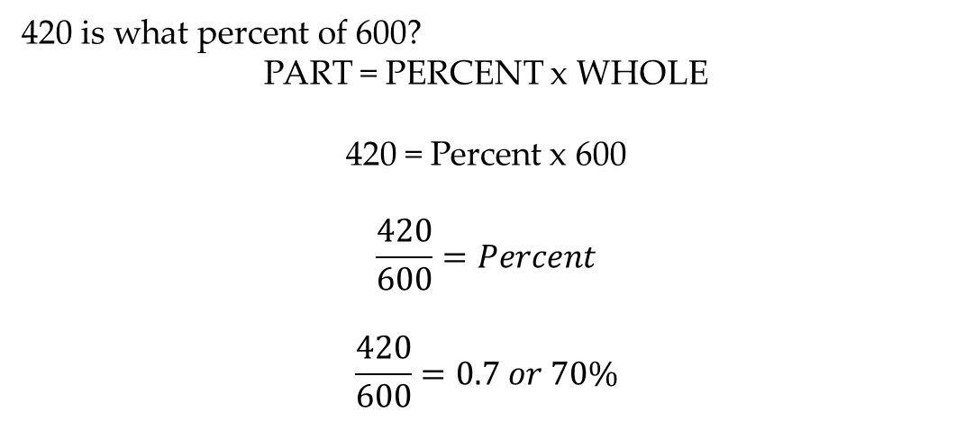
Questions:
Notes:
Cornell Notes
How do I find the PART?
Find 80% of 500?
PART = PERCENT x WHOLE
PART = .8 x 500 = 400
How do I find the PERCENT?
420 is what percent of 600?
PART = PERCENT x WHOLE
420 = Percent x 600
$$\frac{420}{600}=Percent$$
$$\frac{420}{600}=0.7 or 70\%$$

Slide 7
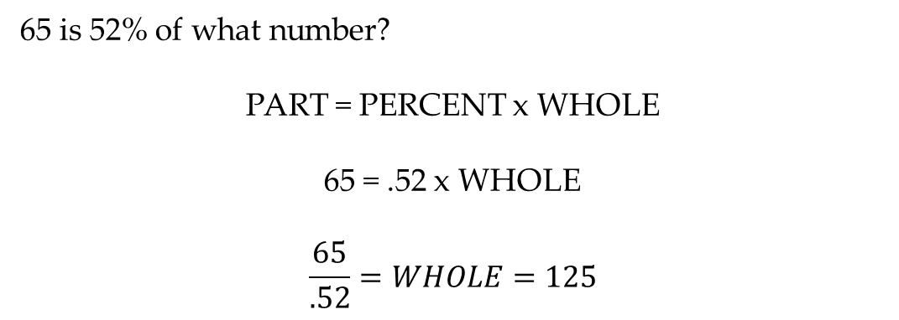
Questions:
Notes:
Cornell Notes
How do I find the WHOLE?
65 is 52% of what number?
PART = PERCENT x WHOLE
65 = .52 x WHOLE
$$\frac{65}{.52}=WHOLE=125$$

Slide 8
Concept Check
Work in groups of 2 using a WHITE BOARD.
Solve each equation using the percent equation.
50 is what percent of 1025?
What number is 20% of 140?
130 is 25% of what number?

Slide 9
Homework
Pgs. 282; 8-24
Cornell Notes Summary

