Slide 1



Do you love to cook?
Want to know how to cook?
Join us for Teen Cuisine night hosted by the Ridgeview Wolfpack After the Bell program.
How do I join?
Complete a Ridgeview Wolfpack After the Bell registration form.
The program is free.
See the monthly calendar for dates.

Slide 2

Love Art?
Do you like to be creative?
WKMA brings the fun (and the art) to you with this customized program.
How do I join?
Complete a Ridgeview Wolfpack After the Bell registration form.
The program is free.
See the monthly calendar for dates.

Slide 3

Ridgeview After the Bell Robotics Club
Build and Learn with Robots
Solve Challenges and Compete
Share and Collaborate
How do I join?
Complete a Ridgeview Wolfpack After the Bell registration form.
The program is free.
See the monthly calendar for dates.

Slide 4
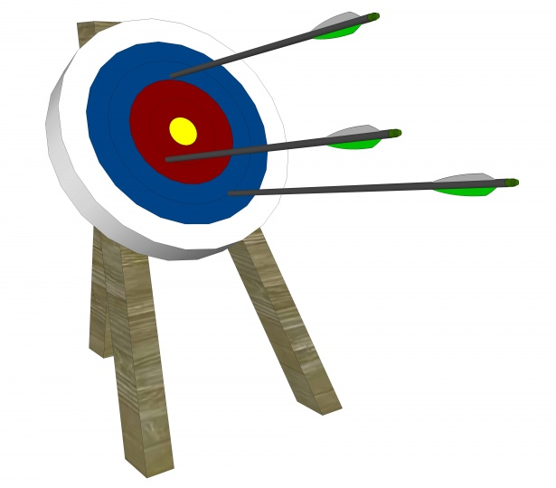
Ridgeview After the Bell Explore Archery Club
What skills do you get from archery?
Mental strength
Balance and coordination
Reaction time
Motivation & self confidence Skill/technique
Agility
Strength & power
How do I join?
Complete a Ridgeview Wolfpack After the Bell registration form.
The program is free.
See the monthly calendar for dates.
Coming Spring 2023

