Slide 1
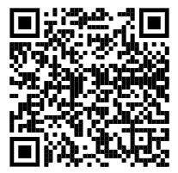
WGSD New Faculty
Tim Brown
Director of Student Assessment, Data, and Learning Technologies
Technology
Training
http://goo.gl/RSQZ5K

Slide 2
Director of Student Assessment, Data, and Learning Technologies
Connecting the Webster Groves staff with professional development opportunities to enhance their understanding of assessment, data management, and teaching with technology in the classroom.

Slide 3
What this looks like . . .
Modeling lessons for teachers and with teachers on current technologies being utilized in the classroom.
1-on-1 PD for teachers, small group PD, building level PD, online support, and whole district PD opportunities.

Slide 4
Technology Support Specialists
If something is broken or is not working properly make sure you fill out a tech. request and the technology support specialists will come to solve your problems.

Slide 5

In the classroom . . .

Slide 6

and in the cloud

Slide 7
Why the Cloud?
Student collaboration
Access to documents anywhere and at anytime
Less printing - students can share their work with you and you can comment or edit.
Staff collaboration and professional development
More storage space for digital files

Slide 8
Google and WGSD
www.google.com
www.wgcloud.org (students domain)
Login: lastname.firstname@wgmail.org
Password: Should be the same password that was put on your AUP form. If not, should have been emailed to you when we created your accounts.
After you log in the program will have you change your password

Slide 9
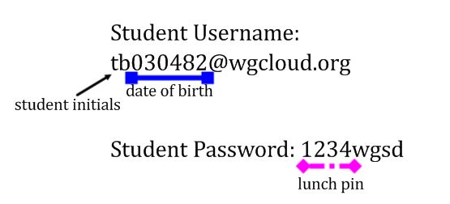
Wgcloud Accounts

Slide 10

Clever
Single sign on platform for our various products.
clever.com/in/wgsd
Click login with Google
Wgcloud login information

Slide 11
Canvas - Learning Management System
The Webster Groves School District uses Canvas as our learning management system.
Resources:
Getting Started with Canvas
Canvas Tutorials and Do Now Activities
LMS in the WGSD YouTube Channel

Slide 12
Tyler SIS - Student Information Systems
https://sis.webster.k12.mo.us
Works best with Google Chrome and Mozilla Firefox
We use SIS for grade reporting k-12, gradebook (6-12), and student data of all kinds.
K-6 Progress Report Online for Parents (printouts only when parent requests a copy)
First time users - type in username and then click enter

Slide 13
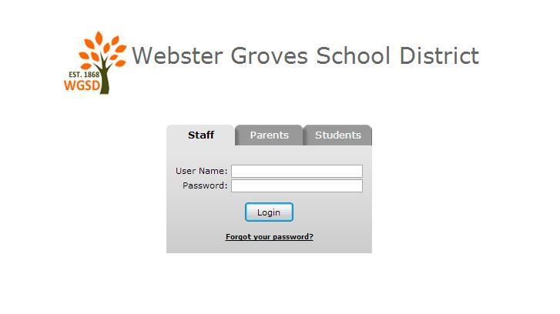

Slide 14
Wireless
Wireless is available district-wide - Webster.
  You will need to put in your login credentials.
All BYOD and single user devices (tablets) use Webster. You will need to put in your login credentials and password and then trust the certificate.

Slide 15
Technology Requests
Use them always to create a formal trail of your requisitions and technical issues, even if you have already spoken to your building tech staff.
(handout)
When to place a tech request?

Slide 16
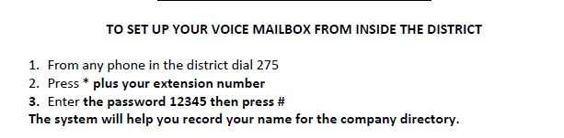
Setting Voicemail

Slide 17
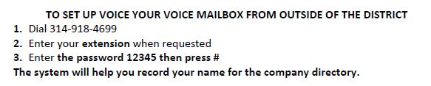

Slide 18
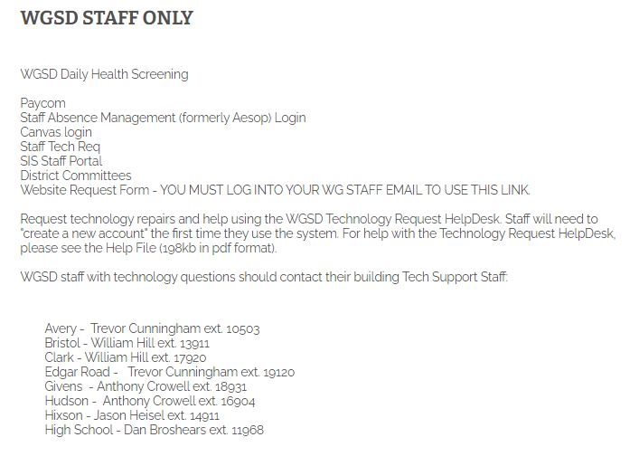
Staff Tech. Req.
Can be found on
All building
homepages as
well as on the
district main.

Slide 19
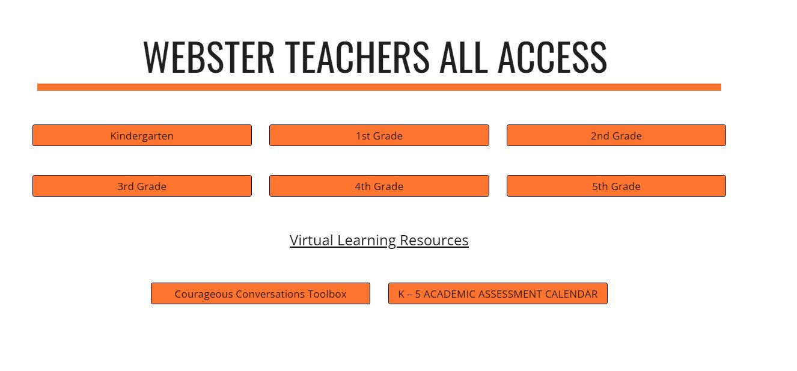

Slide 20
Questions?
Please complete the quick survey by clicking the link below.
Welcome Survey
Director for Learning Technologies
http://goo.gl/YjleWx

