Slide 1
SECRETARY TRAINING – FEBRUARY 18, 2015
STUDENT BODY FUNDS
What are student activities?
Accountability transparency & the need for controls
Internal controls
Resources

Slide 2
What are student activities?

Slide 3
Student activities criteria
Funds support activities based in student organizations.
Students participate in the activities of the organization.
Students are involved in managing and directing the activities.
Approval to disburse monies rests with the student group.

Slide 4
What are student activities?
Typical student activities:
  Classroom fees
  Athletic, student social & performance events
  Student clubs
  Field trips
  Other student curricular and extra-curricular activities

Slide 5
What are student activities?
These are not student activities
  PTA or the activities of other external support organizations.
  Accounting for non-student activities i.e. water cooler funds.
  Activities that are governmentally funded. (Accounted for as grants).
  Activities funded by private gifts or donations. (Also accounted as grants).

Slide 6
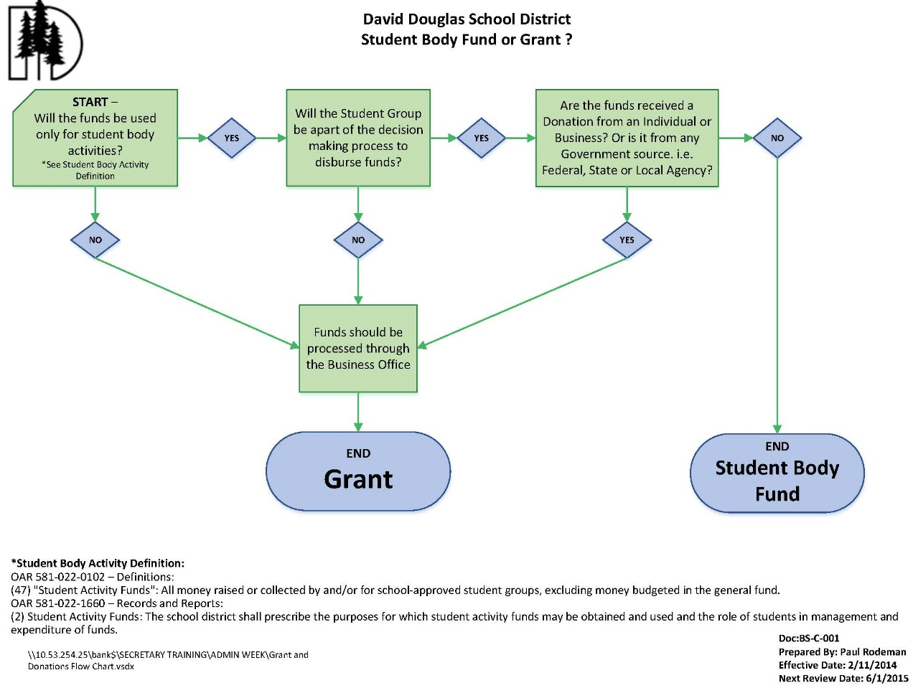
What are student activities?
FLOW CHART

Slide 7
What are student activities?
DECIDING FACTORS
How were the funds obtained?
Do the funds support activities that are based in student organizations?
Are students participating in the activities?
Does the approval to disburse monies from the activity rest with the student group or with a district employee?
How are decisions documented on the use of the funds?

Slide 8
Accountability, transparency and the need for controls

Slide 9
Accountability transparency & controls
Why accountability?
The people’s right to know
Government officials are responsible to citizenry for their decisions and actions.
Transparency requires that the decisions and actions of those in government are open to public scrutiny and that the public has a right to access such information.

Slide 10
Accountability transparency & controls
Accountability for student activities comes from…
Oregon Administrative Rules (OAR)
Oregon Department of Education (ODE)
Generally accepted accounting principles (GAAP).
Internal control frameworks that protect from loss, theft or mis-use of funds.
(see accountability resources on last slide)

Slide 11
Accountability transparency & controls
Who “owns” the student activity funds?
Answer: the District owns them…
Student activity funds belong to the District, are used to support District co-curricular and extracurricular activities, and are administered by the District.
Initial authorization to expend student activity fund monies rests with the school board (i.e. these funds are required to be budgeted by law).
District employees and students ultimately determine how District activity fund monies are expended – in accordance with all applicable rules, regulations and accounting standards.

Slide 12
Accountability transparency & controls
Oregon Administrative Rules (OARs) for student activity funds
All money raised or collected by and/or for school-approved student groups, excluding money budgeted in the general fund. OAR 581-022-0102 (47)
The school district shall prescribe the purposes for which student activity funds may be obtained and used and the role of students in management and expenditure of funds. OAR 581-022-1660 (2)

Slide 13
Internal controls for student activities

Slide 14
Internal controls
DDSD control areas for student activities
Accounting – general ledger controls
Receipts
Disbursements
Bank reconciliations, monthly reporting
External audits (agreed-upon procedures)

Slide 15
Internal controls
Accounting controls
Negative balances:
  Generally the accounts should not have negative balances.
  If a fund should go negative there should be a written plan approved by the principal for how the fund will be positive before year end.

Slide 16
Internal controls
Accounting controls
Inactive accounts should be closed after determining the appropriate way to spend the remaining fund balance.
Adjustments and transfers should be documented with signed approval by the principal prior to entry.

Slide 17
Internal controls
Accounting controls
Accounts that do not relate to students should be closed.
Staff activities, teacher appreciation items, or other activities that do not meet the criteria should not be accounted for in the student activities fund.

Slide 18
Internal controls
Receipts
Receipts must be issued whenever money is turned in. Each transaction is an exchange where the receipt is traded for the money.
Only pre-numbered receipts issued by the District Office should be used.

Slide 19
Internal controls
Receipts
Funds should be deposited daily, and must be deposited at least weekly, or whenever the amount exceeds $500.
For easier reconcilement always deposit on the last business day of the month.
Receipts should be entered into the accounting system as soon as possible after the funds are received and at least daily.

Slide 20
Internal controls
Disbursements
Disbursements are processed only after the principal has signed a pre-approval form designating the activity account, payee and amount.
All disbursements must be supported by original receipts.

Slide 21
Internal controls
Disbursements
Student body funds can be used for:
Employee or student receipted cost reimbursements for GOODS that are used in student body activities.
GOODS purchased directly from a vendor.
If goods purchases are over $300 contact Business Office Purchasing for assistance.

Slide 22
Internal controls
Disbursements
Student body funds CANNOT be used for:
Payments to District employees for services. (W-2 issues, contact Payroll)
Payments to any vendor for services. (1099 issues, contact Purchasing)
Gift cards (IRS and accountability issues)

Slide 23
Internal controls
Disbursements
Student body funds should never be used to disburse funds that will later be charged to the General Fund or to any other fund. This circumvents internal controls required to maintain accountability.

Slide 24
Internal controls
Bank reconciliations
Monthly bank reconcilement and reporting is a critical control monitoring procedure.
At DDSD, signed school bank reconciliations and monthly reports are due in the Business Office by the 25th of the following month.

Slide 25
Internal controls
Student Body Fund “Audits”
[aka Agreed Upon Procedures by the external auditors]
Because of the volume of dollars spent the High School is “audited” every year.
Middle, elementary and alternative schools are “audited” every 2-3 years, and whenever the principal or secretary have changed.

Slide 26
Resources

Slide 27
Resources
Source materials, resources
Preparing for Audit. OASBO Presentation by Pauly Rogers and Co. PC 07.24.2014.
Oregon Administrative Rules (OAR)
    http://sos.oregon.gov/archives/pages/oregon_administrative_rules.aspx
Oregon Department of Education (ODE)
  http://www.ode.state.or.us/home/
Governmental Accounting Standards Board (GASB)
  http://www.gasb.org/

Slide 28
Resources
Source materials, resources
Council of Sponsoring Organizations (COSO) – also known as the Treadway Commission
    http://www.coso.org/

Slide 29
Online Resources
Cash Handling Basics
Student Body Funds Secretary Training Handout
  Monthly & Year End Reconciliation Reports Checklist
  Monthly Reconciliation Reports Cheat Sheet
  Adjustments (Transfers) and Bank Corrections
  Voiding Checks
Stale Checks/Unclaimed Property Instructions for Secretaries
  Sample SBF Unclaimed Property Spreadsheet
  Sample Due Diligence Letter
Petty Cash Basics
http://www.ddouglas.k12.or.us/departments/business-operations/training-materials/

