Slide 1
Personal Finance
Chapter 5: Banking
Section 5.1: Selecting Financial Services and Institutions

Slide 2
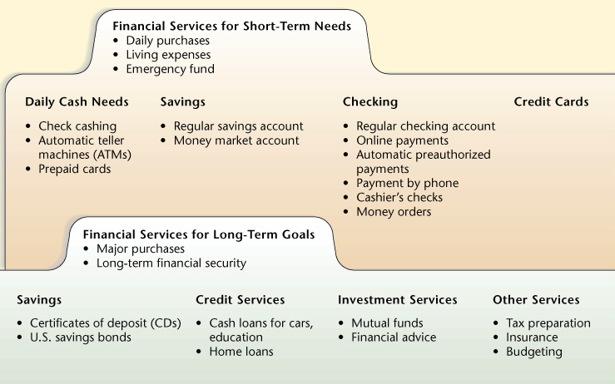
How to Manage Your Cash
Why would it be a good idea to start now to save even a small amount regularly? You will have money set aside for emergencies and money to pay for expensive purchases, like a car.

Slide 3
Basic Banking Quiz (pg. 123)
You do not need to look up the answers to the questions, just answer them to the best of your knowledge at this point in time.

Slide 4
Types of Financial Services
Savings
Safe storage of funds for future use
Payment Services
The transfer of money from your account to businesses or individuals for payments.
Borrowing
Either short-term, such as credit cards or a personal cash loan, or long-term, such as mortgages or auto loans.
Other Financial Services
Financial institutions may offer other financial services, such as insurance protection; stock, bond, and mutual fund investment accounts; tax help; and financial planning services.

Slide 5
Electronic Banking Services
Direct Deposit
Pay is deposited electronically into a specific bank account.
Saves time, money, and effort than conventional paper checks.
Safer because there is no worry of losing or having your paycheck stolen.

Slide 6
Electronic Banking Services
Automatic Payments
Automatic payment allows you to pay for bills without writing checks.
Saves time, money, and effort.
Always have enough money in the withdrawing account to cover payments.
If possible, schedule payments around pay times.
Check monthly bank statements to confirm correct payments.

Slide 7
Electronic Banking Services
Automated Teller Machines (ATMs)
Automatic teller machines (ATMs) - Computer operated cash machines that allow you to withdraw money from your bank accounts.
ATMs are located just about anywhere, including banks, grocery stores, malls, etc.
Debit Card – Also called a cash card, allows you to make payments much like you would with a credit card but the funds are deducted from the attached bank account not added to you credit.

Slide 8
Electronic Banking Services
Automated Teller Machines (ATMs) Cont.
ATM Fees
Using an ATM that is not associated with your bank will usually charge you a fee, a buck or two.
Lost Debit Cards
Notify your bank as soon as your card is lost or stolen so they can cancel the card.
You can be held responsible for a portion or all unauthorized use if you do not report the card missing or stolen in a timely manner.

Slide 9
Electronic Banking Services
Plastic Payments
Point-of-Sale Transactions
Point-of-sale transactions- using your debit card to make purchases at retail stores, restaurants, grocery stores, etc.
You usually have the option of using Debit , where you enter your PIN (generally a four digit code for your card) or Credit, which will require you to sign.
The Credit option will be deducted from your account immediately, where the Debit option will be deducted on the next available banking day.

Slide 10
Opportunity Costs of Financial Services
Find a balance between short-term needs and your future financial security.
Consider not only the money you save but the time as well.
Reevaluate your choices on a regular basis to see if there are better offers and options available.

Slide 11
Types of Financial Institutions
Deposit-Type Institutions
Commercial Banks
Commercial Bank- a for-profit institution that offers a full range of financial services, such as checking, savings, and lending.
Serve both individuals and businesses
Savings and Loan Associations
Savings and Loan Associations (S&L)- Specialize in savings accounts and mortgage loans.
Today, they serve both individuals and businesses with many of the same services as commercial banks.

Slide 12
Types of Financial Institutions
Deposit-Type Institutions Cont.
Mutual Savings Banks
Specialize in savings accounts and mortgage loans.
Offer lower interest rates on loans and higher rates on savings accounts (both good for you).
Credit Unions
Credit Union- Nonprofit financial institution that is owned by its members and organized for their benefit.
Most members are part of the same labor union, church, or company.
Offer same services as commercial banks.
Generally offer lower interest rates on loans.

Slide 13
Types of Financial Institutions
Nondeposit-Type Institutions
Life Insurance Companies
Provide financial security for dependents.
Some policies offer savings and investment features.
May offer retirement planning.
Investment Companies
Invest you money in stocks, bonds, and other securities.
Manage your mutual funds.

Slide 14
Types of Financial Institutions
Nondeposit-Type Institutions Cont.
Finance Companies
Make loans to individuals and small businesses.
Will often provide loans to individuals that have been denied loans elsewhere.
Interest rates on loans from finance companies are higher because the customers are more of a liability.
Mortgage Companies
Specialize in loans for buying homes.
Why would individuals use commercial banks more than other types of banking institutions? They offer more services, such as online banking, and they are available in more locations.

Slide 15
Comparing Financial Institutions
Where can you get the highest interest on your savings?
Where can you obtain a checking account with low or no fees to write checks?
Will you be able to borrow money from the institution with a credit card or another type of loan when you need it?
Do you need an institution that offers free financial advice?
Is the institution FDIC of SAIF insured?
Does the institution have convenient locations?
Does it have online banking services?
Does it have any special banking services that you might need?

