Slide 1

Sutton’s Law
Occam's Razor, or law of parsimony concerning competing hypothesis and mathematics.
Used in medical science, pharmacology, computer repair, IT networking, crime scene analysis, management, accounting, sports, any process of diagnosis.
The Process of Diagnosis
When diagnosing a problem, one should first consider the obvious.
William Sutton (June 30, 1901 – November 2, 1980) was an American bank robber. During his forty-year robbery career he stole an estimated $2 million, and he eventually spent more than half of his adult life in prison and escaped three times.
For his talent at executing robberies in disguises, he gained two nicknames, "Willie the Actor" and "Slick Willie". Sutton is also known as the namesake of the so-called Sutton's law, although he denied originating it.

Slide 2
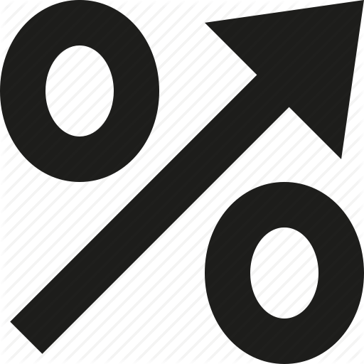
Interest Rates
The FED establishes the baseline interest rates such as the benchmark:
Federal Funds Rate currently at .25%.
  This is the rate that banks charge each other.
Banks more than double the Federal Funds Rate to create the Prime Lending Rate for their best customers: currently at 3.25%.
The rate that banks will charge you for your own loans will move up or down, depending on your income, property ownership, wealth, and credit score.

Slide 3

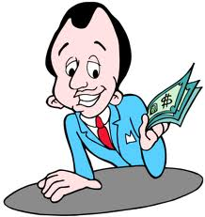
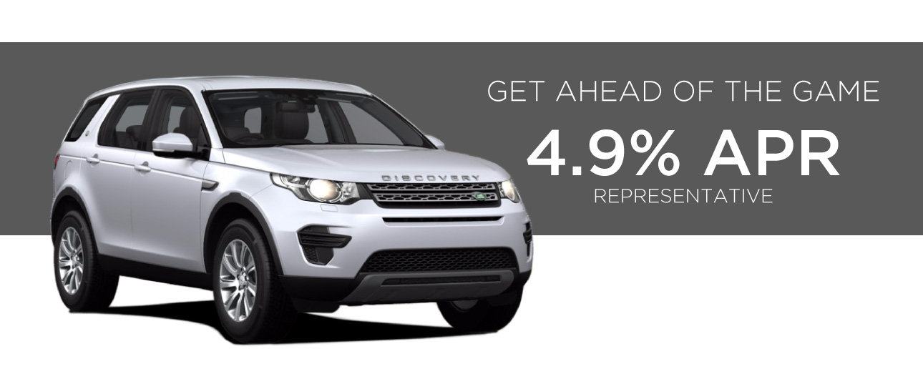
Interest Rates: APR vs. APY
The APR (annual percentage rate) is the simple interest rate that is charged for a loan, representing the actual yearly cost of a loan over the term of the loan.
This includes financing charges and any fees or additional costs associated with the loan such as closing costs or points.
Please borrow money from us
and pay us this rate.
APR-12%

Slide 4
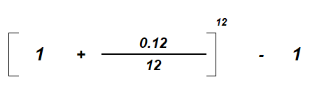
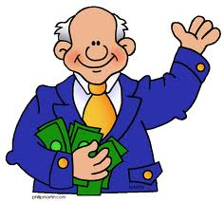
APR: Simple Interest
$1000 loan (principal) p
12% (rate) r for one year (time) t
APR=(prt)
APY: Compound Interest
12.683%
Jan. $1000 x 1% = $1010
Feb. $1000 x 1% = $1020
Mar. $1000 x 1% = $1030
12 months = $1120 to pay back (93.33/month)
10 years, $100,000= $220,000.00 to pay back
(1833.33/month)
Jan. $1000 x 1% = $1010
Feb. $1010 x 1% = $1020.10
Ma. $1020.10 x 1%= 1030.30
12 months = $1,126.83 to pay back (93.90/month)
10 years, $100,000= $330,038.69 to pay back
(2750.32/month)
APR is used as an input to calculate APY

Slide 5
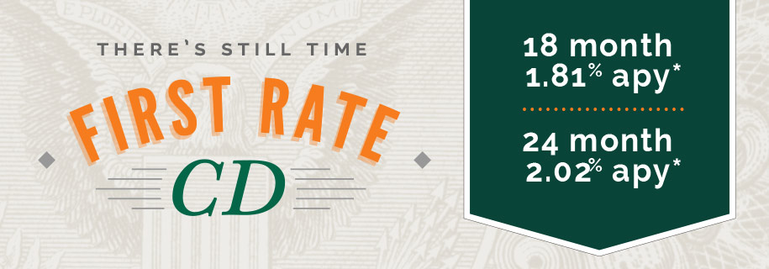

Interest Rates: APR vs. APY
The APY (annual percentage yield) is the compound interest rate or
(effective rate) that you actually pay the bank back for your loan, or that a bank pays you for your deposits.
Please put your money in our bank
and we pay you this rate.
APY-12.683%

Slide 6
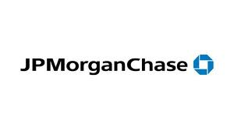
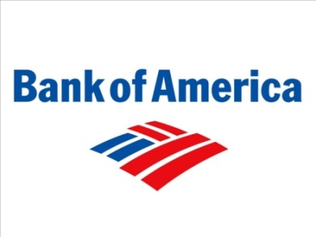

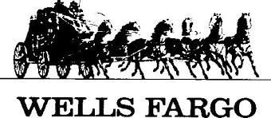


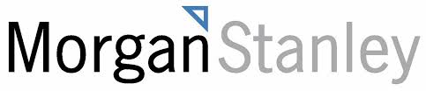



Banking Services
Checking accounts (demand deposit) around 0.20% interest APY | Direct Deposit and Online bill pay
Savings accounts also around 0.30% interest APY | Loans (personal, business, auto, student, home-4.5%-10% APR)
Money market accounts 0.50% APY | Safety deposit boxes
Certificates of deposit (CD’s) 0.80% APY | Rewards/Points programs
Debit cards/Checks | Insurance (life, auto, home)
Credit cards | Bond purchases, Mutual funds, Stocks
ATM machines/Change Machines | Online investments

