Slide 1


Fiscal Sustainability
Task Force
Meeting #2
February 23, 2017

Slide 2
THE FORECAST

Slide 3
Dublin Outlook
Last Three Years
  We’ve rebounded from the recession
  Property and Sales Tax growth has been strong
  Development has accelerated
  Housing market is up
  Unfunded liabilities have been contained (though still exist)
  Operating budget surpluses

Slide 4
Dublin Outlook
Next Three Years
  Another recession may hit
  Property and Sales Tax growth will be steady but without great gains
  Development will slow as projects are completed
  The housing market will flatten
  PERS is doing poorly

Slide 5
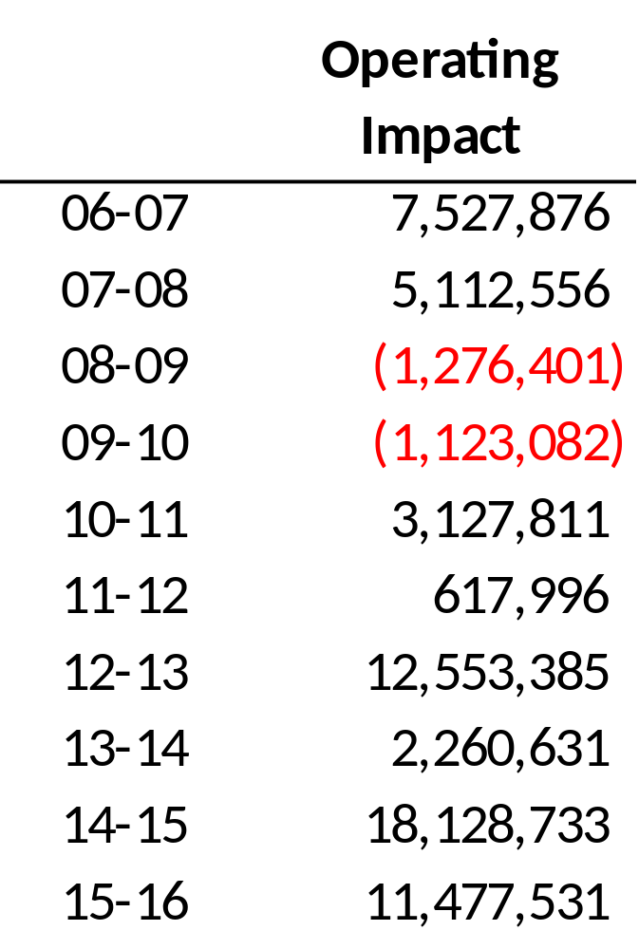
Dublin Outlook

Slide 6
Dublin Outlook
Goal of 10-Year Forecast
  Ensure ongoing operational costs are sustained by ongoing revenues in the long term
    Maintenance of new parks / facilities
    Contract services increases
    Inclusion of true ongoing (baseline) development revenues
    Conservative assumptions in years 5-10
    Smart use of reserves now

Slide 7
Forecast Revenues
Property Taxes
  4.4% in 17-18; 3.0% in 20-21; 3.2% thereafter
  2.0% CPI through 20-21
  4.0% growth on property transfers
  More Prop 8 recovery next year, then minimal
Sales Taxes
  2.5% in FY 18-19; 2.0% thereafter
Development Revenue
  Declines beginning FY 18-19, as build-out approaches (expenditures reduced also)

Slide 8
Forecast Expenditures
Personnel
  Five-year employee agreement – employees contribute 8% + 7% towards pension
    Saves City $700,000 / year
  Budget built in for PERS changes
    PERS earnings down, results in higher contribution: $500,000 / year
  COLA continues, based on CPI
  Merit adjustments continue until deficit
  Retiree health benefit capped
    Saves City $4.6 million over 15 years

Slide 9
Forecast Expenditures
Contract Services
  5.5% / year for Police
  4.0% / year for Fire
  4.0% / year for Maintenance (incl. new facilities)
  3.0% / year for others
Preventative Maintenance
  $1.0 million annually by FY 18-19

Slide 10
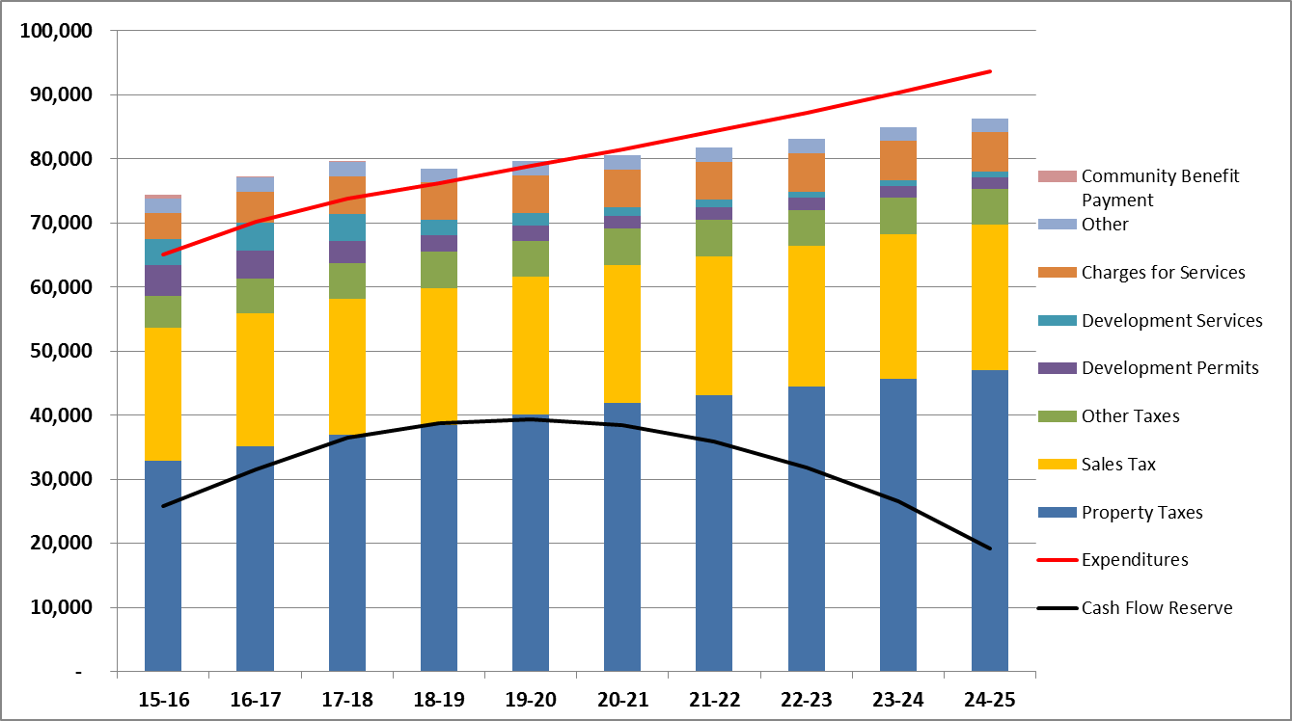
10-YEAR FORECAST

Slide 11
Reserves
Savings Accounts set aside for specific purposes
  $6 million for restricted / accounting purposes
  $38 million for specific projects / programs
  $22 million for contingency / emergency
  $14 million for pension and retiree health
  $30 million unassigned (cash flow reserve)
  $109 million total reserves

Slide 12
Reserves
Fund Balance and Reserves Policy
  Purpose
    Determine liquid resources
    Classify fund balances (accounting rules)
    Defines how net resources are allocated
    Provides info to make sound financial decisions

Slide 13
Reserve Categories
Non-Spendable
  Accounting reserves
Restricted
  Restrictions placed by external entities
Committed
  Designated by the City Council before the end of fiscal year
Assigned
  Constrained by the City’s intent, but neither restricted or committed

Slide 14
Reserve Categories
Unassigned
  Available for any purpose
  “Cash Flow” Reserve
  Dublin’s policy targets 2 - 4 months of the following year’s budget set aside in cash flow reserve
  30 million / 70.1 million * 12 = 5.1 months

Slide 15
Note on Contingency
Use of Contingency Reserve
  Use of reserves does not solve the structural problem
  Could be considered as bridge funding but then would need to be built back up
  Economic Stability Reserve ($8 mil) buys us 1-3 years, then we face a cliff
  No contingency built in for NEW facilities

Slide 16
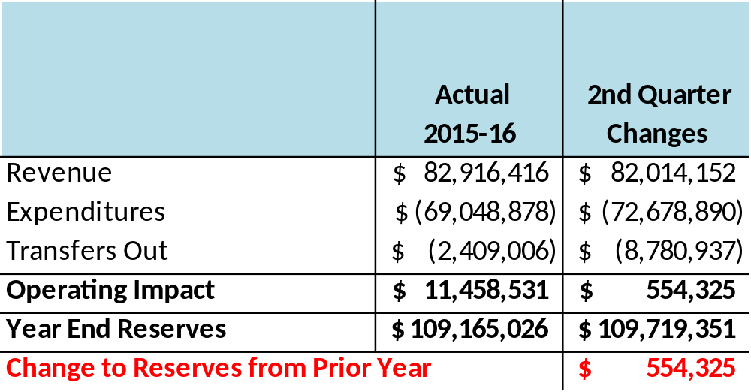
The Flow of Resources
Revenue minus Expenditures (including Transfers Out) = Operating Impact
Add Operating Impact to Prior Year Reserves

Slide 17
The Flow of Resources
Shift reserves among categories, according to:
  Accounting rules
  Specific reserves used during the year
  Any specific designations made by City Council
  Make sure cash flow is provided
Any residual reserves are split 50/50 between:
  Non-Streets CIP Reserve
  City Pension/OPEB Reserve

Slide 18
City Council Strategic Planning
March 2015 Meeting Take-Aways:
  City is transitioning from development to maintenance city
  Financial challenges of being built-out city
  Focus on maintaining a high level of services to the community
  Be smart about budget choices and reserve uses
  Staff identified 8 Focus Areas

Slide 19
Focus Areas
Develop preventative maintenance plans
  Study underway, estimated impact included in budget and forecast
Reinvest in existing facilities
  Shannon Center Parking Lot
  Dublin Sports Grounds
  Public Safety Complex
Evaluate cost recovery and pricing policy for services / maintenance
  User Fee Study to begin in March

Slide 20
Focus Areas
Performance measures
  Finance looking at software products
Plan for future expansion of public safety services
  CIP approved for $15 million renovation of Public Safety Complex
  Internal Service Funds
    Finance review underway
Pension and Employee Benefits
  Reduced City share of PERS
  Reduced Retiree Health
Strategies for new or increased revenue streams
  All up for discussion!

Slide 21

Thank you

